Slide 1
Experiments with hourly RUC
Anikó Várkonyi
varkonyi.a@met.hu

Slide 2
Outline
1., Technical parameters
2., Examined periods
3., Results
4., Conclusions and future plans

Slide 3
Technical parameters
The experiments were based on AROME
operational configuration
30-minute cut-off time in 1 hourly RUC
All model runs started at 00,06,12,18 UTC
12-hour forecast range

Slide 4
Experiments
1., AROME_3hourly: represents the original settings of
operational AROME
2., AROME_1hourly: represents 1 hourly DA cycle for 3DVAR
and surface data
3., AROME_combo_1hourly_surf3: consists of a combination
of 1 hourly cycle for 3DVAR and 3 hourly cycles for surface data
4., AROME_combo_1hourly_surf6: consists of a combination
of 1 hourly cycle for 3DVAR and 6 hourly cycles for surface data

Slide 5
Periods
First period:
→ between 08/01/2017 and 06/02/2017
→ extremely cold
Second period:
→between 04/05/2019 and 02/06/2019
→ extremely rainy

Slide 6
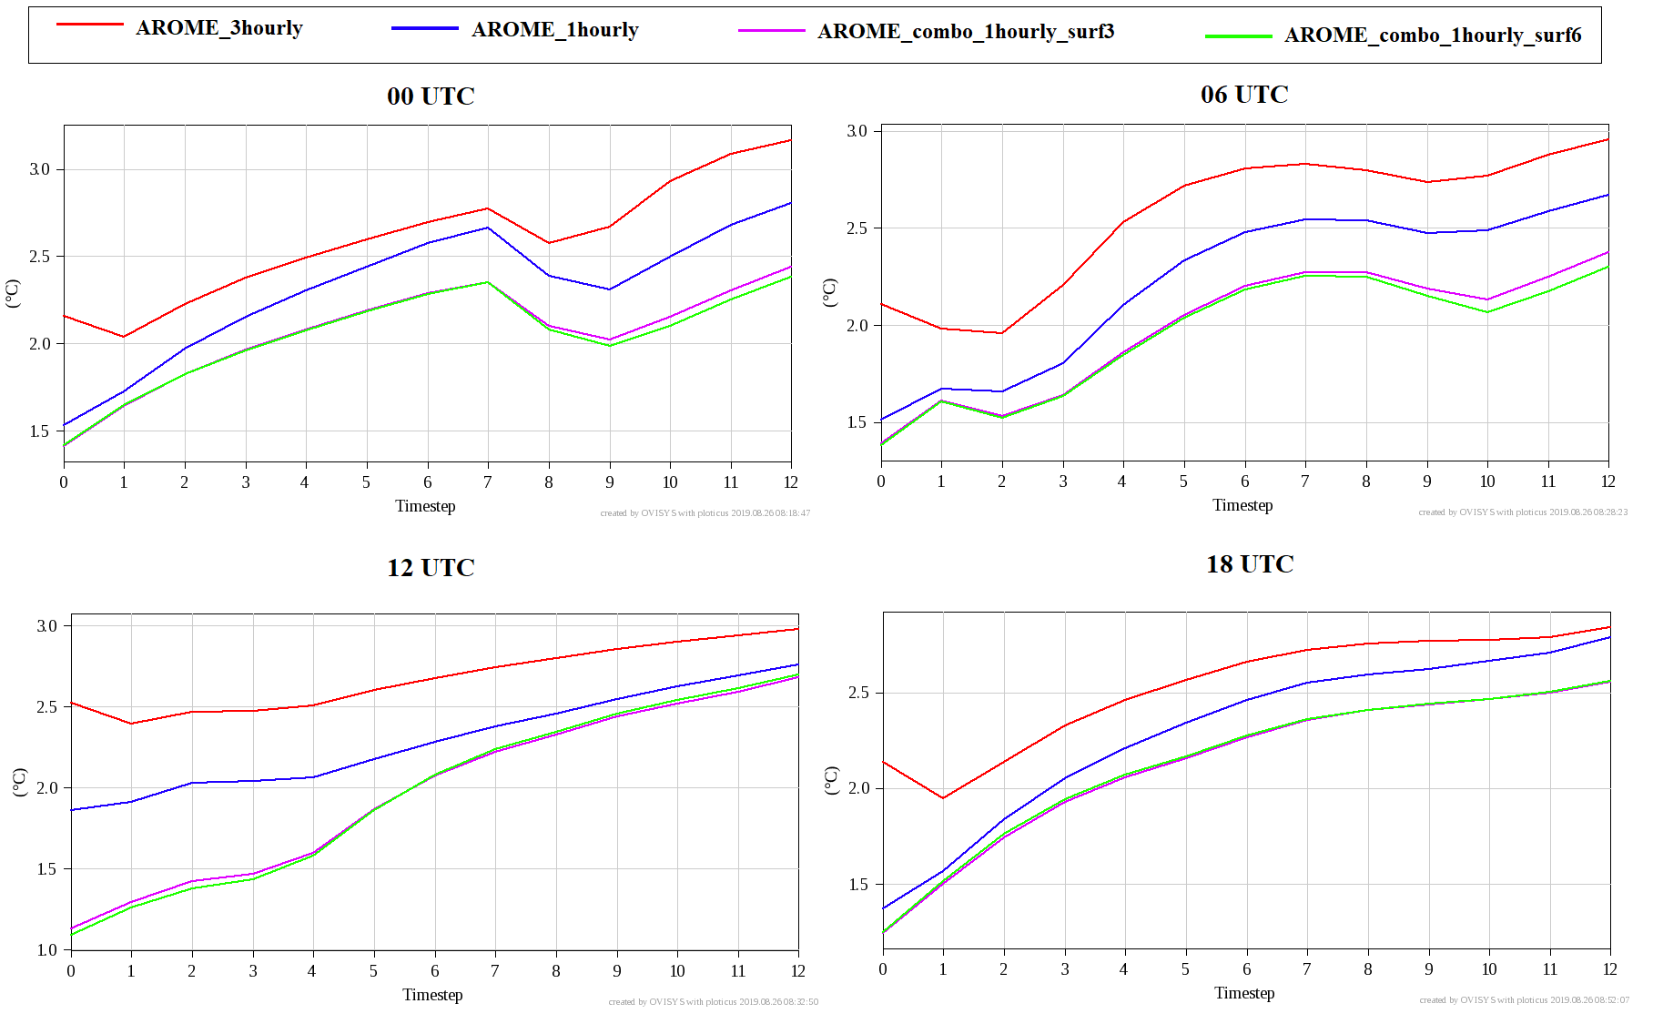
Results
RMSE of 2m temperature in function of timestep in the first period

Slide 7
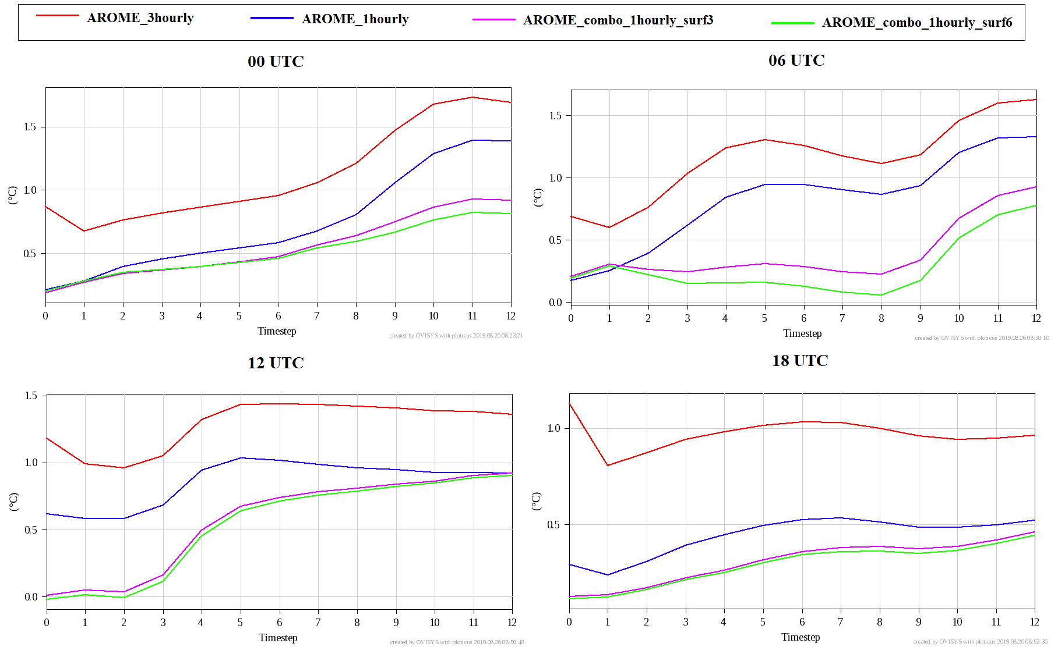
Results
BIAS of 2m temperature in function of timestep in the first period

Slide 8
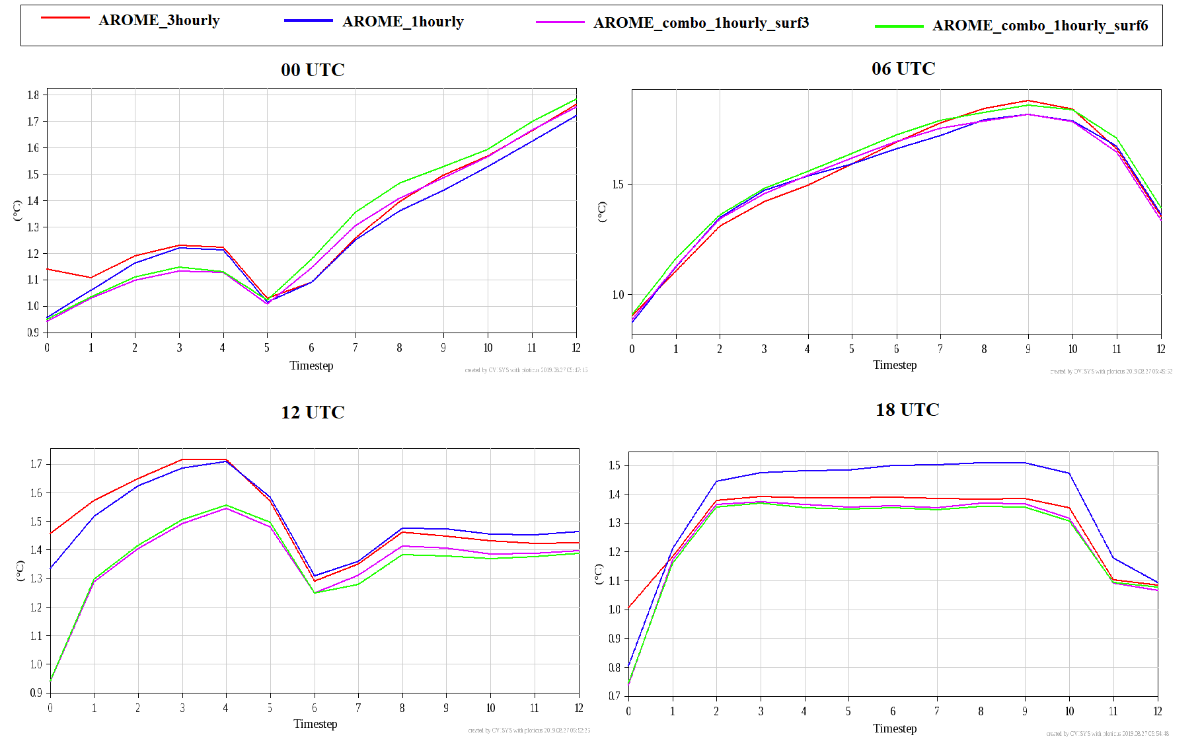
Results
RMSE of 2m temperature in function of timestep in the second period

Slide 9
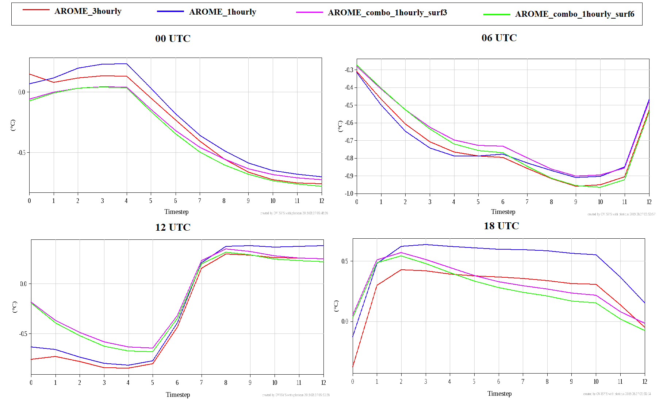
Results
BIAS of 2m temperature in function of timestep in the second period

Slide 10
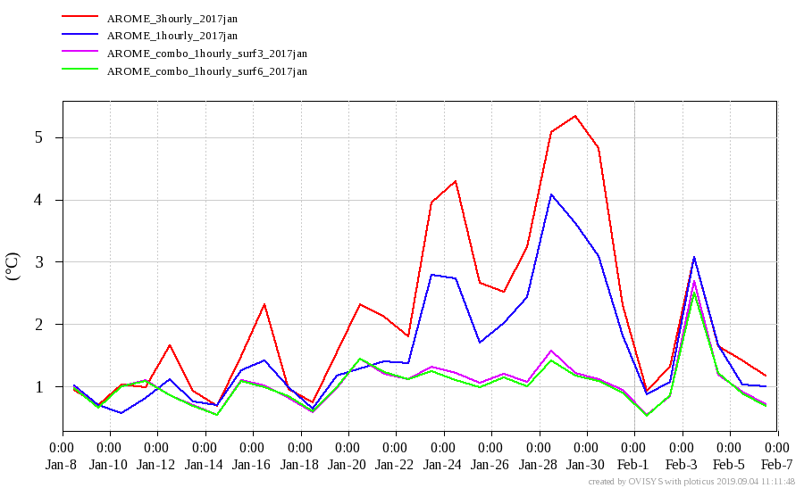
29/01/2017 12 UTC
This is a TIME-T diagram for 12 UTC runs in 0 timestep
Notes:
This is a TIME-T diagram for 12 UTC runs in 0 timestep. The biggest difference between the different configurations is on 29th of January. AROME-3hourly has more than five degrees Celsius RMSE, but AROME_combo_1hourly_surf3 and surf 6 have only around 1 degree Celsius RMSE. I had examined the background of this unusual difference.

Slide 11
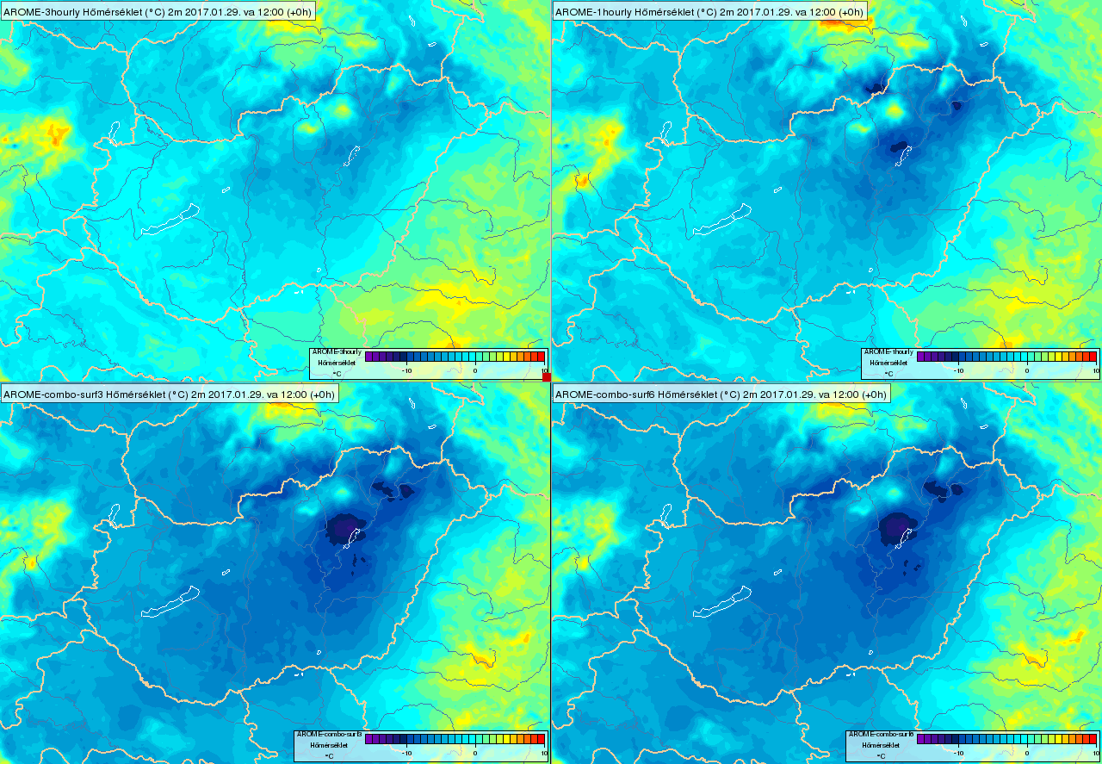
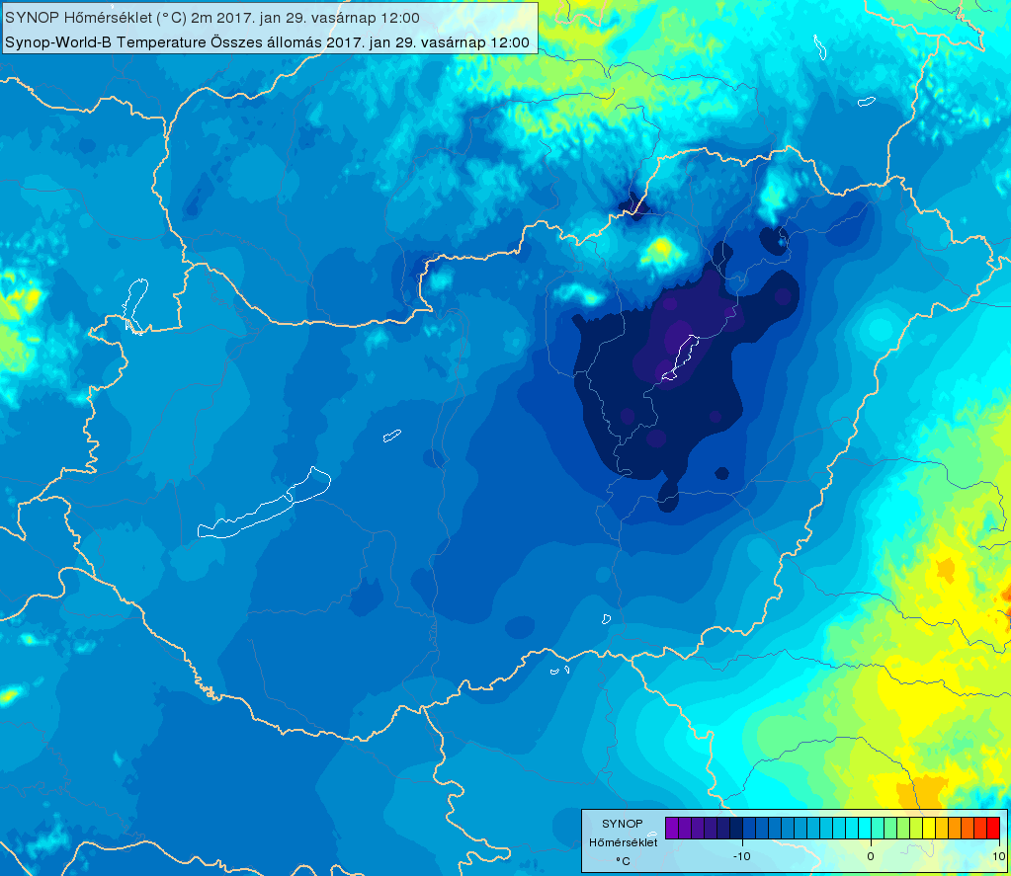
29/01/2017 12 UTC
AROME_3hourly
AROME_1hourly
Measurements
AROME_combo_1hourly_surf3
AROME_combo_1hourly_surf6
Notes:
On these temperature forecasts we can see the fact that caused the difference in the RMSE. AROME_combo_surf3 and surf6 proved to be closer to reality.

Slide 12
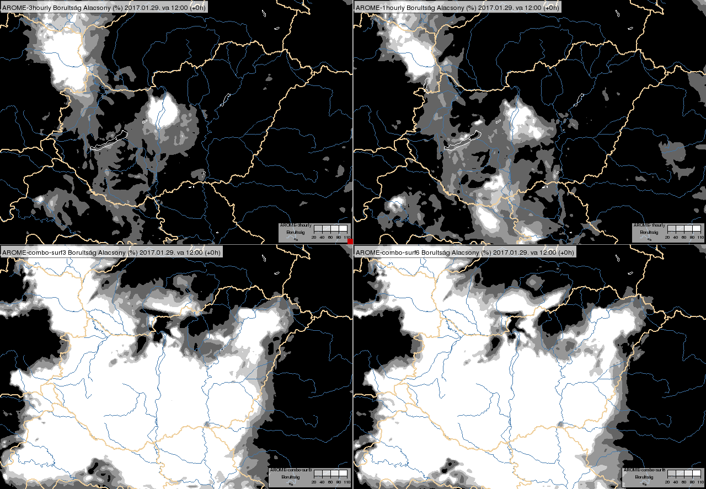
29/01/2017 12 UTC
AROME_3hourly
AROME_1hourly
HRV composite fog
AROME_combo_1hourly_surf3
AROME_combo_1hourly_surf6
Notes:
Here, it can be seen the real cause of the error is the lack of cloudcover in AROME_3hourly and in AROME_1hourly. This usually happens in the Carpathian Basin when the clouds get stuck during winter time. In this situation the NWPs usually are not able to serve accurate forecast.

Slide 13
Number of obsevations in CANARI
- I checked the number of observations in CANARI
-There was no significant difference between 1 hourly and 3 hourly numbers

Slide 14
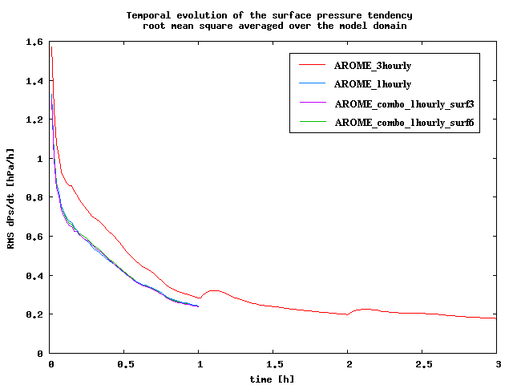
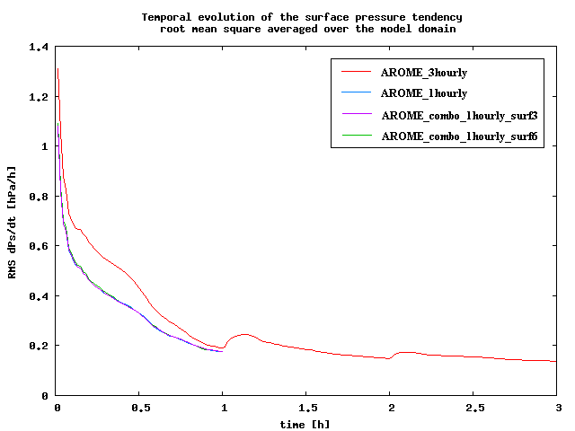
ECHKEVO
- In order to investigate the spin-up time ECHKEVO
diagnostic were used
- The results show that model spin-up is less than one hour
for both periods
- The small increase after 1 and 2 hour due to coupling
In the first period:
In the second period:

Slide 15
Conclusions and future plans
AROME_1hourly was performed better than AROME_3hourly in case of 2 m temperature
Higher accuracy were provided by reduction of surface assimilation frequency
The results show a bigger difference between the performance of configurations in January comparing to May
Considering precipitation there is no significant difference between the configurations
My plan is → to examine new periods
→ to assimilate GNSS in RUC
→ to evaluate the increments

Slide 16
Thank you for your attention !

