Slide 1
BATOR - way from cy40 to cy47
Regional Cooperation for
Limited Area Modeling in Central Europe
Michal Nestiak

Slide 2
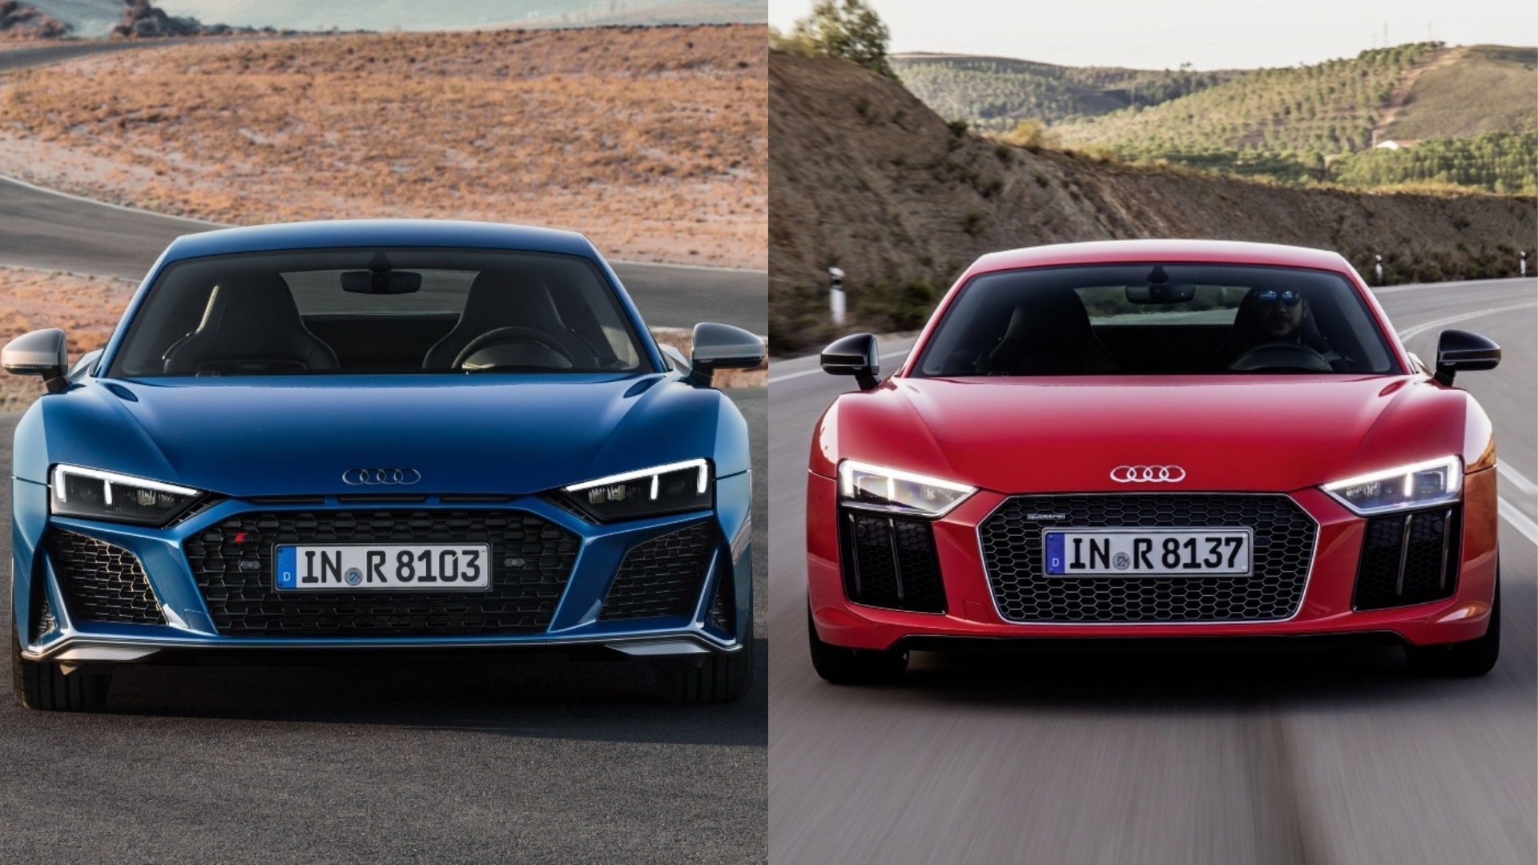
Why loosing time with that?
. cy43 .
. cy46 .
2020 Audi R8
2015 Audi R8

Slide 3
Introduction
Our plan for radar DA stay 2018/12 in OMSZ in Budapest was step by step better understanding of ODIM radar data handling in Bator (mainly odb/pandor/module/bator_decodhdf5_mod.F90 ) and step by step continue on radar DA.
start point: cy40bf09_cy43 (backphased BATOR stay 2018/09)
after the discussion on RC LACE DA WD in Bucharest (Romania), 20180917-21 task
control radar ray geometry and mapping of observations
SUBROUTINE Maps(rscale,rstart,elangle,arrayin,elevation)
2018/12 phasing cy46 -after investigate it we find some very useful features
end point (stay 2018/12):
OMSZ:wfma
cy40bf09_cy43 (backphased BATOR on cy46 2018/12)
cy43t2bf09
SHMU:HPC2
cy40bf09_cy43
cy43t2bf10
cy43t2bf10_cy46
cy46t1 - “prephasing code”

Slide 4
SUBROUTINE Maps(rscale,rstart,elangle,arrayin,elevation)
maps : maps bins to get a profile
in SUBROUTINE Odim(FileId,TabSlots,AnalysisDate,Kobs,Kw,Kfic,Conformity)
call maps (Radar%FinalElev(i)%DBZH%Attrib%RScale,Radar%FinalElev(i)%DBZH%Attrib%RStart, Radar%FinalElev(i)%Elangle,real2buf,Radar%FinalElev(i)%DBZH%Values)
call maps
(Radar%FinalElev(i)%TH%Attrib%RScale,Radar%FinalElev(i)%TH%Attrib%RStart, Radar%FinalElev(i)%Elangle,real2buf,Radar%FinalElev(i)%TH%Values)
call maps (Radar%FinalElev(i)%VRAD%Attrib%RScale,Radar%FinalElev(i)%VRAD%Attrib%RStart, Radar%FinalElev(i)%Elangle,real2buf,Radar%FinalElev(i)%VRAD%Values)
(associated(Radar%FinalElev(i)%FLAG))
call maps (Radar%FinalElev(i)%DBZH%Attrib%RScale,Radar%FinalElev(i)%DBZH%Attrib%RStart,&
& Radar%FinalElev(i)%Elangle,real2buf,Radar%FinalElev(i)%FLAG%Values)

Slide 5
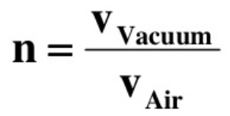
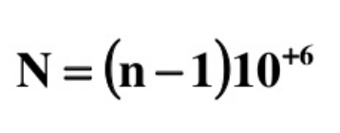
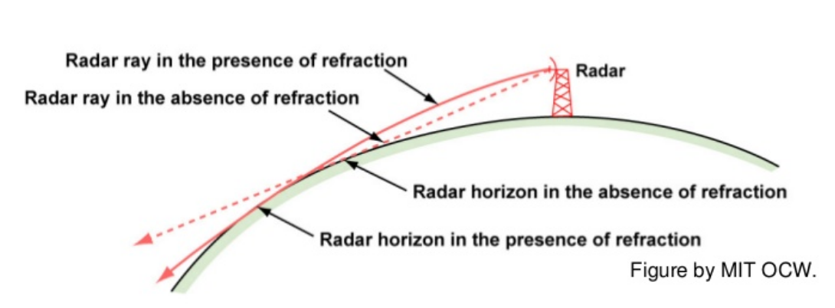
Ray geometry
In normal condition N decreases with height in the atmosphere, which leads to a downward bending of radar beams.
N = 77.6/T*(0.01*p + 4810*e/ T )
p - pressure
T - temperature
e - partial pressure of water vapour
N -refractivity
n - index of refraction

Slide 6
i= 1, Radar%NRayons
j= 1, Radar%NPoints
l=1, NbSelectedElangles
RAE = RA*4./3.
zdimhpiy = 360./Radar%NRayons
zaz_offset = 0.
zdist(iobs) = (1000. * (j - 0.5))**2
zazim(iobs) = ispindir * zdimhpiy * (i - 0.5) + zaz_offset
zalt = RA + sin(Radar%FinalElev(l)%Elangle*RADIANS) * sqrt(zdist(iobs)) + zdist(iobs)/2./RAE
zalpha = acos((RA**2 + zalt**2 - zdist(iobs)) / (2. * RA * zalt))
Radar%FinalElev(l)%Elangle
sqrt(zdist(iobs))
TREF_RADAR(JPXRADS)%stalt
s
RA
zalt
zalpha
cos(alfa)=(b*b+c*c-a*a)/(2*b*c)
Notes:
(((250000)^2)/2)/(6378000)
4899.65506
cosine theorem
Non standard propagation when not 4/3 occurance

Slide 7
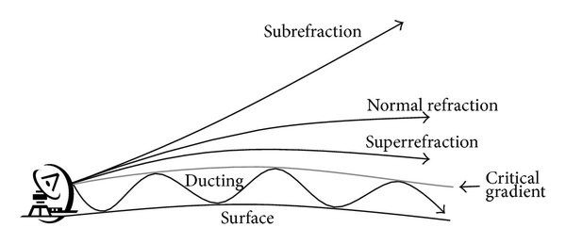
In reality somehow little bit complicated
also in INCA3_prec developed in SHMU we already have simple beam propagating model …
developed by SHMU radar department staff Ladislav Meri, Lubo Okon ...
Notes:
https://www.quora.com/What-is-the-maximum-range-a-ground-radar-can-detect-a-target-taking-in-account-earths-curvature

Slide 8
YOMCOCTP - CMA OBS./CODE TYPES
pack/43t2_bf09_export.03.MPIGNU493.x/src/local/arpifs/module/yomcoctp.F90
!* 1.13 RADAR
! NRADAR I RADAR
! NRADARSQ I RADAR SQ. NO
INTEGER(KIND=JPIM), PARAMETER :: NRADAR = 13
INTEGER(KIND=JPIM), PARAMETER :: NRADARSQ = 13
MNOCTP(NRADAR)=NRDRCT
CCMOOTP(NRADAR)='RADAR, meteorological radar
nothing change for radars … cy40 to cy47

Slide 9
43t2_bf10: odb/pandor/module/bator_module.F90
TYPE HRadarSel
real(kind=jprb) :: Resolution = rabsi
integer(kind=jpim) :: Sample = 1000
character(len=LabelLength) :: ChoosenTask = '?'
character(len=LabelLength) :: GrpElevName = '?'
character(len=LabelLength) :: GrpWhereName = '?'
character(len=LabelLength) :: GrpWhatName = '?'
character(len=LabelLength) :: GrpHowName = '?'
character(len=LabelLength) :: GrpParamName = '?'
character(len=LabelLength) :: GrpFlagName = '?'
integer(kind=jpim) :: NbWagon = 0
integer(kind=jpim) :: NbSupp = 0
character(len=5), dimension(200) :: NodeNames = '?'
character(len=LabelLength) :: ConventionName = '?'
character(len=LabelLength), dimension(10) :: AllowedConventions = '?'
character(len=LabelLength) :: ElevName = '?'
character(len=LabelLength) :: NRaysName = '?'
character(len=LabelLength) :: NbinsName = '?'
character(len=LabelLength) :: RStartName = '?'
character(len=LabelLength) :: RScaleName = '?'
character(len=LabelLength) :: ObjectName = '?'
character(len=LabelLength) :: SourceName = '?'
character(len=LabelLength) :: DateName = '?'
character(len=LabelLength) :: TimeName = '?'
character(len=LabelLength) :: StartDateName = '?'
character(len=LabelLength) :: StartTimeName = '?'
character(len=LabelLength) :: QuantityName = '?'
character(len=LabelLength) :: GainName = '?'
character(len=LabelLength) :: OffsetName = '?'
character(len=LabelLength) :: NoDataName = '?'
character(len=LabelLength) :: NoDetectName = '?'
character(len=LabelLength) :: SiteHeightName = '?'
character(len=LabelLength) :: SiteLatName = '?'
character(len=LabelLength) :: SiteLonName = '?'
character(len=LabelLength) :: TaskName = '?'
character(len=LabelLength) :: BeamWidthName = '?'
logical :: LPrint = .TRUE.
END TYPE HRadarSel
TYPE(HRadarSel) :: HOdim
cy46_bf01:
odb/pandor/module/bator_module.F90
TYPE HRadarSel
real(kind=jprd) :: Resolution = rabsi
real(kind=jprd) :: DOWThreshold = rabsi
real(kind=jprd) :: NIlimit = rabsi
integer(kind=jpim) :: Sample = 1000
character(len=LabelLength) :: ChoosenTask = '?'
character(len=LabelLength) :: GrpElevName = '?'
character(len=LabelLength) :: GrpWhereName = '?'
character(len=LabelLength) :: GrpWhatName = '?'
character(len=LabelLength) :: GrpHowName = '?'
character(len=LabelLength) :: GrpParamName = '?'
character(len=LabelLength) :: GrpFlagName = '?'
integer(kind=jpim) :: NbWagon = 0
integer(kind=jpim) :: NbSupp = 0
character(len=5), dimension(200) :: NodeNames = '?'
character(len=LabelLength) :: ConventionName = '?'
character(len=LabelLength), dimension(10) :: AllowedConventions = '?'
character(len=LabelLength) :: ElevName = '?'
character(len=LabelLength) :: NRaysName = '?'
character(len=LabelLength) :: NbinsName = '?'
character(len=LabelLength) :: RStartName = '?'
character(len=LabelLength) :: RScaleName = '?'
character(len=LabelLength) :: ObjectName = '?'
character(len=LabelLength) :: SourceName = '?'
character(len=LabelLength) :: DateName = '?'
character(len=LabelLength) :: TimeName = '?'
character(len=LabelLength) :: StartDateName = '?'
character(len=LabelLength) :: StartTimeName = '?'
character(len=LabelLength) :: QuantityName = '?'
character(len=LabelLength) :: GainName = '?'
character(len=LabelLength) :: OffsetName = '?'
character(len=LabelLength) :: NoDataName = '?'
character(len=LabelLength) :: NoDetectName = '?'
character(len=LabelLength) :: SiteHeightName = '?'
character(len=LabelLength) :: SiteLatName = '?'
character(len=LabelLength) :: SiteLonName = '?'
character(len=LabelLength) :: TaskName = '?'
character(len=LabelLength) :: BeamWidthName = '?'
character(len=LabelLength) :: MinDetectName = '?'
character(len=LabelLength) :: NyquistVel = '?'
logical :: LPrint = .TRUE.
END TYPE HRadarSel
TYPE(HRadarSel) :: HOdim

Slide 10
what does this button do? DEE-DEEEEEEEEEEEE

Slide 11
jprd vs jprb - ifsaux/module/parkind1.F90
INTEGER, PARAMETER :: JPIB = SELECTED_INT_KIND(12)
#ifdef PARKIND1_SINGLE
INTEGER, PARAMETER :: JPRB = SELECTED_REAL_KIND(6,37)
#else
INTEGER, PARAMETER :: JPRB = SELECTED_REAL_KIND(13,300)
#endif

Slide 12
jprd vs jprb -DPARKIND1_SINGLE
Single Precision IFS - Filip Váňa - Aladin WS / HIRLAM ASM, Helsinki, 5 April, 2017
https://www.umr-cnrm.fr/aladin/IMG/pdf/filip_sp.pdf
Extensive validation required.
Single precision in cycle 43 Ole Vignes, ALADIN/HIRLAM all staff meeting 2019
http://www.umr-cnrm.fr/aladin/IMG/pdf/sp_cy43_olev_asm2019.pdf
This is not because the computer necessarily computes faster in 32 bits, but mostly because the data volumes become smaller:
The memory cache layers can hold larger portions of arrays (memory bandwidth becomes better)
Amount of data involved in MPI message passing smaller (halved)

Slide 13
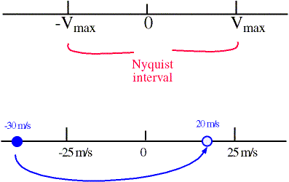
call GetAttribute - Attributes%NyquistVel
call GetAttribute(GroupId,HODIM%NyquistVel,WaitedRank,WaitedAtomic,Iret)
Attributes%NyquistVel = Real1Buf(1)
Velocity Folding
If a particle's radial velocity is outside the range of the nyquist interval, then the radial velocity will be aliased, or folded. This is called velocity folding/aliasing.
Example: if nyquist velocity is 25 m/s and the particle's radial velocity is -30 m/s, then it will fold over and the radar will interpret it as +20 m/s -->>

Slide 14
DataAttributes%NyquistVel
TYPE GAttributes
real(kind=jprd) :: NyquistVel= -1._jprd*rabsi
END TYPE GAttributes
SUBROUTINE BuildAttributesList(RootAttributes,DatasetAttributes,DataAttributes)
DataAttributes%NyquistVel = RootAttributes%NyquistVel
DataAttributes%NyquistVel = DatasetAttributes%NyquistVel
!cy46 GetAttribute(GroupId,HODIM%NyquistVel,WaitedRank,WaitedAtomic,Iret)
!cy47 GetAttribute(GroupId,HODIM%NyquistVelName,WaitedRank,WaitedAtomic,Iret)
call GetAttribute(GroupId,HODIM%NyquistVel,WaitedRank,WaitedAtomic,Iret)
write (Batout,'("*** INFO - BATOR : NyquistVel",18x,": ",F11.6)') Radar%NyquistVel
when not exist Radar%NyquistVel=-1._jprd*rabsi
! Radial Velocity
if (associated(Radar%FinalElev(l)%VRAD) .and. &
& Radar%FinalElev(l)%VRAD%Attrib%NyquistVel>=HODIM%NIlimit .and. &
& Radar%FinalElev(l)%VRAD%Attrib%NyquistVel/=rabsi) then
if ((sqrt(zdist(iobs)) < 150000.) .and. (abs(Radar%FinalElev(l)%VRAD%Values(j,i)) <= 100.)) then
ztwag(iw,4) = -1.*Radar%FinalElev(l)%VRAD%Values(j,i) ! Change sign because of PANT convention

Slide 15
call GetAttribute - HODIM%MinDetectName
call GetAttribute(GroupId,HODIM%MinDetectName,WaitedRank,WaitedAtomic,Iret)
Radar%MinDetect = real1buf(1)
write (Batout,'("*** INFO - BATOR : MinDetect",18x,": ",F11.6)') Radar%MinDetect
when not exist
Radar%MinDetect=-40

Slide 16
distcrit(l,j) … dbzh_inter(l,j,:)
!! statistic computation of threshold of radar detection !!
do i= 1, Radar%NRayons
do j= 1, Radar%NPoints
do l=1, NbSelectedElangles
if (associated(Radar%FinalElev(l)%DBZH)) then
if (Radar%FinalElev(l)%DBZH%Values(j,i) /= -rabsi) then
dbzh_inter(l,j,i) = Radar%FinalElev(l)%DBZH%Values(j,i)
else
dbzh_inter(l,j,i) = rabsi
endif ! -rabsi endif ! associated enddo enddo enddo
!! above initialization of dbzh_inter for computing minimum
do l=1, NbSelectedElangles
if (associated(Radar%FinalElev(l)%DBZH)) then
do j= 1, Radar%NPoints
if (minval(dbzh_inter(l,j,:)) /= rabsi .and. minval(dbzh_inter(l,j,:)) /= rabso ) then
distcrit(l,j) = j/10.0**(minval(dbzh_inter(l,j,:))/20.)
zunkm(l,j) = 20.0*LOG10(1/distcrit(l,j))
else
distcrit(l,j) = rabso
zunkm(l,j) = -rabso
endif
enddo !! NPoints
do j = 1, Radar%NPoints
zunkmparelev(j) = zunkm(l,j)
enddo
write(*,'("minloc de zunkmparelev vaut",I5.5)') minloc(zunkmparelev,DIM=1)
distcritmin(l) = distcrit(l,minloc(zunkmparelev,DIM=1))
write(*,'("Distance ou le bruit s annule",F8.3)') distcritmin(l)
endif ! associated
enddo ! Elangles !! end of defining distcritmin(l) for threshold

Slide 17
to keep if satellite algorithm for clear sky?
elseif (Radar%FinalElev(l)%FLAG%Values(j,i) < 0.7) then ! flag < 0.7
ztwag(iw,8) = 1.
ztwag(iw+1,8) = 1.
ztwag(iw,4) = rabso ! do not this if you want to keep
!...only dbzh at -rabsi see below...
inlv = inlv - 1 ! to keep if satellite algorithm for clear sky
! removing has to be used : test in screening if flag == 1 and
! ztwag(iw,4)=-rabsi then ztwag can be used as no rain detection
ztwag(iw+1,4) = rabso
inlv = inlv - 1
endif
finally? because I trying blackmagic throught “put NWCSAF Cloud Mask - QC “
TYPE FilteredElangle
real(kind=jprd) :: Elangle = rabsi
TYPE(GrpData),pointer :: DBZH => NULL()
integer(kind=jpib) :: DbZHDeltaTime = 86400
TYPE(GrpData),pointer :: TH => NULL()
integer(kind=jpib) :: THDeltaTime = 86400
TYPE(GrpData),pointer :: VRAD => NULL()
integer(kind=jpib) :: VRadDeltaTime = 86400
TYPE(GrpQual),pointer :: FLAG => NULL()
TYPE(GrpData),pointer :: NWCSAF_CM => NULL()
integer(kind=jpib) :: NWCSAF_CMDeltaTime = 86400
END TYPE FilteredElangle
Notes:
http://www.nwcsaf.org/cma_description

Slide 18
NWCSAF - CMA - http://www.nwcsaf.org/cma_description
Mandatory R0.6µm T3.8µm T10.8µm T12.0µm

Slide 19
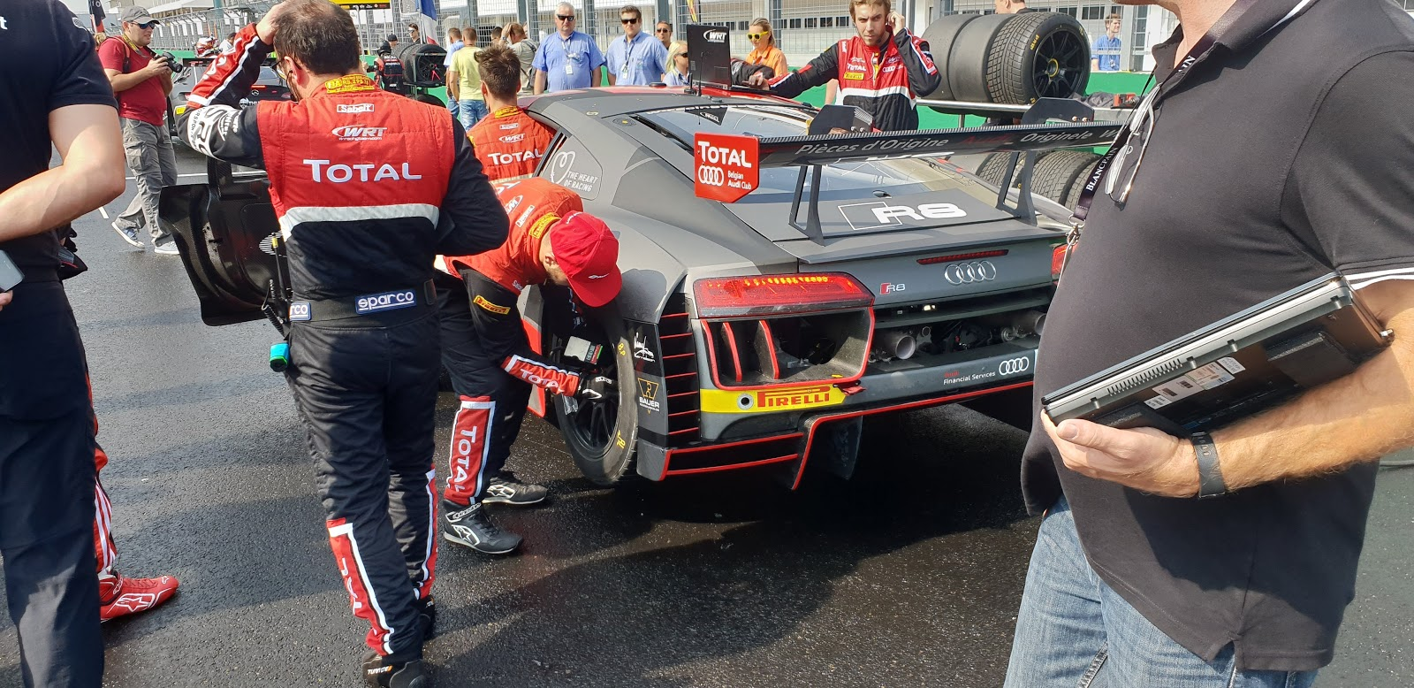
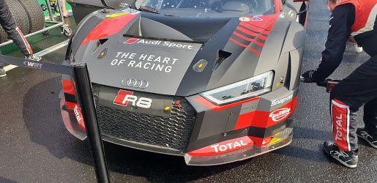
You know when the owner of serial produced Audi R8 want different car?
Budapest 2018/09 - Hungaroring

Slide 20
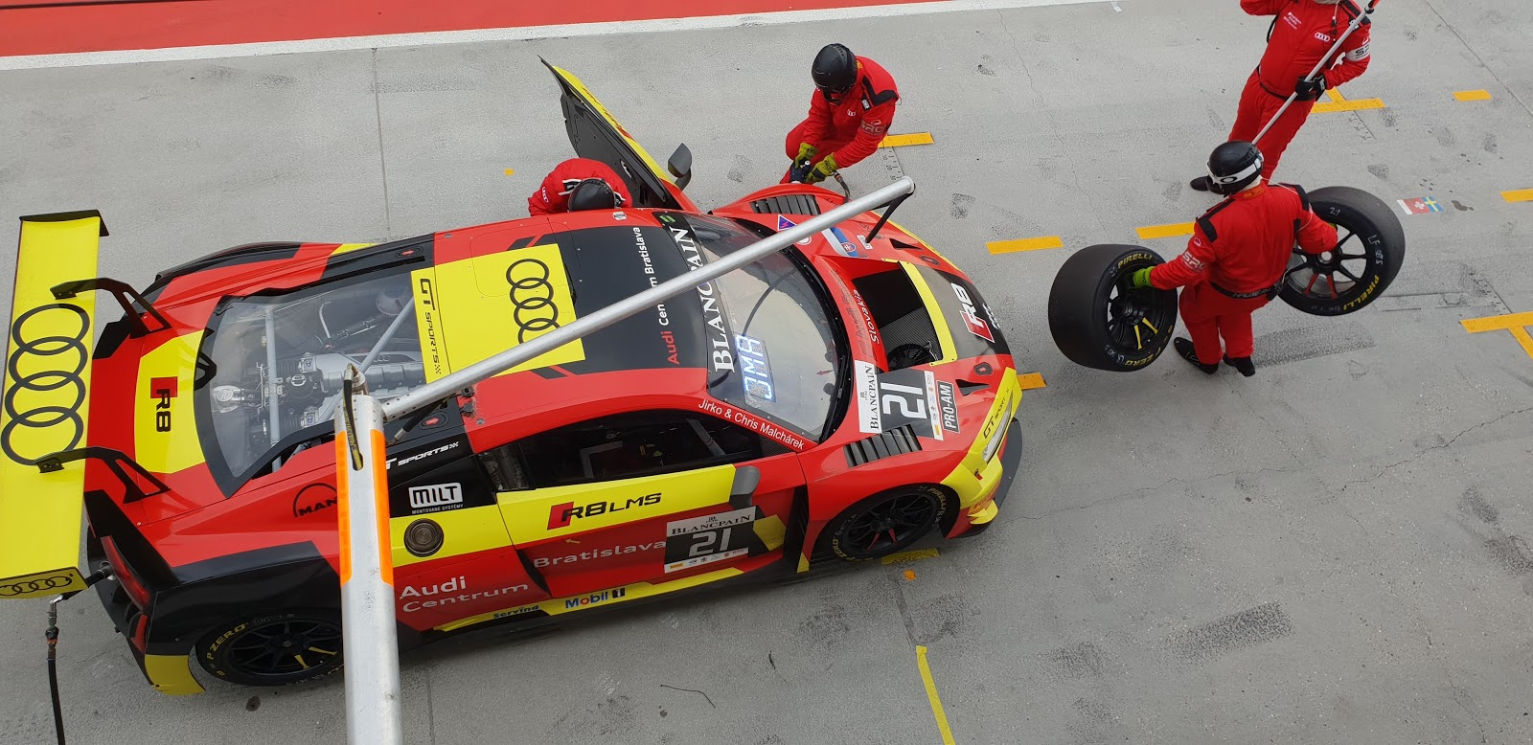
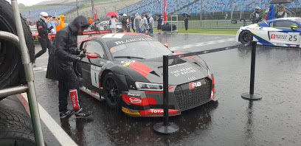
cy47: TE is an echo type classification available in the Météo France radar product
TYPE FilteredElangle
TYPE(GrpData),pointer :: TE
END TYPE FilteredElangle
A Fuzzy Logic Algorithm for the Separation of Precipitating from Nonprecipitating Echoes Using Polarimetric Radar Observations
https://journals.ametsoc.org/doi/full/10.1175/JTECH2035.1
A New Fuzzy Logic Hydrometeor Classification Scheme Applied to the French X-, C-, and S-Band Polarimetric Radars
https://journals.ametsoc.org/doi/full/10.1175/JAMC-D-12-0236.1
Hassan Al-Sakka, Abdel-Amin Boumahmoud, and Béatrice Fradon
Centre de Météorologie Radar, Direction des Systèmes d'Observation, Météo France, Toulouse, France

Slide 21
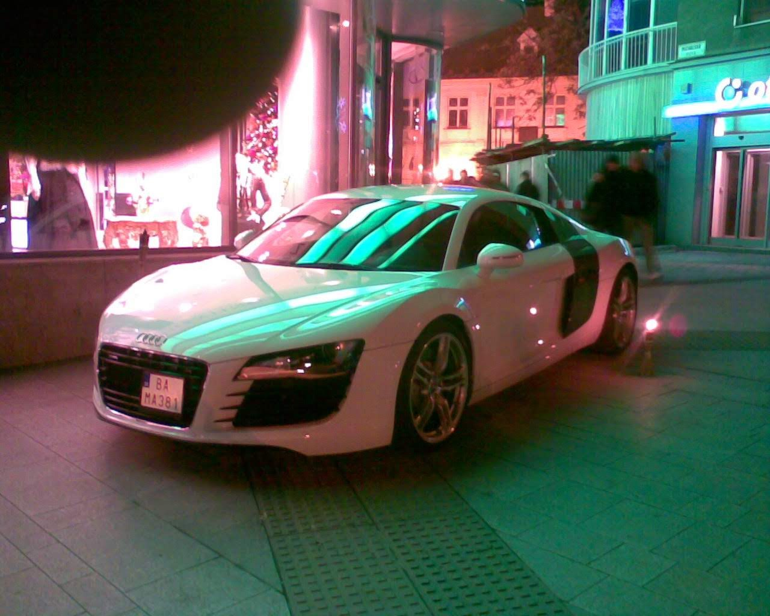
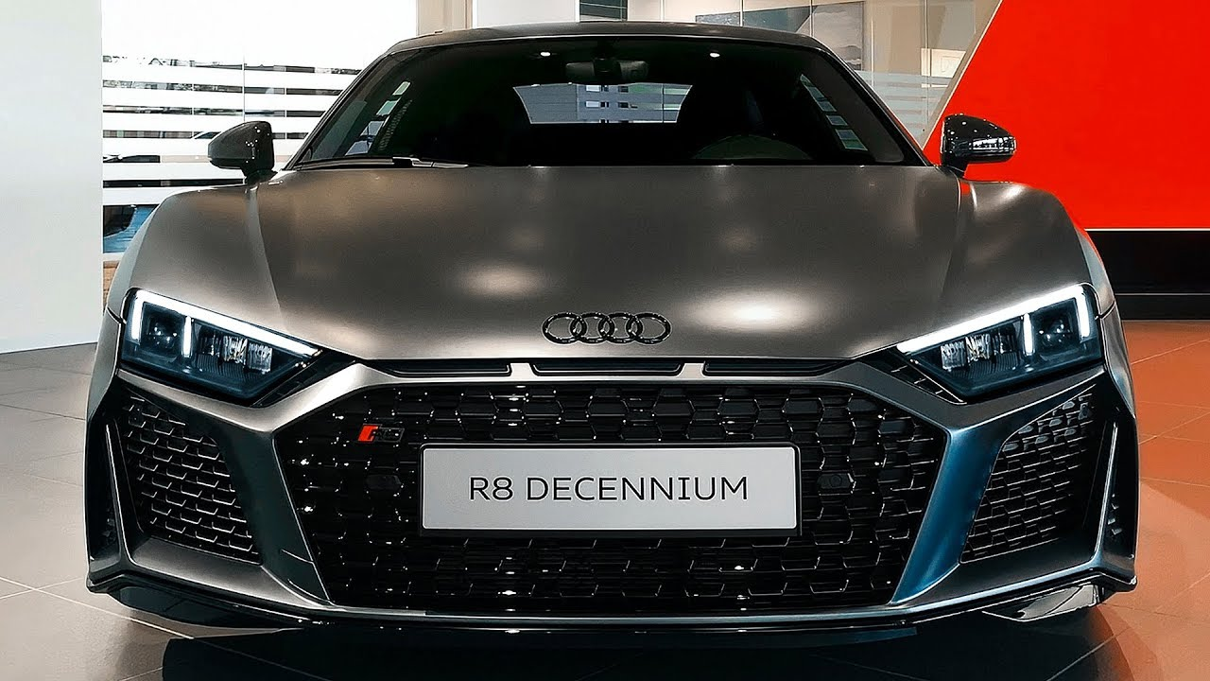
Many thanks for your time
First time in Bratislava 2007 Audi R8
2020 Audi R8
Audi is celebrating the success story of the V10 engine with the Audi R8 V10 Decennium
and what the BATOR?
Notes:
https://www.audi.com/en/experience-audi/audi-sport/r-rs-serial-models/r8/r8-v10-decennium.html

