Slide 1
Tuning the TKE based mixing length and first results
Radmila Brožková

Slide 2
Background
Development of the turbulence mixing length determination based on TKE (based on the BL89 approach, see talk of Mario) got mature enough to undergo intensive testing in the 3D model and tuning;
The availability of the code is as follows: locally on the CY46T1 in Prague, the basis is in the CY48T3, last modifications are planned to enter the CY50T1;
The modification set is not that large and could be provided.

Slide 3
Main Parameters of the scheme
Main parameters of the mixing length calculation itself:
CGMIXLEN=‘EL1’ : switching on the TKE based mixing length, BL89 approach;
LPBLH_TKE=.T. and XMAXLM: PBL height is defined by TKE and not by Ayotte method, and its maximum value;
ETKE_DTHETA_S1 and ETKE_DTHETA_S2 : thresholds for Cu and Sc regime nearby PBL top;
ETKE_LBLT1 and ETKE_LBLT2: thresholds of mixing length for Cu and Sc regime nearby PBL top, used also for the gradient of moist entropy calculation;
ETKE_HUTLS and ETKE_LUTLS: height and value of upper air length scale;
ETKE_R1SIM and ETKE_R2SIM: parameters to determine weight used to approach the mixing length to kappa * (z+z₀) within the surface layer;
ETKE_C0SHEAR: parameter for the shear term (extension to the BL89 approach).

Slide 4
Complementary tuning
Cloud scheme:
QXRAL, QXRAL_ADJ = 140. (150.) to lower a bit the excess of clouds;
SCLESPS = 11800. (5100.) to correct a bit resolved condensation/evaporation for ice;
Soil – interaction with vegetation:
GF3(3) = 10. (0., this value is 40. for high vegetation) to lower a bit the evaporation from low vegetation to correct for a cold bias in summer;
RCTVEG(3) = 1.7E-05 (1.4E-05) to lower warm bias in summer nights by decreasing a bit the heat capacity of low vegetation.
These choices may not be final ones, there could be some more.

Slide 5
Choice of testing periods
All the periods were tested in the simple forecast mode, i.e. the initial conditions were taken from the operational archive and results were compared to the operational reference.
Early March 2024: stratocumulus regime
mostly shallow convection and stratocumulus type of clouds;
Second half of June 2024: moist deep convection regime
days with thunderstorms, warm weather;
September 2024 flood period: heavy winds and precipitation
to test we do not deteriorate forecast;
December 2024: anticyclone, fogs
very stable stratification.

Slide 6
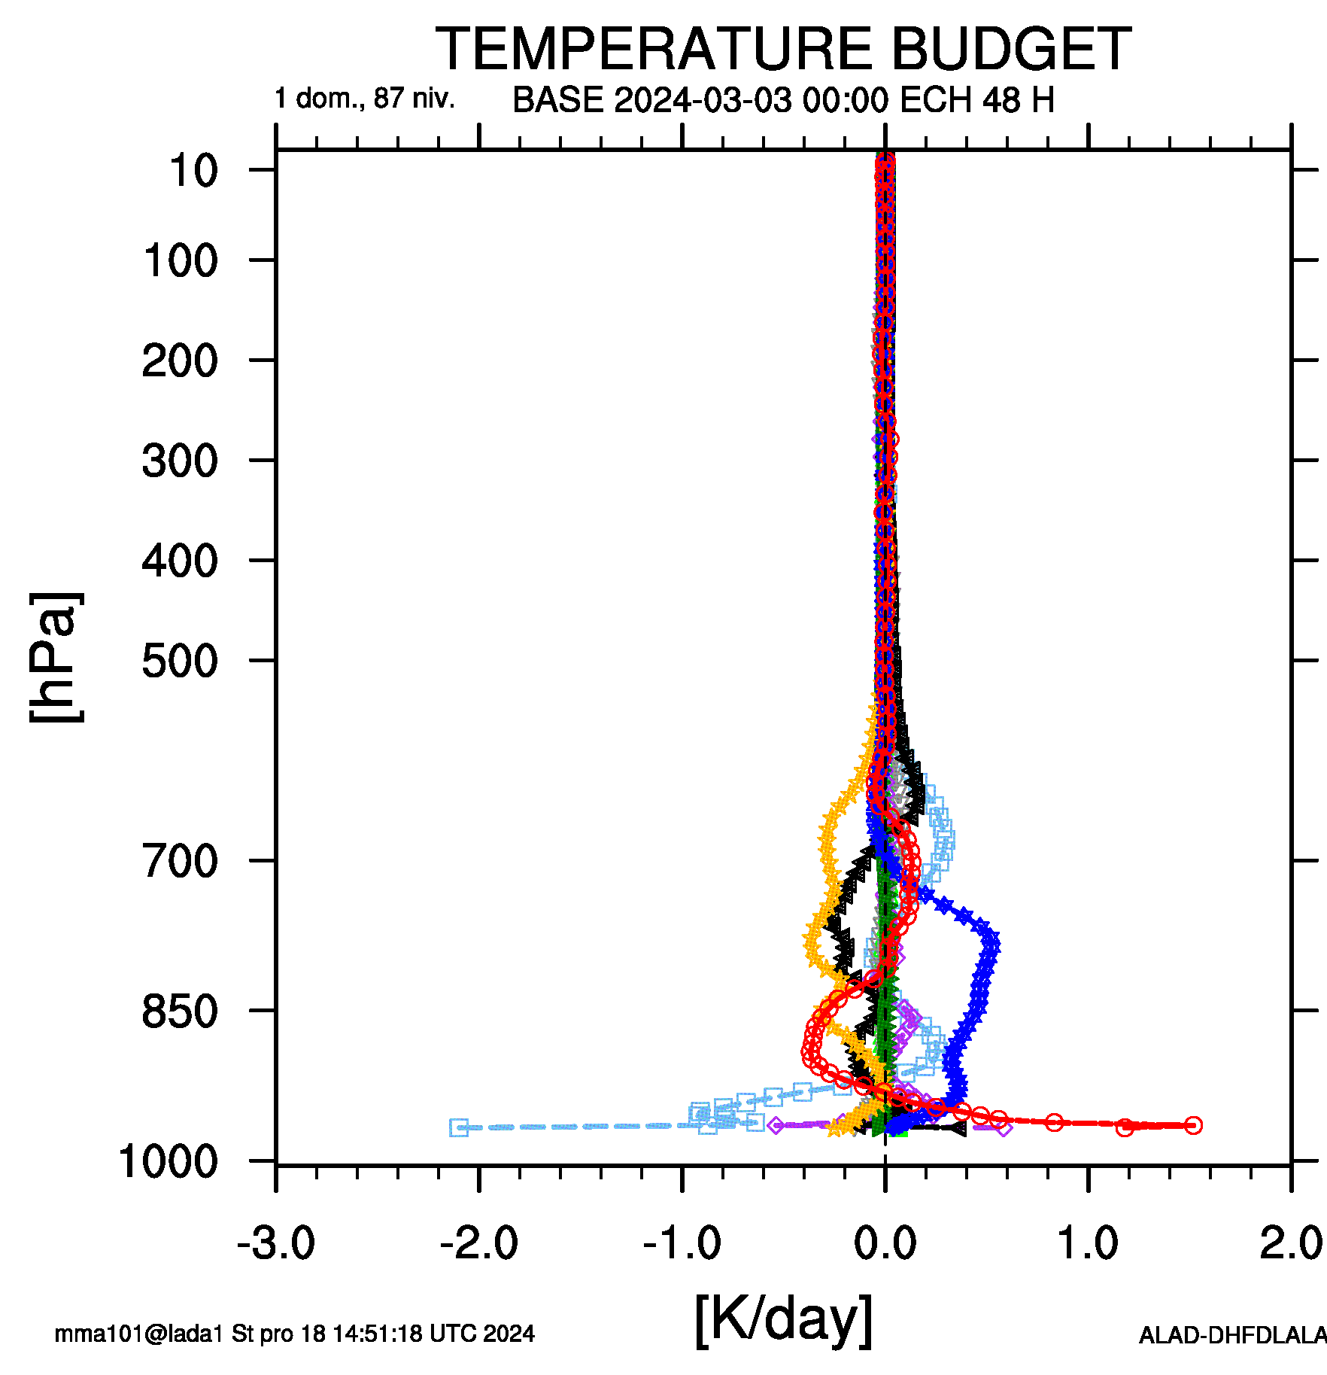
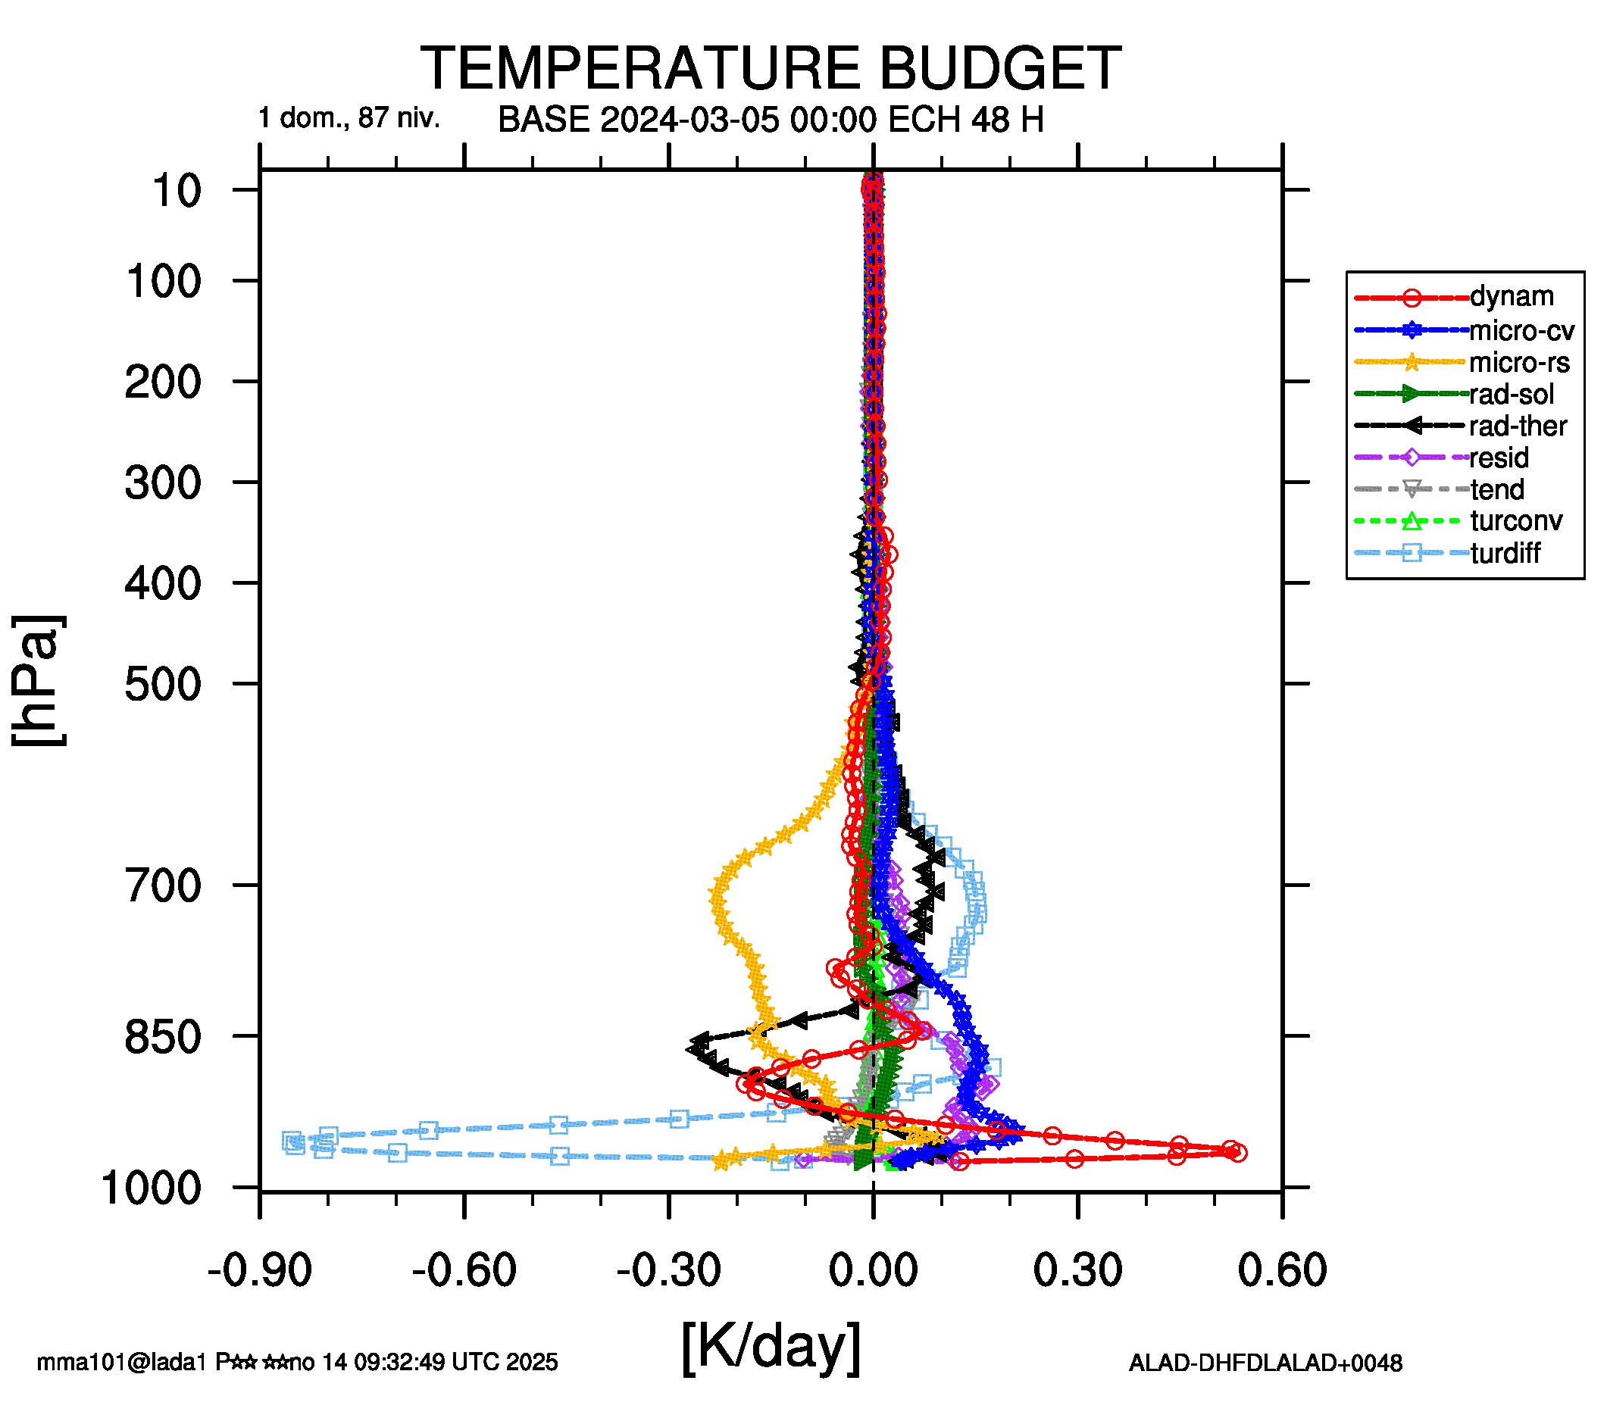
March period – very first setup
There was quite a big change in the tendencies by processes, of course namely in the transport by turbulence – see the enthalpy budget difference;
The model reacted to counter it by the dynamics, but there was also a non-negligible increase in the convective activity – condensation, reacting to the moisture transport;
The scores have also shown quite some impact and not always good;
It helped to retune the low levels profile by changing namely ETKE_R2SIM, ETKE_LBLT1 and ETKE_LBLT2
Next results contain already the retuning, including parameters of other schemes.

Slide 7
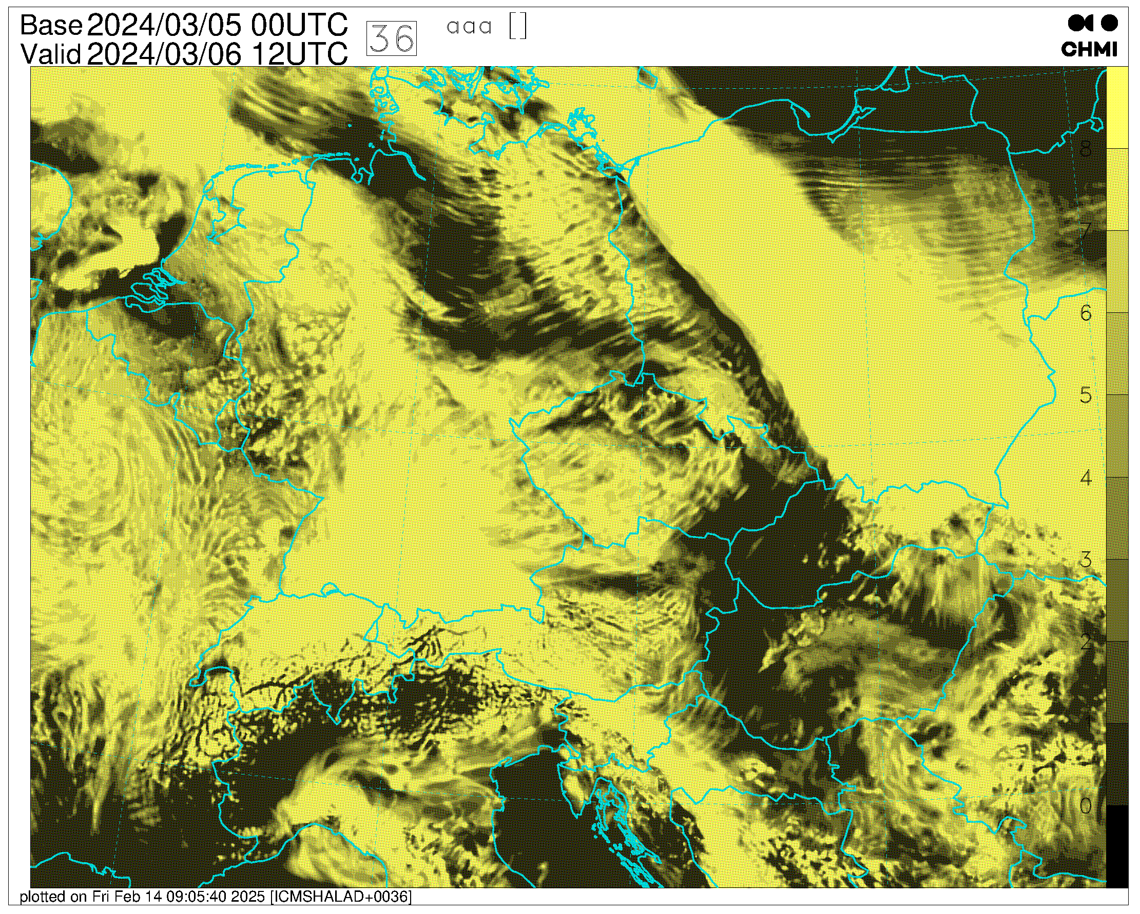
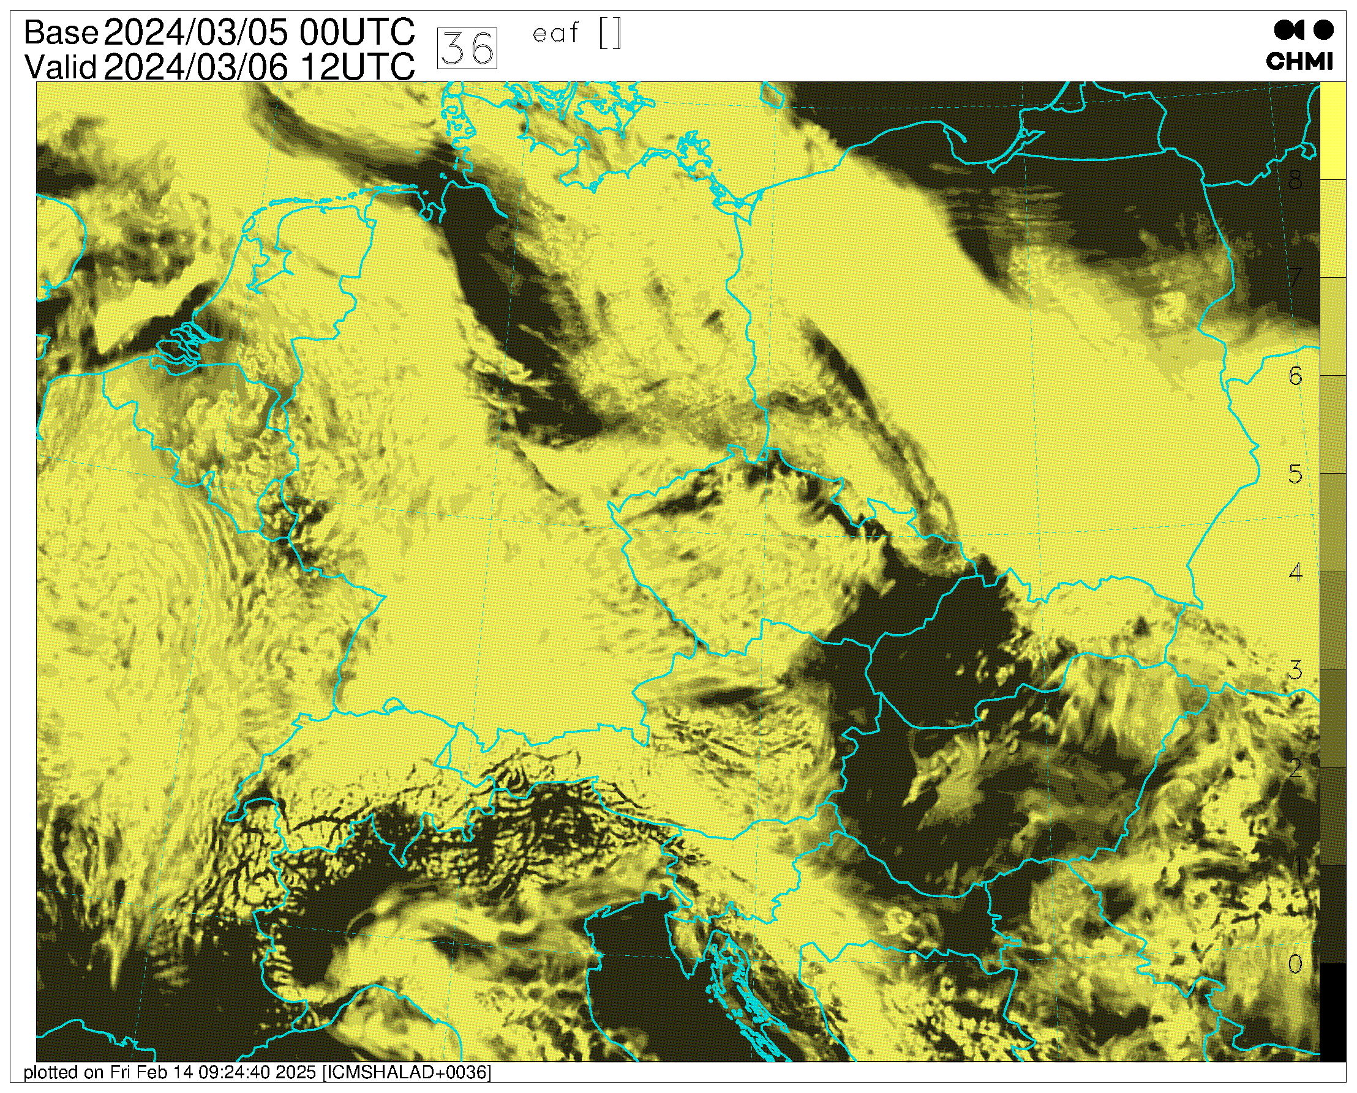
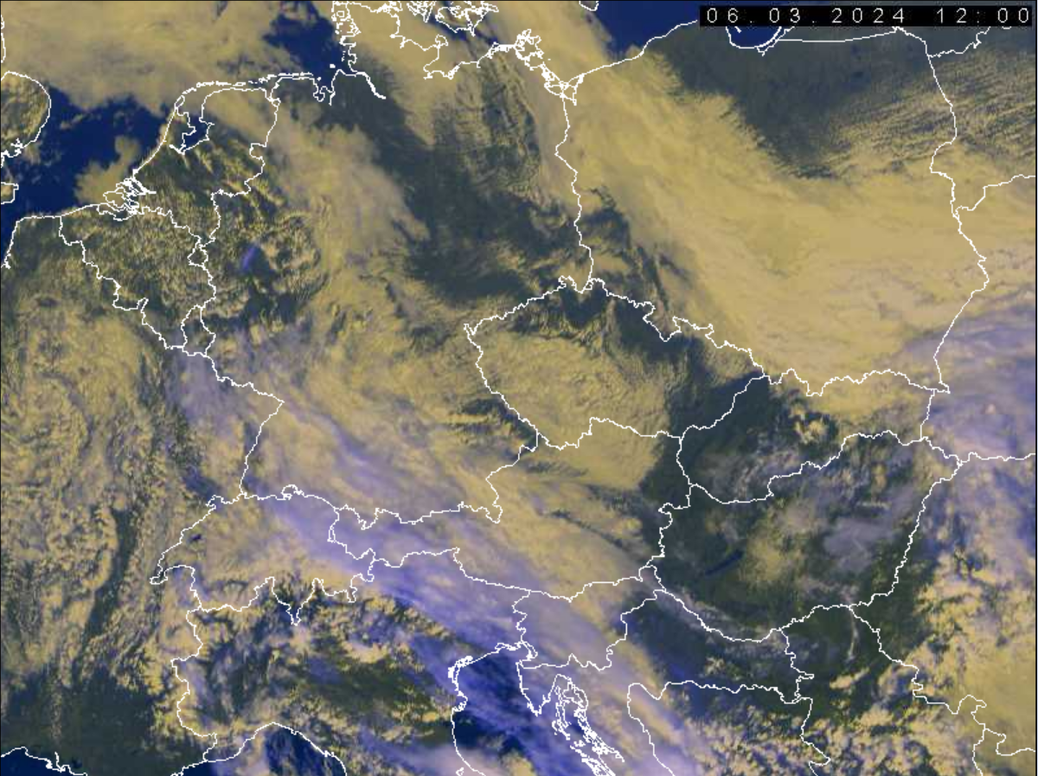
March period - cloudiness
Low level cloudiness forecast at +36 h: left is reference, middle is the EL1 experiment. Clearly, there are more clouds in the EL1 run. Both forecast are not that bad.

Slide 8
March period – some scores
In general, surface biases are better, albeit temperatures are a bit colder. At noon, there is less friction.
More cloudiness is also confirmed (on the left). Despite worse bias of T2m, its RMSE and STDE is better (on the right).

Slide 9
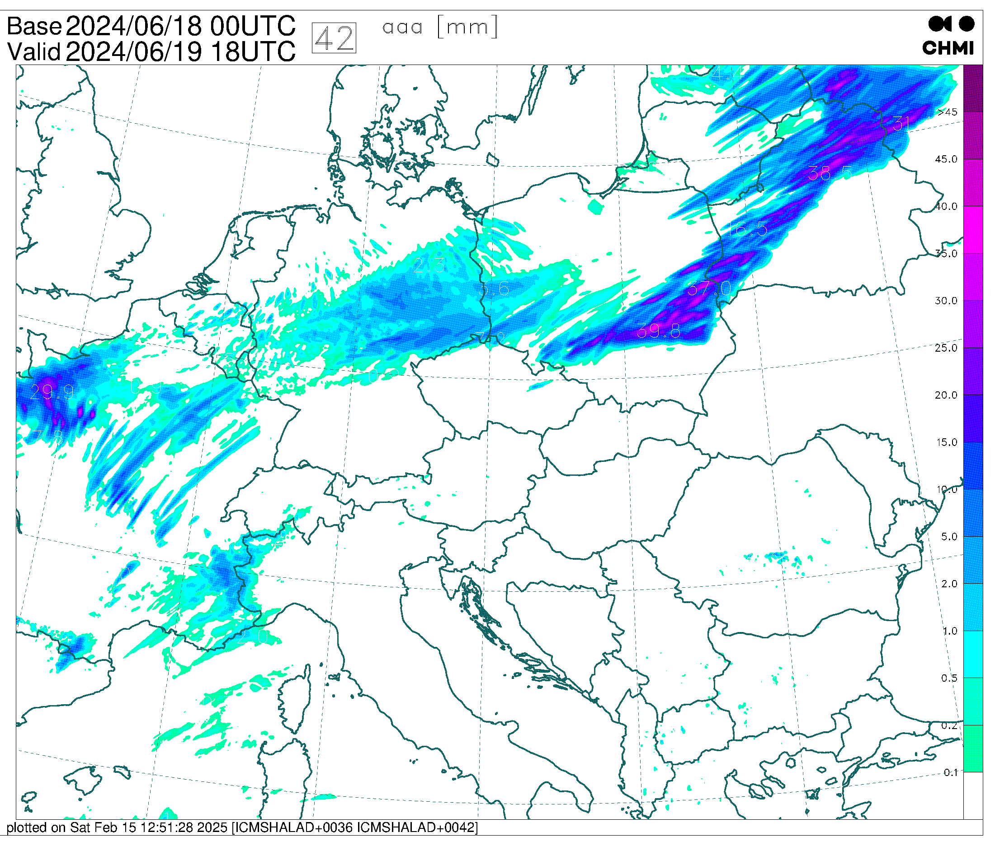
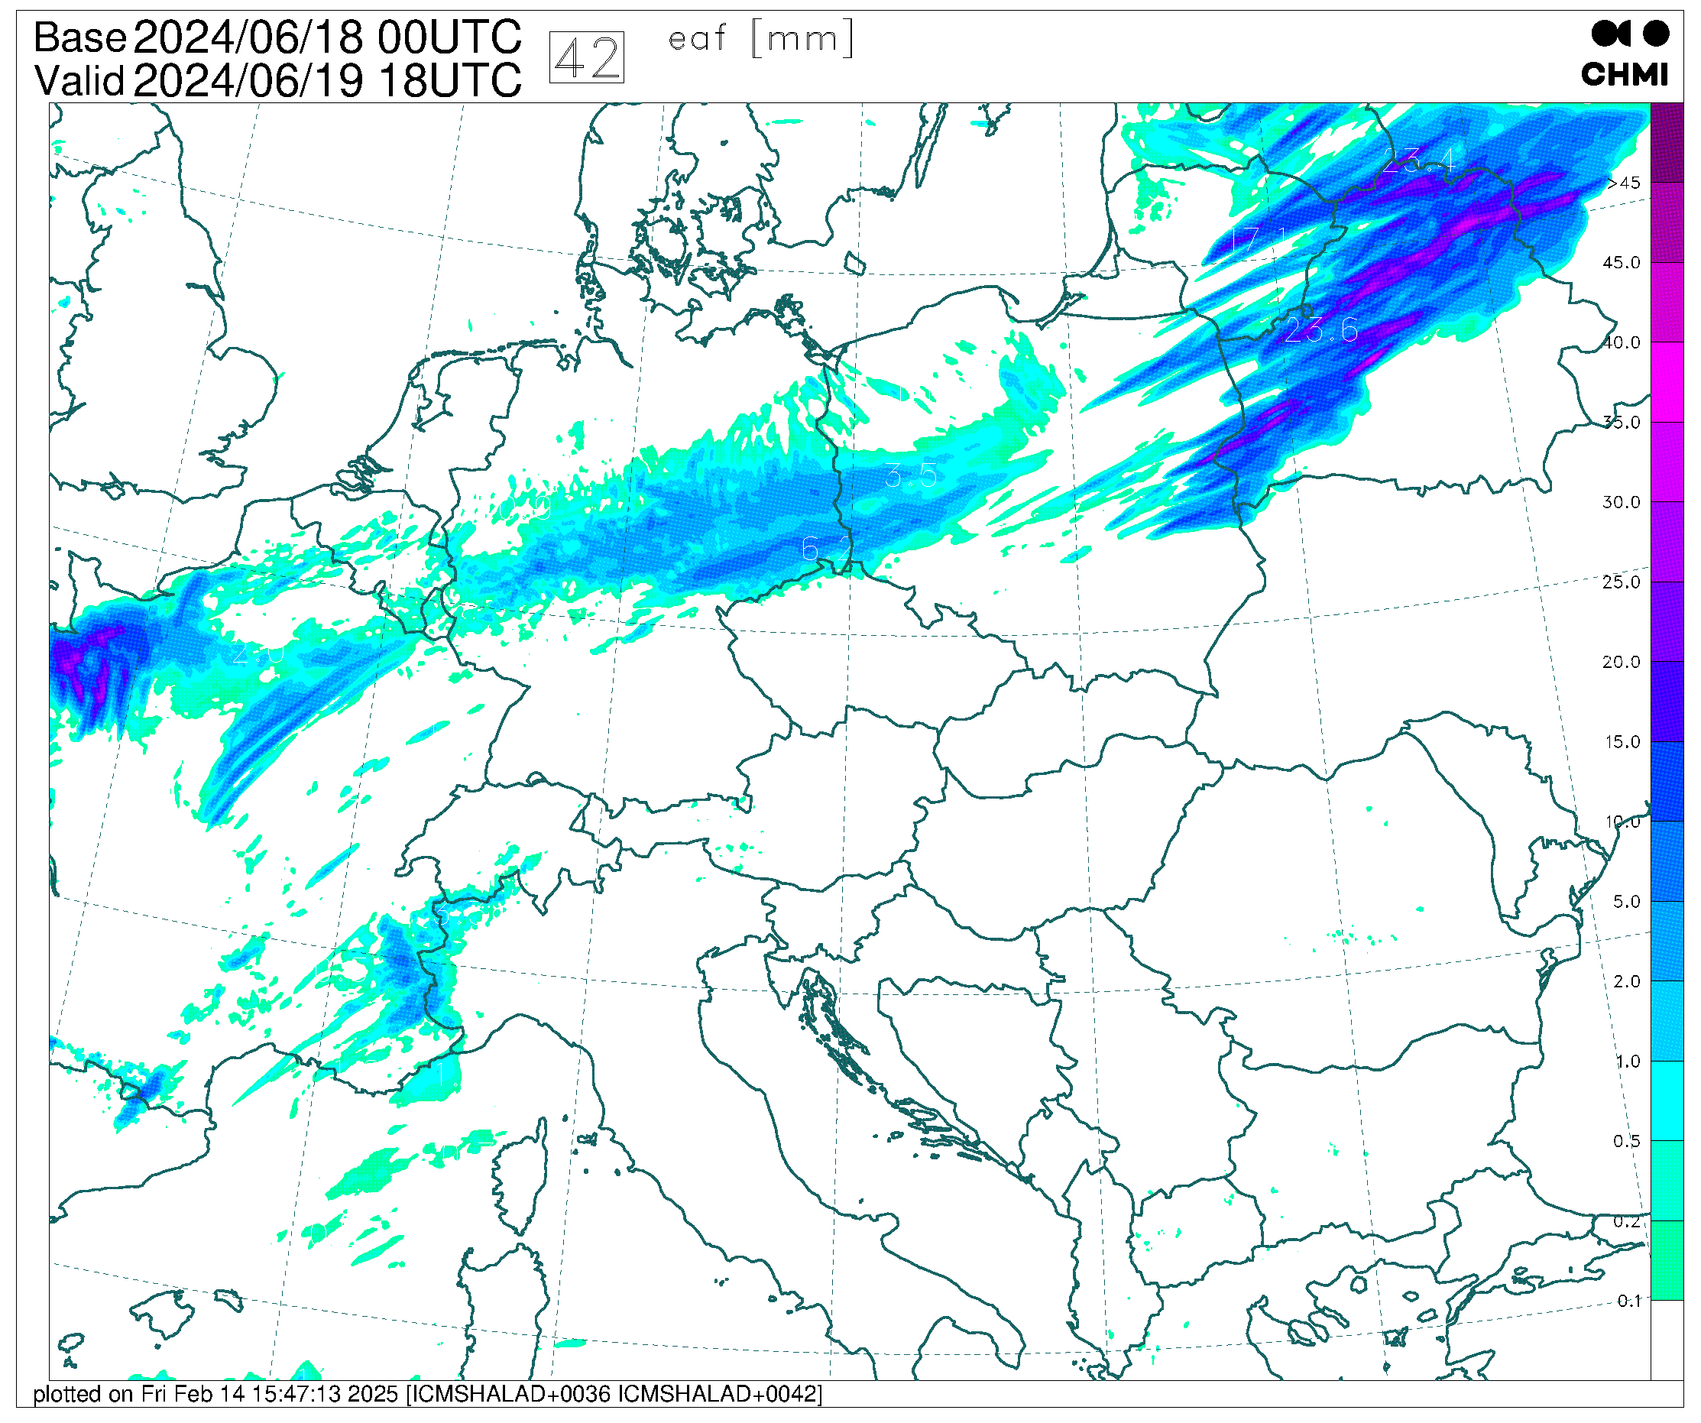
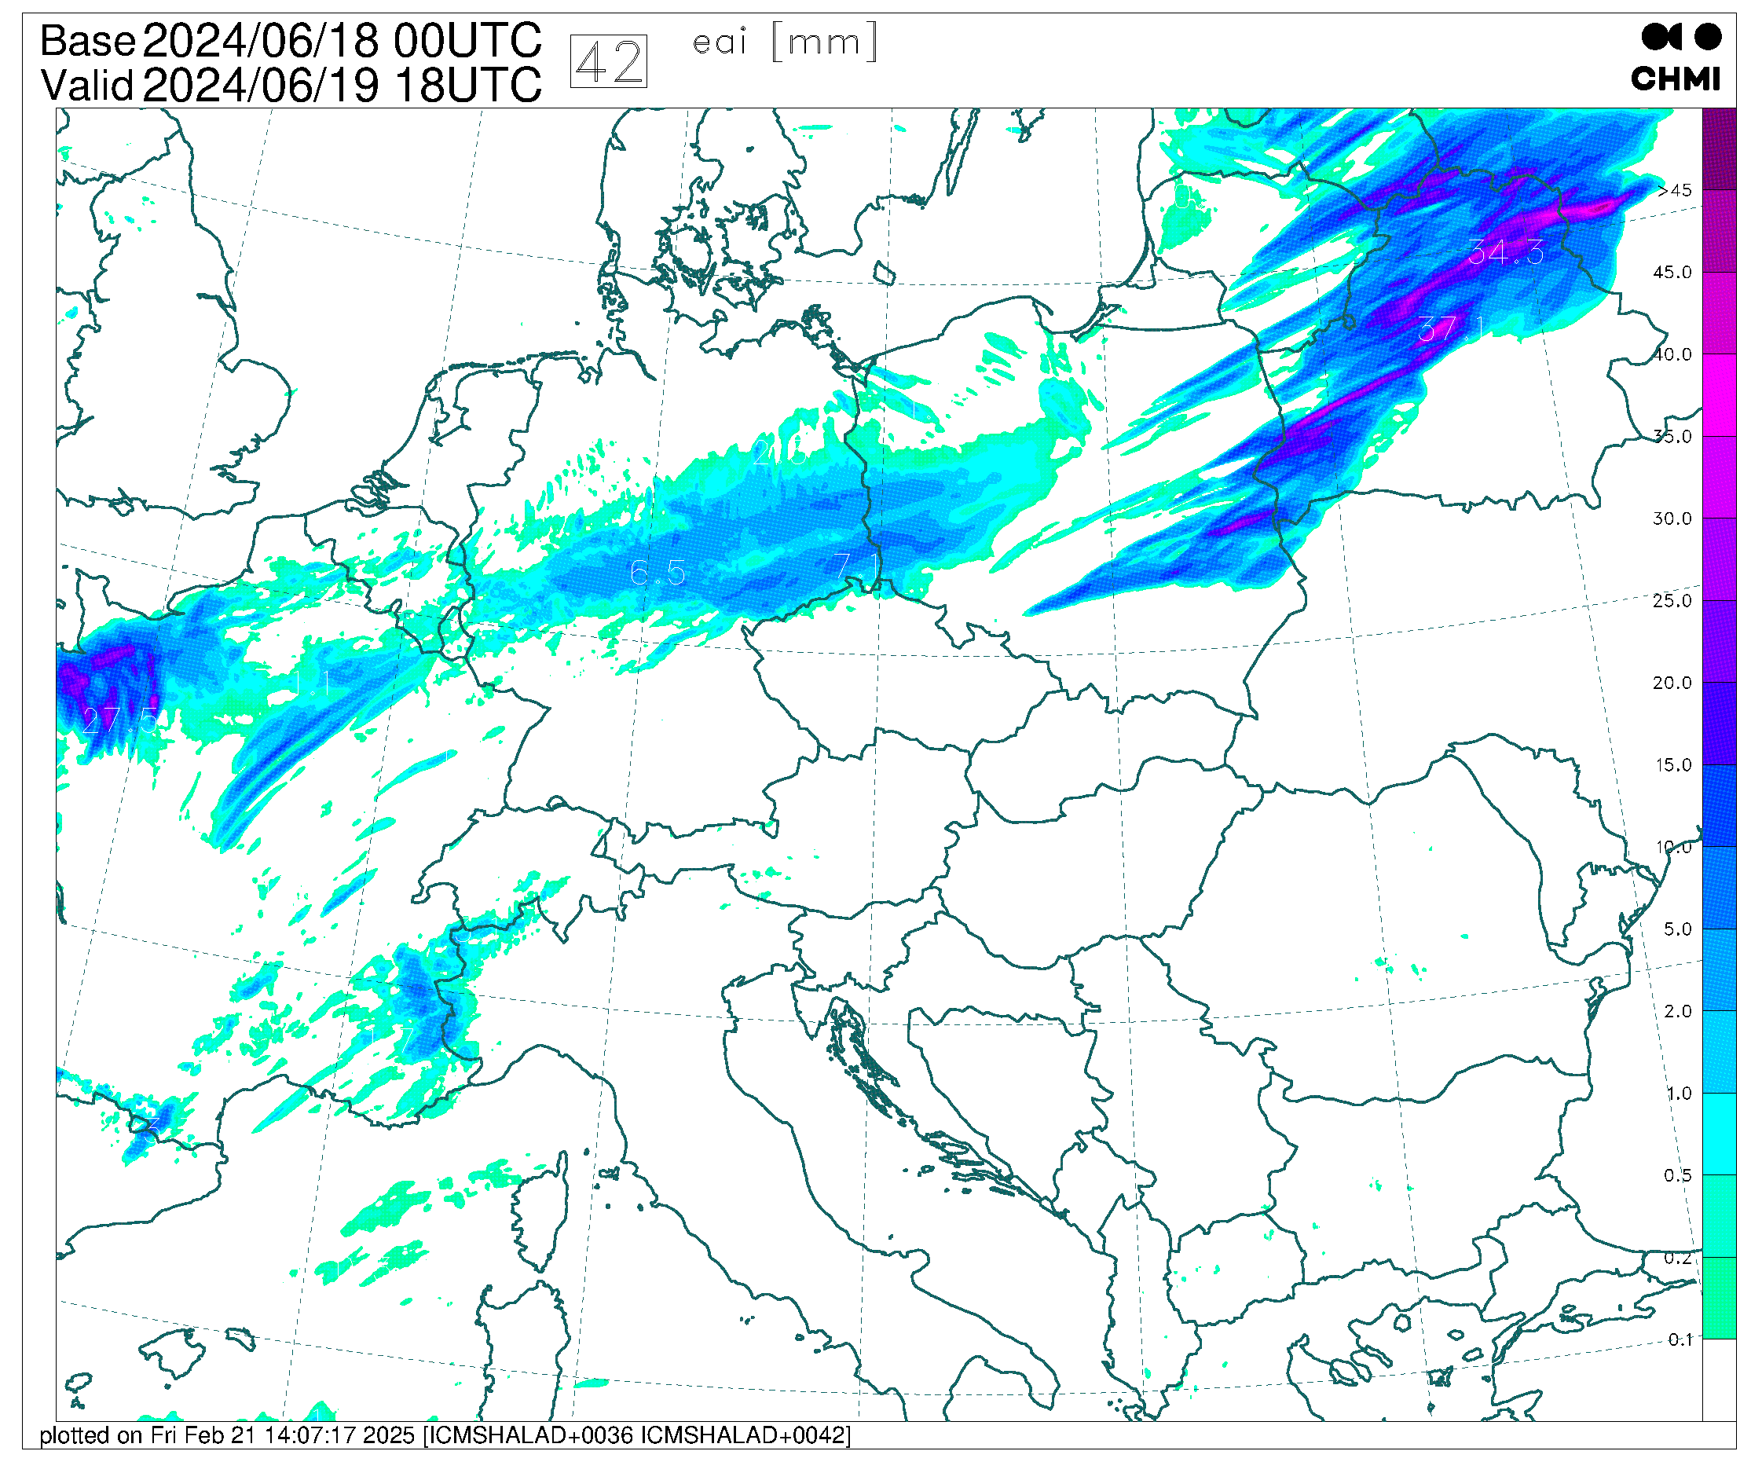
June period – precipitation
Moist deep convection response to the moisture transport – contribution to the closure. At the same time, there is less grid-scale condensation as well.
Precipitation 6h sum: reference EL1 EL1 & cutting less surface evap.

Slide 10
June period – some scores
In general, surface biases are better. There is more cloudiness and less precipitation.
However, standard deviation is worse for T2m, RH2m, V10m …, namely at hours of convective activity

Slide 11
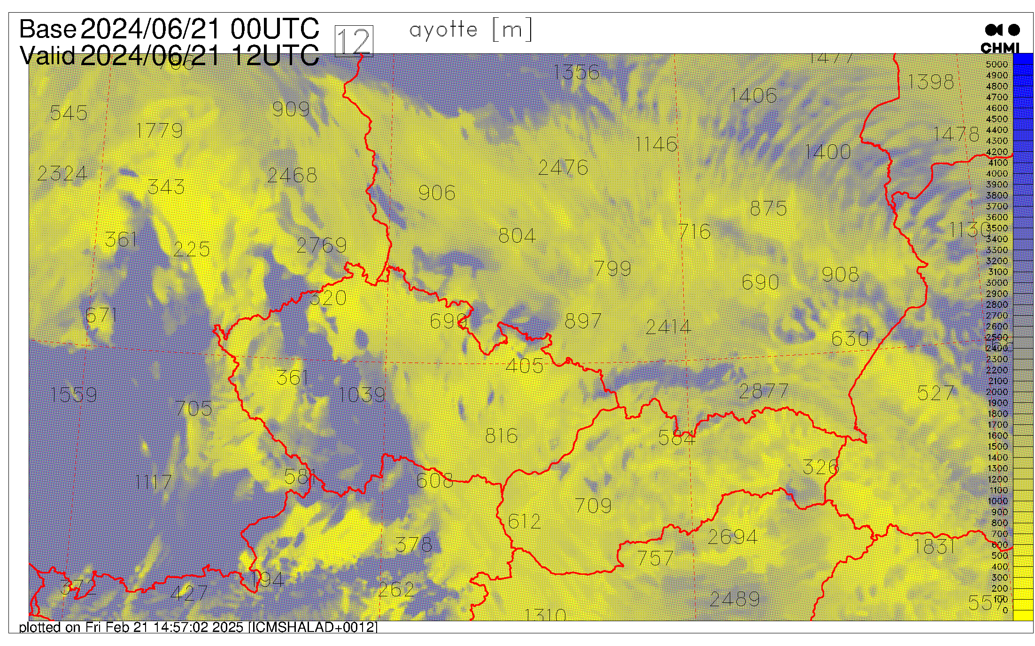
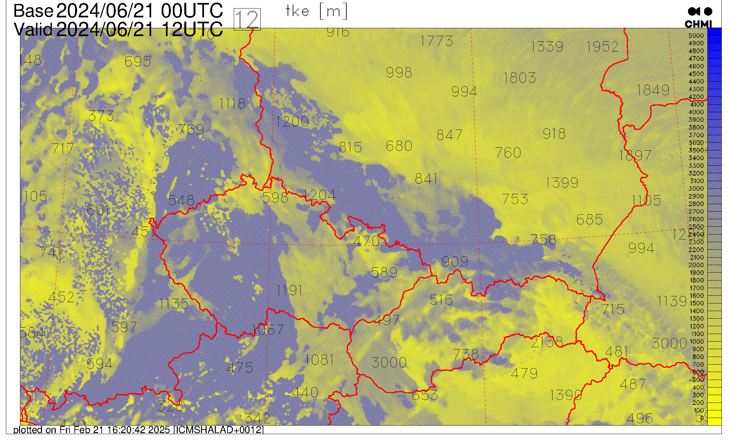
June period – some remarks (1)
The reason of worse STDEV is not known. One possibility could be that the TKE based PBL height is noisy … that could be hopefully addressed.

Slide 12
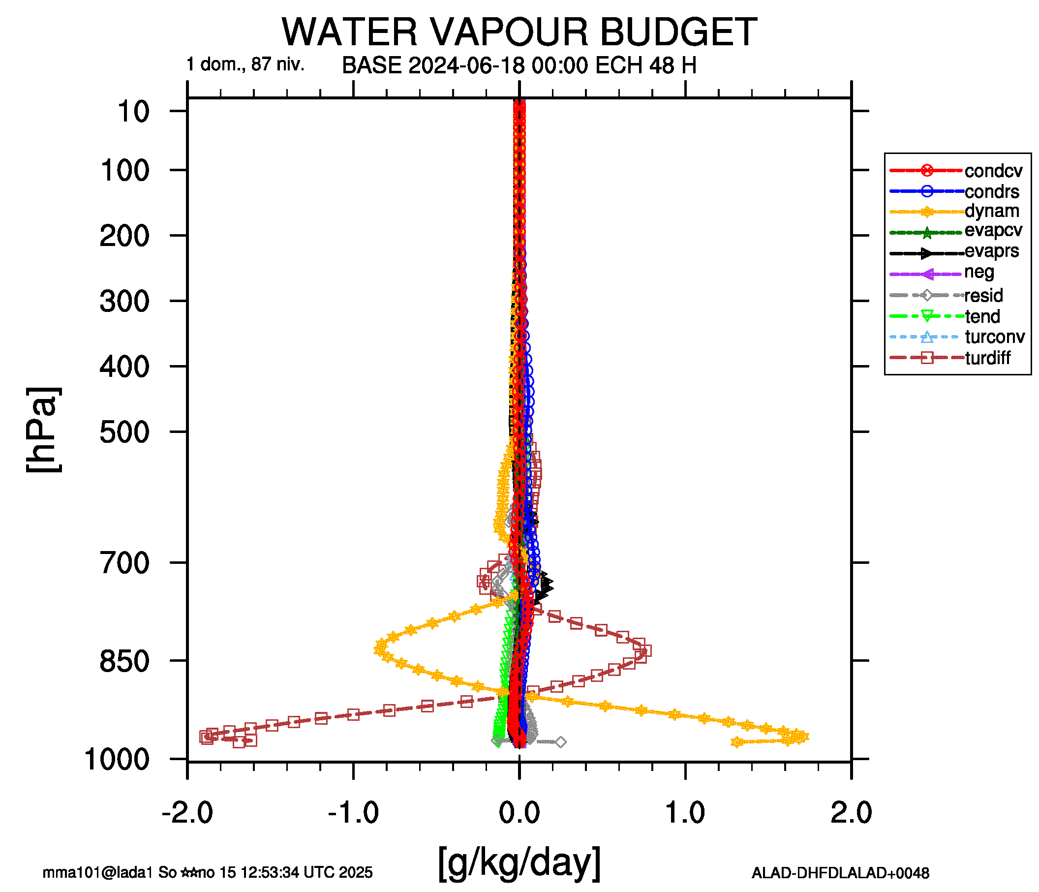
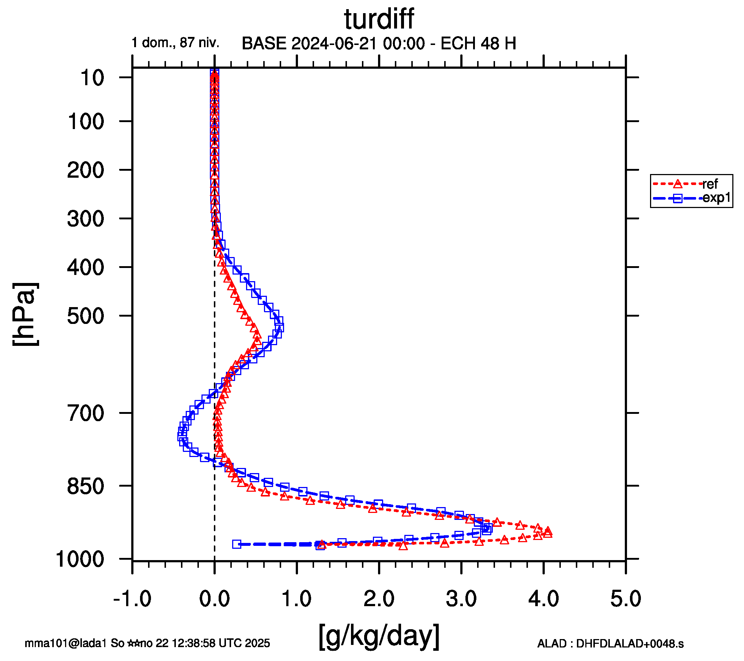
June period – some remarks (2)
It looks that EL1 dries too much levels closer to the surface. We need to do something with the transport – it dominates all the rest.
Multi-budget difference: reference minus EL1
Turbulence transport of QV: exp1 is the EL1

Slide 13
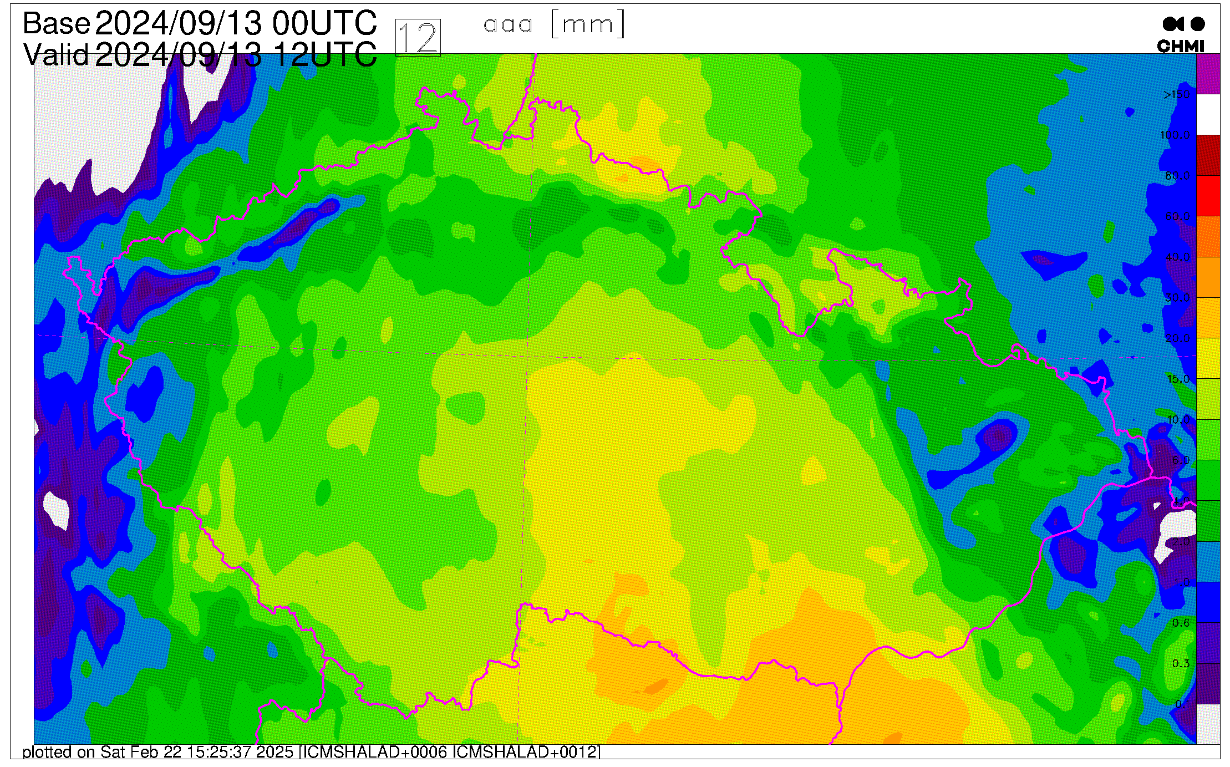
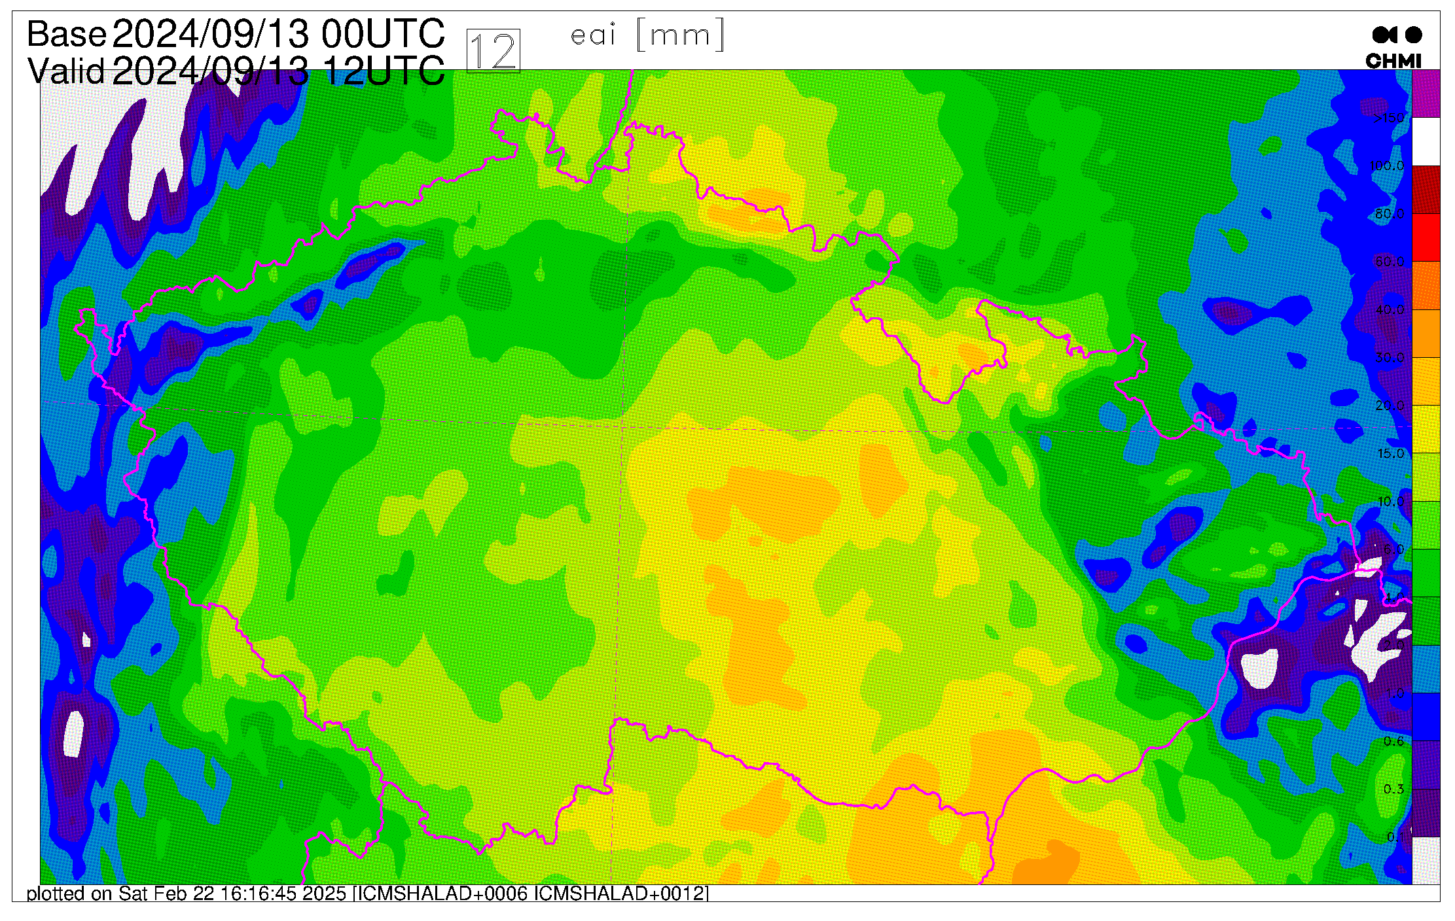
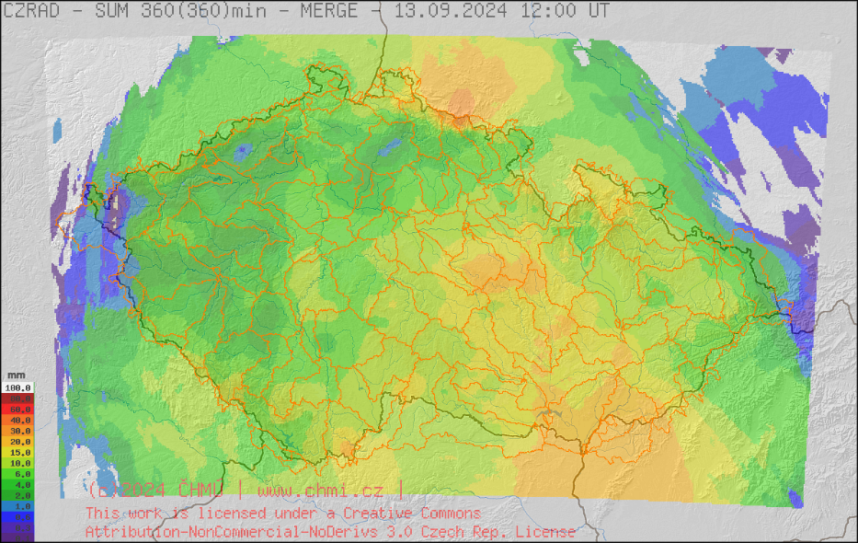
September period - precipitation
Just to check this period. Scores are rather OK, albeit there is T2m cold bias like in the spring period. Pointwise precipitation showed better STDEV, however this might hide other problem. This time it looks good.

Slide 14
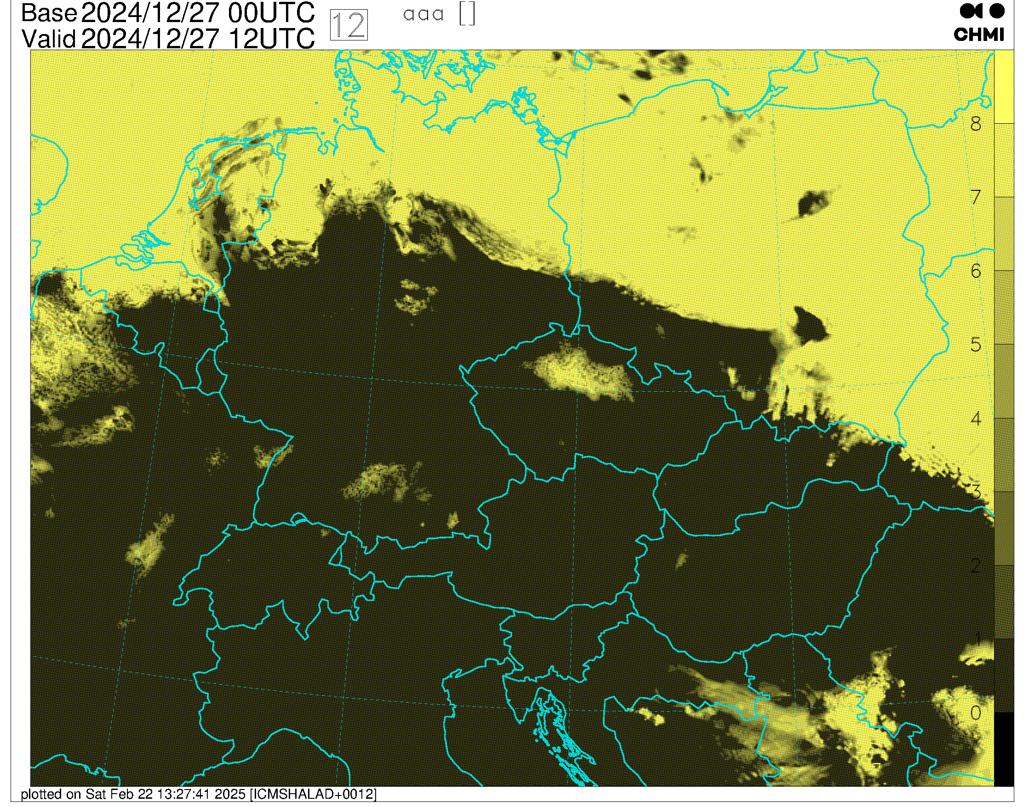
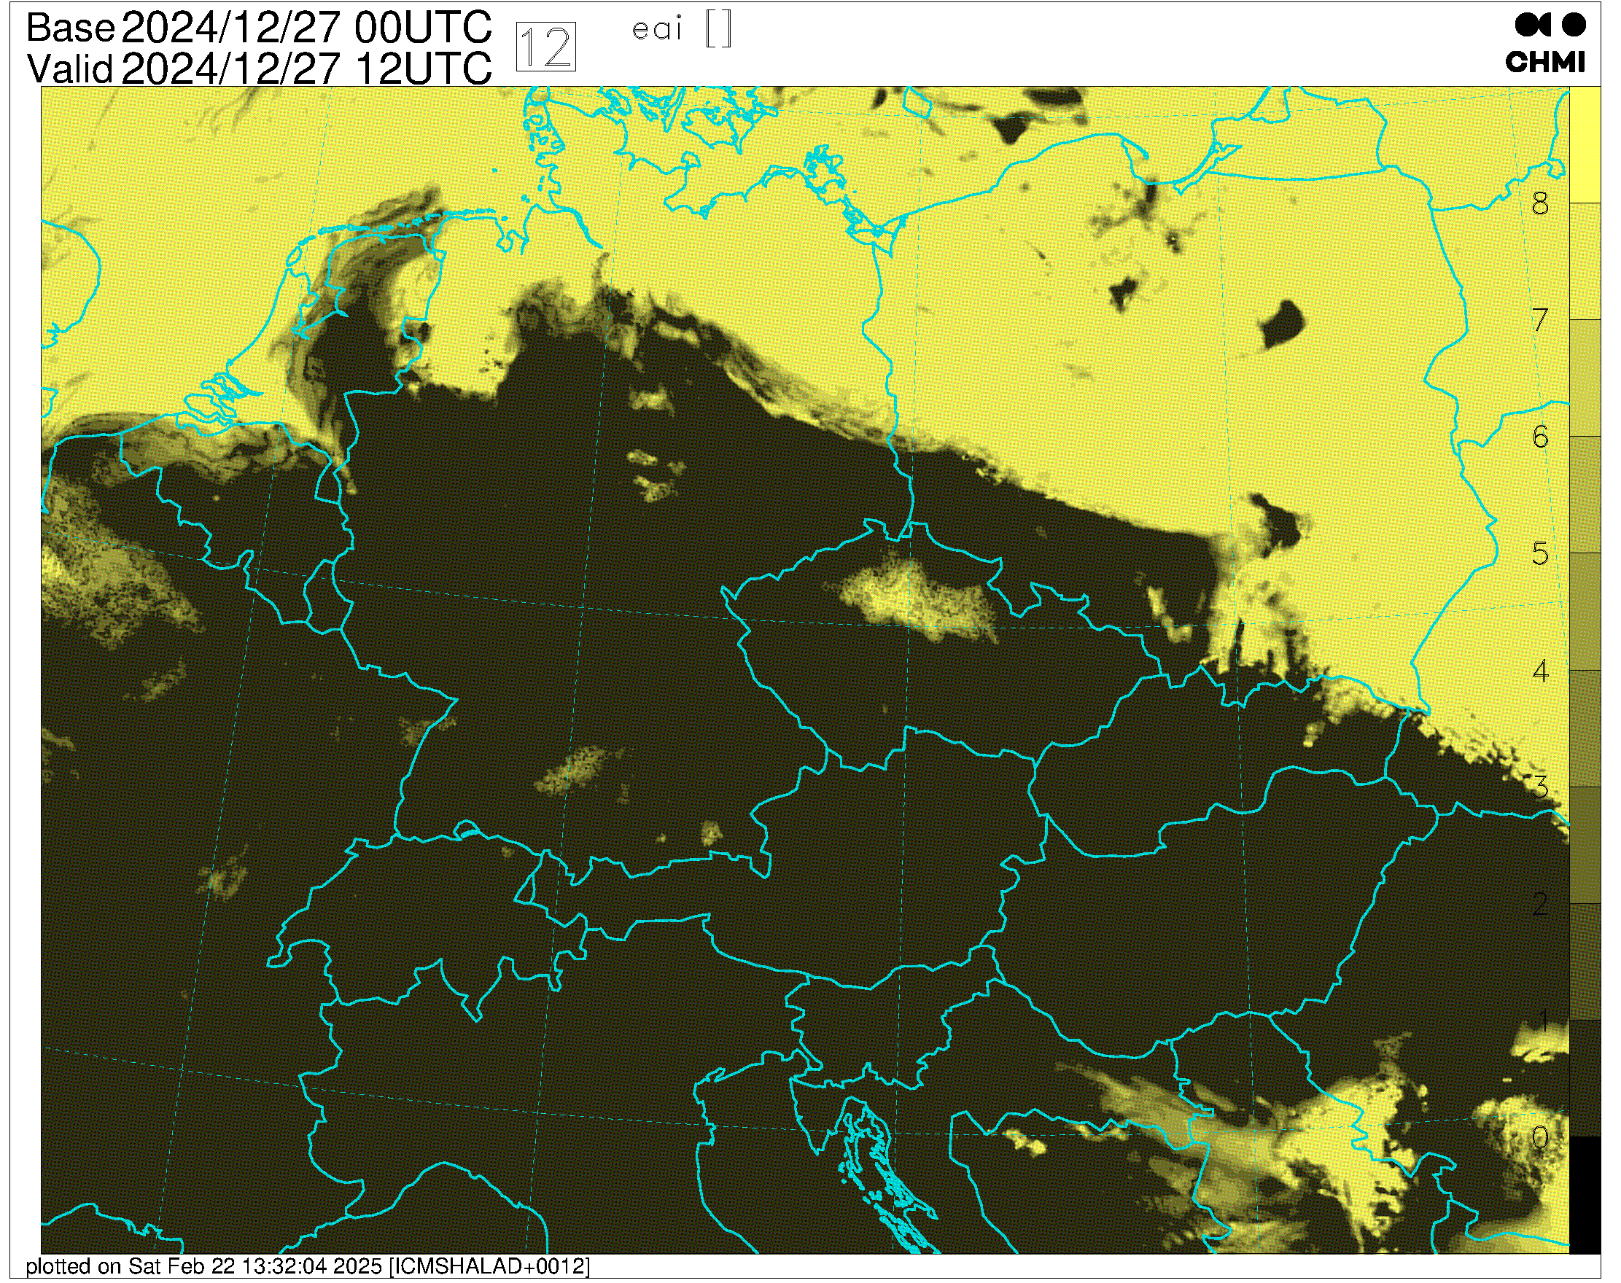
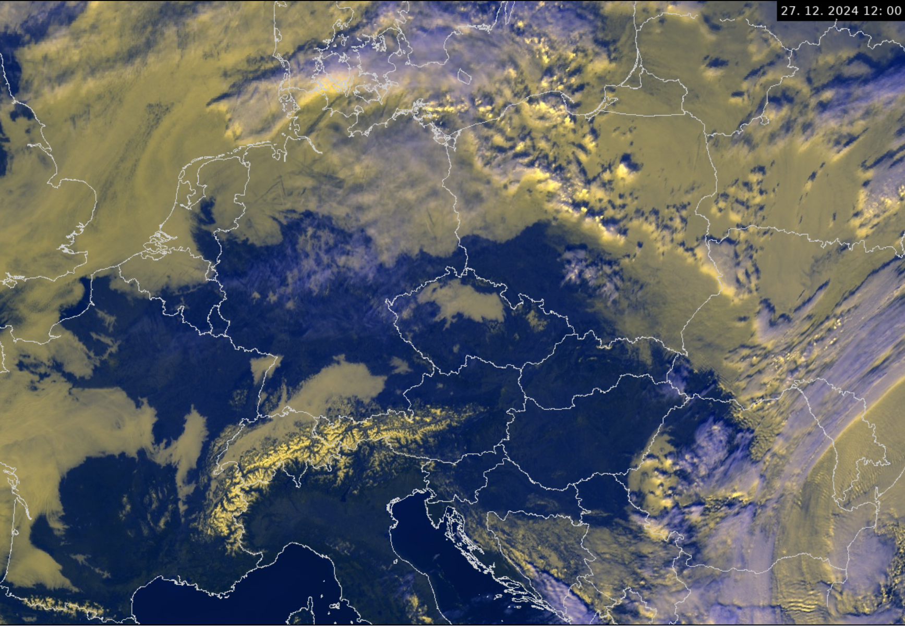
December period - fog
In the very stable conditions, like we had by the end of December 2024, the EL1 does not make better. It dissipates fog a bit more than the reference. More about this case in the talk on ALARO experiences.

Slide 15
Summary
Recently developed TKE based mixing length has a good potential to improve the model performance;
There are remaining issues namely linked to the moist deep convection regime:
Noisy PBL height;
Moisture transport – a possible feedback with the “shallow” calculation of the N profile …?
It does not help always – e.g. the fog.

Slide 16
Thank you for your attention
Radmila Brožková and Ján Mašek
jan.masek@chmi.cz, radmila.brozkova@chmi.cz

