Slide 1



Use of CAMS atmospheric aerosols in ALARO model
ACCORD project:PH6 Cloud-Aerosol-Radiation (CAR) interaction
Piotr Sekuła (IMGW-PIB), Jan Masek (CHMI)
Kraków
3-6.03.2025
ALARO Working Days

Slide 2
Outline
1. Current aerosols in radiation
2. CAMS aerosols in ACCORD system
General description
ACRANEB2 modifications
CAMS climatological aerosols
Vertical distribution of aerosols
Background aerosols
Aerosol inherent optical properties
GFL array definition
CAMS n.r.t aerosols
3. Results and verification
Case study – clear sky
Seasonal verification
4. Summary

Slide 3
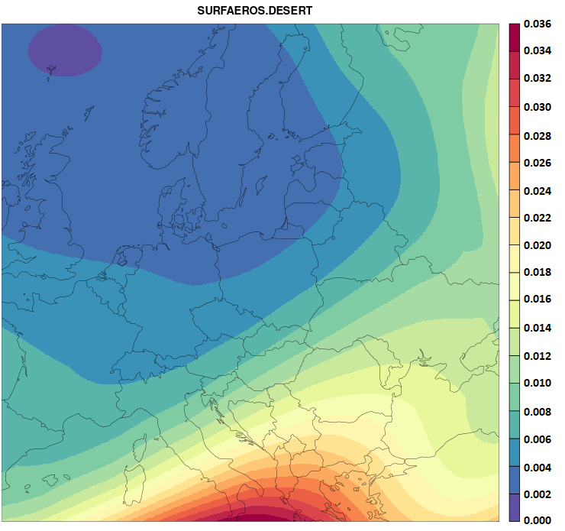
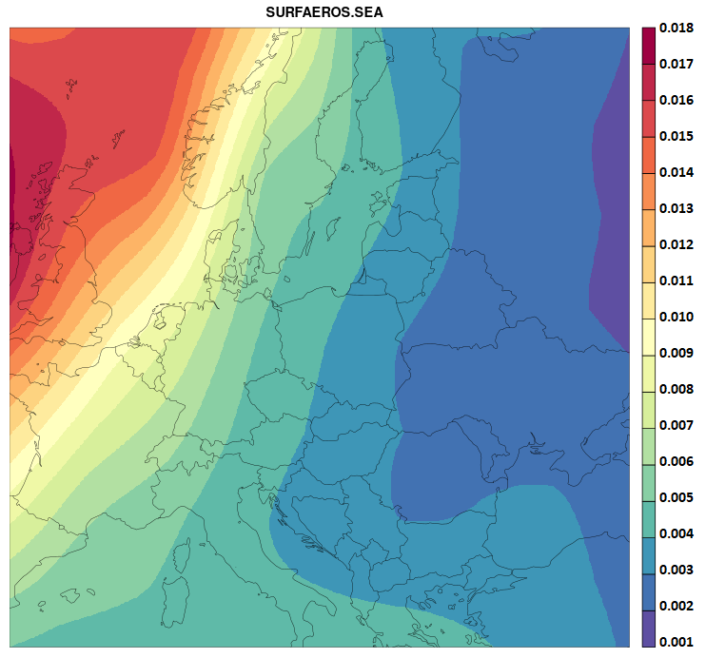

1. Current aerosols in radiation
Dust
Sea
Tegen climatology:
6 fields containing aerosol optical depth at 550nm (AOD550).
Each of them is activated or deactivated by its own key in the namelist &NAMPHY.
Three background variables (reduction of bias at clear sky)
  tropospheric
  stratospheric volcanic (ashes) and sulfuric type
Stratospheric species (sulfates and volcanic) – defined as constant background values.
Aerosol density in troposphere is assumed to be proportional to exp(-z/H)
Weight for vertical distribution at level l is equal to:
Table 1. Tegen aerosols description.
No. | Field name | Description | Location
1 | SURFAEROS.LAND | land | Tropospheric
2 | SURFAEROS.SEA | sea
3 | SURFAEROS.DESERT | dust
4 | SURFAEROS.SOOT | urban
5 | SURFAEROS.SULFAT | sulfates | Stratospheric
6 | SURFAEROS.VOLCAN | volcanic
$$ω_{l}=\exp\left(−\frac{z}{H}\right)= {(\frac{p}{p_{surf}})}^{\frac{H_{atm}}{H}}$$
z - height of the model level
H - height scale; H = 3km (dust ); H = 1km (sea, land and urban).
H_{atm} = 8434m – height scale of the standard atmosphere
p, p_{surf} – surface and level pressure

Slide 4
2. CAMS aerosols in ACCORD system
→ general description
The user can define which source of data they want to use:
2D CAMS climatological aerosols (maximum number of species 11),
3D n.r.t. CAMS aerosols (maximum number of species 42),
Combination of 2D climatological and 3D n.r.t. CAMS aerosols (maximum number of species 42).
The final code contains developments introduced by Jan Masek, Ana Sljivic, Laura Rontu, Daniel Martin and Piotr Sekuła:
reading 2D CAMS climatological aerosols
externalization of ACRANEB2 aerosols optical properties
conversion CAMS aerosol mass mixing ratios (MMRs) to aerosol optical properties
vertical distribution of 2D CAMS climatological aerosols
externalization of the effective radius of cloud liquid and cloud ice from ACRANEB2
Reading n.r.t. CAMS aerosols is available since CY46 (GFL array defined in namelist).
The modifications were first tested locally in CY46mp_op3aero and then they were submitted to CY50t1.

Slide 5
2. CAMS aerosols in ACCORD system
→ ACRANEB2 modifications
In the radiation routine ACRANEB2 four coefficients needed for solving the delta-two stream and adding system α₁, α₂, α₃ and α₄ are diagnosed.
Originally, they were calculated from aerosol optical depth at 550 nm (PDAER) of the six Tegen aerosols.
The updated ACRANEB2 instead uses these delta-unscaled quantities:
  aerosol optical depth δ (PAERDEL),
  asymmetry factor g (PAERASM)
  single scattering albedo ω (PAERSSA) of the mixture.
More details are included in the reports:
Ana Sljivic and Jan Masek (2021). Interfacing near real-time aerosols with radiation schemes
https://www.rclace.eu/media/files/Physics/2021/aerosols_report_2021_1_.pdf
Ana Sljivic and Jan Masek (2022). Interfacing near real-time aerosols with radiation schemes.
https://www.rclace.eu/media/files/Physics/2022/AS22P_aerosols_report_final.pdf

Slide 6
2. CAMS aerosols in ACCORD system
→ ACRANEB2 modifications
In the updated version of ACRANEB2, PAERDEL, PAERASM and PAERSSA are calculated from MMRs
and inherent optical properties for each aerosol type and each RRTM spectral interval
(14 in the shortwave and 16 in the longwave part) from the NetCDF file.
The inherent optical properties are read from the NetCDF during setup.
From spectrally averaged optical properties and MMRs,
optical properties of aerosol in each target spectral interval are calculated.
To keep the possibility of using Tegen aerosols, the temporary subroutine converts PDAER to PAERDEL, PAERASM and PAERSSA.
Through the namelist the user can modify spectral weights given to input spectra intervals (four variables).
→They are not needed to modify!
&NAMAERO
RAERO_WEIGHT_SW | default set in SUAERO (no need to modify) | SW spectral weights for 14 input RRTM bands.
RAERO_WEIGHT_LW | default set in SUAERO (no need to modify) | LW spectral weights for 16 input RRTM bands.
RAERO_MASK_SW | default set in SUAERO (no need to modify) | Masks defining portions of input RRTM bands falling to output SW bands.
RAERO_MASK_LW | default set in SUAERO (no need to modify) | Masks defining portions of input RRTM bands falling to output LW bands.

Slide 7
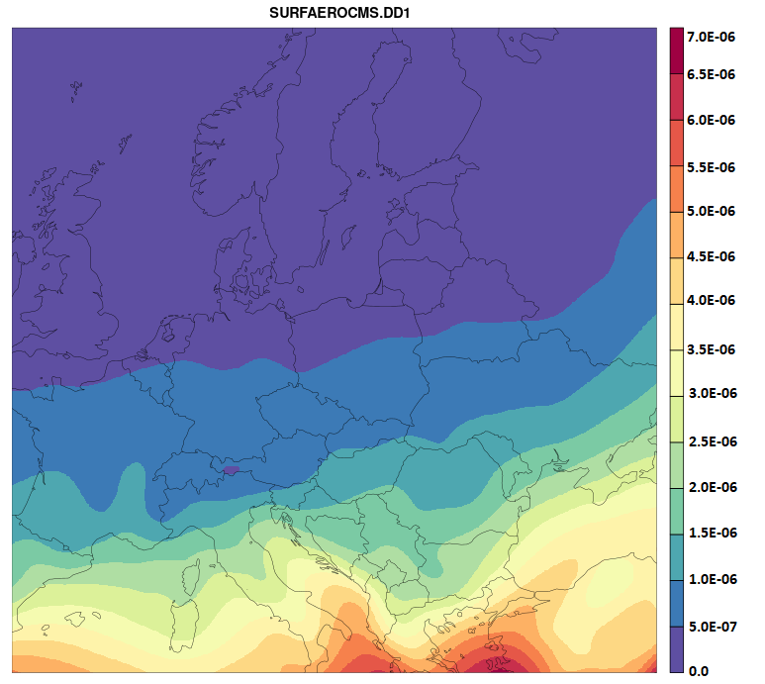
2. CAMS aerosols in ACCORD system
→ climatological and n.r.t. data
Small desert dust [kg/m²]
Dust - Tegen climatology (AOD550)
The user can define which source of data they want to use:
2D CAMS climatological aerosols (number of species 11),
3D n.r.t. CAMS aerosols (maximum number of species 42),
Combination of 2D climatological and 3D n.r.t. CAMS aerosols (maximum number of species 42).
Two logic keys are defined in &NAMPHY for using CAMS aerosols database.
CAMS aerosols (2D climatological and 3D n.r.t.) during the integration are stored in 3D GFL array described by the user in the namelist &NAMGFL
Table 2. Selected CAMS aerosols description.
No. | Field name | Description | MAP_AERO_GFL2NC value
1 | SURFAEROCMS.SS1 | sea salt, small | -1
2 | SURFAEROCMS.SS2 | sea salt, medium | -2
3 | SURFAEROCMS.SS3 | sea salt, large | -3
4 | SURFAEROCMS.DD1 | desert dust, small | 1
5 | SURFAEROCMS.DD2 | desert dust, medium | 2
6 | SURFAEROCMS.DD3 | desert dust, large | 3
7 | SURFAEROCMS.OM1 | organic matter, hydrophilic | -4
8 | SURFAEROCMS.OM2 | organic matter, hydrophobic | 10
9 | SURFAEROCMS.BC1 | black carbon, hydrophilic | 11
10 | SURFAEROCMS.BC2 | black carbon, hydrophobic | 11
11 | SURFAEROCMS.SU | sulfates | -5
12 | NITRATE1 | fine mode Nitrate | -9
13 | NITRATE2 | coarse mode Nitrate | -10
14 | AMMONIUM | ammonium | -8
&NAMPHY
LAEROMMR3D | .FALSE. | Main key activating use of aerosol MMRs in the model physics, implemented via GFL fields. These can be filled by climatological aerosols, n.r.t. aerosols (CAMS, MOCAGE), or their combination.
LAEROMASS2D | .FALSE. | Complementary key activating reading of vertically integrated mass of 11 climatological aerosols from initial file; some or all of them can be used by model.
The Tegen and CAMS aerosol species cannot be used together!

Slide 8
2. CAMS aerosols in ACCORD system
→ climatological data
Preparation of initial file with CAMS climatological aerosols taken from Climate File
Tegen climate aerosols | CAMS climate aerosols
&NAMPHY LAERODES=.T., LAEROLAN=.T., LAEROSEA=.T., LAEROSOO=.T., &NAMFPC NFPCLI=3, CFPPHY= 'SURFAEROS.SEA ', 'SURFAEROS.LAND ', 'SURFAEROS.SOOT ', 'SURFAEROS.DESERT', | &NAMPHY LAERODES=.F., LAEROLAN=.F., LAEROSEA=.F., LAEROSOO=.F., &NAMFPC NFPCLI=3, LCLIMAEROCMS=.T., LCLIMAEROSOL =.F., CFPPHY= 'SURFAEROCMS.DD1', 'SURFAEROCMS.DD2', 'SURFAEROCMS.DD3', 'SURFAEROCMS.SS1', 'SURFAEROCMS.SS2', 'SURFAEROCMS.SS3', 'SURFAEROCMS.OM1', 'SURFAEROCMS.OM2', 'SURFAEROCMS.BC1', 'SURFAEROCMS.BC2', 'SURFAEROCMS.SU',
LCLIMAEROSOL=.FALSE. ! Read Tegen climate aerosols from climate file - default value is TRUE
LCLIMAEROCMS=.TRUE. ! New key
! Read 2D CAMS climate aerosols from climate file - default value is FALSE
NFPCLI=3, ! Option 3 means that you copy field from a climate file without interpolation
User can keep Tegen and CAMS climate aerosols in the initial file, during the integration describes which of them will be used.

Slide 9

2. CAMS aerosols in ACCORD system
→ climatological fields
CAMS climatology:
vertically integrated mass per unit area of 11 aerosol species [kg/m²]
Vertical distribution of aerosols is defined by gamma distribution – two parameters to modify H and β
  Exponential distribution β = 1
  Default values for height scales:
    1000m for sea salt and black carbon
    2000m for organic matter
    3000m for dust
    4000m for sulfate.
The CAMS 2D climatological aerosols which are taken from Climate File are mapped then to the GFL array in variable MAP_AERO_CMS2GFL.
  The user can define which of them will be used in the namelist
  (0 – aerosol not used).
The order of 2D CAMS climatological aerosol types is hardcoded (Table 2.).
Optical properties are read from the NetCDF file (variable CFAERO)
  User must properly define their properties (variable MAP_AERO_GFL2NC )
Vertical mass mixing ratio distribution of 11 aerosol types, based on CAMS 3D climatology. Values were normalized with their surface value. [1]
$ω_{l}={\left(−lnσ_{l}\right)}^{β−1}{σ_{l}}^{\frac{H_{atm}}{H}}$ $σ_{l}=\frac{p_{l}}{p_{surf}}$
&NAMAERO
RAERO_HEIGHT_SCALE=1000.0, 1000.0, 1000.0,3000.0, 3000.0, 3000.0,2000.0, 2000.0,1000.0, 1000.0,4000.0,
RAERO_GAMMA_EXP=1,1,1, 1,1,1,1,1,1,1,1,
MAP_AERO_GFL2NC=-1,-2,-3,1,2,3,-4,10,11,11,-5,
MAP_AERO_CMS2GFL=1,2,3,4,5,6,7,8,9,10,11,
CFAERO= 'aerosol_optics.nc'
ω_{l} - weight for vertical distribution at level l
H - height scale
H_{atm} = 8434m
p, p_{surf} – surface pressure and pressure at level l

Slide 10
2. CAMS aerosols in ACCORD system
→ vertical distribution
a) January
CAMS climatology:
Vertical distribution for some aerosol types don’t have maximum at the surface but near the Planetary Boundary Layer top.
Parameter β can be very seasonally and based on type dependent (default value in the code is 1).
Table 3. Parameter β estimated from CAMS 3D climatology (20-year averaged fields (2003-2022) over Europe). Empty fields mean that the distribution is exponential (β=1).[1]
b) June
 | Period
 | 1 | 2 | 3 | 4 | 5 | 6 | 7 | 8 | 9 | 10 | 11 | 12 | Yearly
SS1 |  |  |  |  | 1.5 | 1.5
SS2 |  |  |  |  | 1.5 | 1.5
SS3
DD1 |  | 1.5 | 1.5 | 1.5 | 2 | 1.7 | 2 | 1.7 | 2 | 1.7 | 1.7 | 1.5
DD2 | 1.3 | 1.5 | 1.5 | 1.5 | 2 | 1.7 | 2 | 1.7 | 2 | 1.7 | 1.7 | 1.5 | 1.3
DD3 | 1.3 | 1.5 | 1.5 | 1.5 | 2 | 1.7 | 1.7 | 1.7 | 1.7 | 1.7 | 1.5 | 1.5 | 1.3
OM1
OM2
BC1 |  |  |  |  |  | 1.5
BC2
SU |  |  | 1.1 | 1.1 | 1.1 | 1.1 | 1.1 | 1.1 | 1.1
Vertical mass mixing ratio distribution of 11 aerosol types, based on CAMS 3D climatology. Values were normalized with their surface value. [1]
Notes: Impact of gamma distribution is small, so default values for β exponents are set to 1.

Slide 11
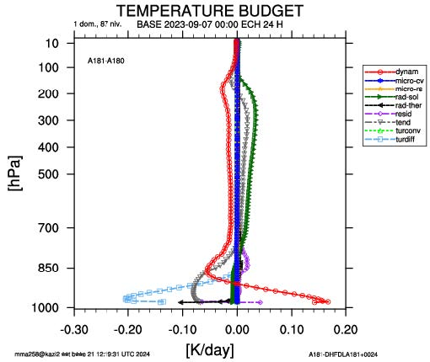
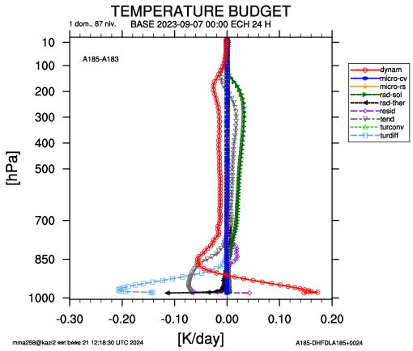
2. CAMS aerosols in ACCORD system
→ background aerosols
a) Tegen troposphere
For Tegen climatology we use three background values.
In CAMS climatology two background values are introduced:
  tropospheric & stratospheric
Tropospheric (Tegen #1) and stratospheric (Tegen #5) backgrounds from Tegen were added to hydrophobic organic matter (two namelist variables):
  RBGST_MMR_OM2
  RBGTR_MMR_OM2
User must specify the location of hydrophobic organic matter in GFL structure - NUMGFL_AERO_OM2
(for CAMS climatological – field No. 8) or set those two variables to 0
Background values for CAMS were scaled in such way to have the similar the impact on shortwave radiation as in the Tegen case [1]
b) CAMS troposphere
&NAMAERO
NUMGFL_AERO_OM2 | 0 | REQUIRED: Position of hydrophobic organic matter in the GFL array when using CAMS aerosols. Not needed when RBGST_MMR_OM2 and RBGTR_MMR_OM2 to 0. For using only CAMS climatological aerosols NUMGFL_AERO_OM2 is equal to 8.
RBGST_MMR_OM2 | 4.50E-10 | Unit: kg/kg, equivalent of Tegen #5 background stratospheric AOD@550=0.007
RBGTR_MMR_OM2 | 1.65E-09 | Unit: kg/kg, equivalent of Tegen #1 background tropospheric AOD@550=0.0534
Horizontally averaged change in temperature tendency due to the presence of background values of 24-hour temperature budget for clear sky case 07/09/2023.

Slide 12
2. CAMS aerosols in ACCORD system
→ background aerosols
In CAMS data, no stratospheric volcanic aerosols are provided.
Stratospheric volcanic aerosols (Tegen #6) can be prescribed, but only as total AOD550 (FA field SURFAEROS.VOLCAN)
Stratospheric aerosol has similar properties as CAMS sulfates → they can be added to this field (LAEROVOL=.TRUE.)
  possible conversion from AOD550 to vertically integrated mass by using
  mass extinction coefficient at 550nm – variable REXT550_SU
In the case of CAMS 2D climatology - sulfates are always at the position 11 (variable NUMGFL_AERO_SU in the namelist).
For CAMS 3D case, user must know the position of sulfates in GFL structure
Overview of the fields added to existing aerosol types for Tegen and CAMS cases [1].
&NAMAERO
REXT550_SU | 6000 | Unit: m^2/kg, tuned mass extinction coefficient at 550nm of stratospheric volcanic aerosols
NUMGFL_AERO_SU | 0 | GFL position of sulfate required when LAEROVOL=.TRUE. and Tegen field SURFAEROS.VOLCAN in the initial file.
Case | LAEROVOL=.T. | LAEROVOL=.F. | added to field
Tegen | SURFAEROS.VOLCAN | STBKG = 0.0045_JPRB (default) | Tegen #6
CAMS 2D / 3D | SURFAEROS.VOLCAN | 0 | #NUMGFL_AERO_SU

Slide 13
2. CAMS aerosols in ACCORD system
→ aerosol inherent optical properties
&NAMAERO
MAP_AERO_GFL2NC=-1,-2,-3,1,2,3,-4,10,11,11,-5, | Defines aerosol inherent optical properties (IOPs) used in radiation read from NetCDF file. The index is order in GFL array. The value order in the NetCDF file: Positive value – hydrophobic; Negative value - hydrophilic aerosols; Zero – aerosol not used. The size of the array must be consistent with NAERO variable (GFL array attributes).
NETCDF FILE
Description hydrophobic
1: Desert dust, bin 1, 0.03-0.55 micron, (SW) Dubovik et al. 2002 (LW) Fouquart et al. 1987,
2: Desert dust, bin 2, 0.55-0.90 micron, (SW) Dubovik et al. 2002 (LW) Fouquart et al. 1987,
3: Desert dust, bin 3, 0.90-20.0 micron, (SW) Dubovik et al. 2002 (LW) Fouquart et al. 1987,
4: Desert dust, bin 1, 0.03-0.55 micron, Fouquart et al 1987,
5: Desert dust, bin 2, 0.55-0.90 micron, Fouquart et al 1987,
6: Desert dust, bin 3, 0.90-20.0 micron, Fouquart et al 1987,
7: Desert dust, bin 1, 0.03-0.55 micron, Woodward 2001, Table 2,
8: Desert dust, bin 2, 0.55-0.90 micron, Woodward 2001, Table 2,
9: Desert dust, bin 3, 0.90-20.0 micron, Woodward 2001, Table 2,
10: Hydrophobic organic matter, OPAC (hydrophilic at RH=20%),
11: Black carbon, OPAC,
12: Black carbon, Bond and Bergstrom 2006,
13: Black carbon, Stier et al 2007,
14: Stratospheric sulfate (hydrophilic ammonium sulfate at RH 20%-30%),
Description hydrophilic
1: Sea salt, bin 1, 0.03-0.5 micron, OPAC,
2: Sea salt, bin 2, 0.50-5.0 micron, OPAC,
3: Sea salt, bin 3, 5.0-20.0 micron, OPAC,
4: Hydrophilic organic matter, OPAC,
5: Ammonium sulfate (for sulfate), GACP Lacis et al https://gacp.giss.nasa.gov/data_sets/ ,
6: Secondary organic aerosol - biogenic, Moise et al 2015,
7: Secondary organic aerosol - anthropogenic, Moise et al 2015,
8: Fine mode Ammonium sulfate (for ammonia), GACP Lacis et al
9: Fine mode Nitrate, GLOMAP,
10: Coarse mode Nitrate, GLOMAP,

Slide 14
2. CAMS aerosols in ACCORD system
→ GFL array definition
Description of the first aerosol type is given (all used aerosol types must be declared in &NAMGFL)
&NAMGFL |  | CAMS n.r.t.
NAERO=11, | Number of GFL aerosol fields; this variable must be consistent with variable MAP_AERO_GFL2NC in &NAMERO
YAERO_NL(1)%CNAME='SEA.SALT1', | Name of field in the initial FA file | Important for CAMS n.r.t. reading
YAERO_NL(1)%LADV=.F., | Advection off | Switch on only for CAMS n.r.t.
YAERO_NL(1)%LINTLIN=.T., | Use linear interpolator (non-overshooting, cheaper) | Set to TRUE on only for CAMS n.r.t.
YAERO_NL(1)%LPC=.T., | Attribute for predictor-corrector scheme | Important for CAMS n.r.t. reading
YAERO_NL(1)%LGP=.T., | Determines if field is defined in grid point space
YAERO_NL(1)%LSP=.F., | Determines if field is defined in spectral space. LSP and LGP cannot be both TRUE!
YAERO_NL(1)%LREQOUT=.T., | Save field to the output file
YAERO_NL(1)%NREQIN=0, | Initialize field to zero | Set to 1 on only for reading CAMS n.r.t.
YAERO_NL(1)%NCOUPLING=0, | Coupling off | Set to 1 on only for reading CAMS n.r.t.
 | …
YAERO_NL(11)%NREQIN=0,
YAERO_NL(11)%NCOUPLING=0,

Slide 15
2. CAMS aerosols in ACCORD system → CAMS n.r.t aerosols
CAMS n.r.t aerosols:
Maximum possible size of GFL array is 42
The user must define aerosol optical properties, in the NetCDF file are defined 24 aerosol species
During the tests 14 aerosol species were used (Table 2) – mass mixing ratio of aerosols on model levels
Aerosol fields must be included in initial file and optionally in the coupling files
Possible advection and coupling of the aerosols – deposition (dry and wet) not yet available in ALARO model !
Possible combination of CAMS n.r.t and climatological aerosols.
How to prepare initial and coupling files (only for tests) [2]:
Extract GRIB files from MARS using request
Convert GRIB to FA format using GL tool (available on belenos)
. /home/gmap/mrpm/seity/gl/config/setenv.belenos
The conversion script is:
/home/gmap/mrpm/masekj/cams_mmr/run_cams_grib2fa
Notes:
GL needs also GRIB file with CAMS orography in order to make vertical interpolations,
and the climate file to determine target FA geometry and orography.

Slide 16
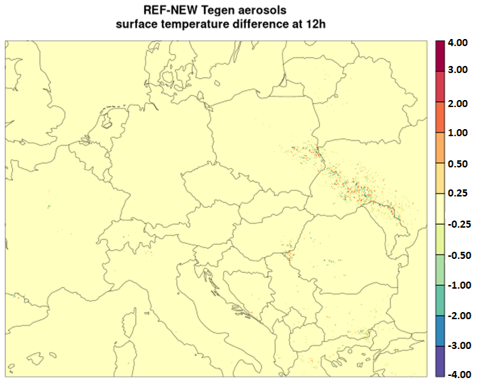
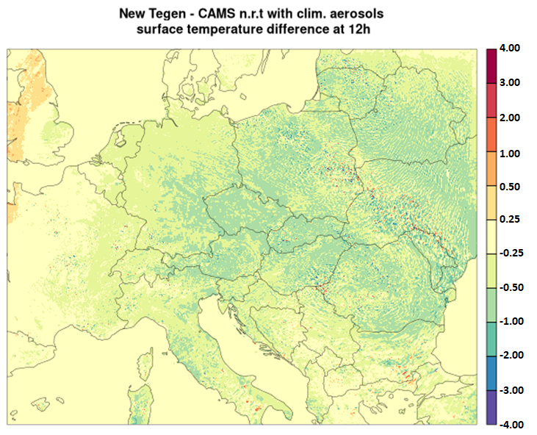
3. Results and verification
→ case study – 7 Sep. 2024
Test | Reference | Notes
ALARO without any aerosols | ALARO without any aerosols (no modifications) | Results are identical
ALARO with Tegen aerosols | ALARO with Tegen aerosols (no modifications) | Small differences related to conversion of aerosol optical depth at 550.
ALARO with climatological CAMS aerosols | ALARO with Tegen aerosols (with modifications) | Warmer surface temperature for ALARO with CAMS by 0.5-1°C
ALARO with nr.t. CAMS aerosols | ALARO with Tegen aerosols (with modifications) | Warmer surface temperature for ALARO with CAMS by 0.5-1°C
ALARO with nr.t. CAMS (only dust species) and climatological aerosols | ALARO with Tegen aerosols (with modifications) | Warmer surface temperature for ALARO with CAMS by 0.5-1°C

Slide 17
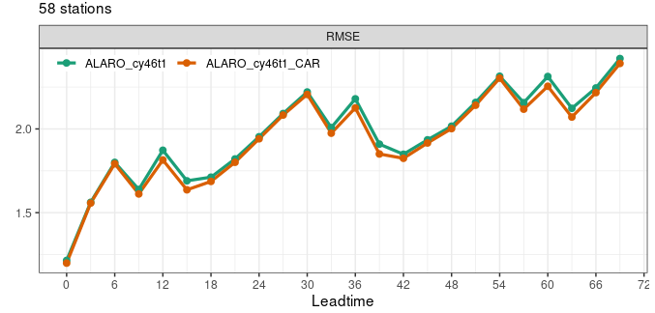
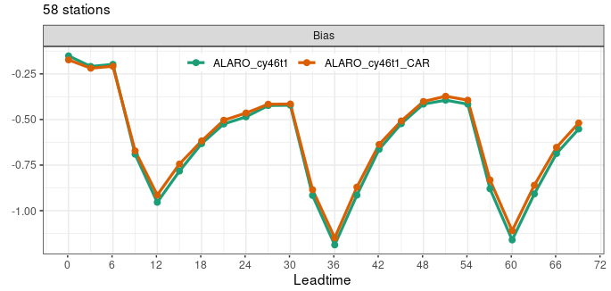
3. Results and verification
→ Verification – Jan. 2024
ALARO CY46 with new climatological aerosol fields – 11 species
Air temperature verification
Parameter | Impact
T2m | Impact not significant
RH2m | Impact not significant
PMSL | Impact not significant
WS | Impact not significant
WD | Impact not significant

Slide 18
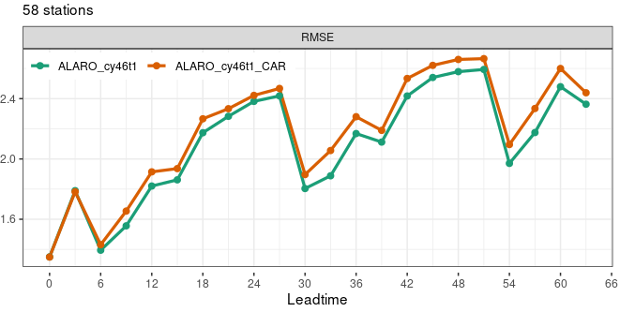
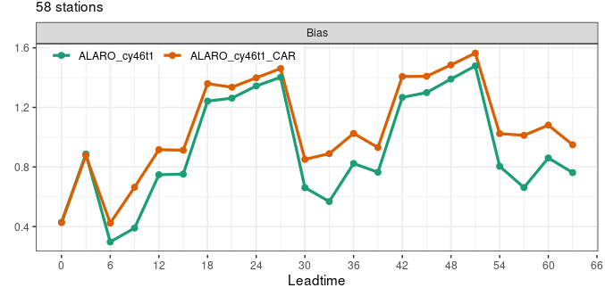
3. Results and verification
→ Verification – Sep. 2024
ALARO CY46 with new climatological aerosol fields – 11 species
Air temperature verification
Parameter | Impact
T2m | Higher BIAS and RMSE for ALARO with CAMS
RH2m | Slightly higher BIAS and RMSE for ALARO with CAMS
PMSL | Impact not significant
WS | Impact not significant
WD | Impact not significant
Air temperature at 2 m for ALARO with CAMS warmer up to 0.5°C compared to the reference.

Slide 19
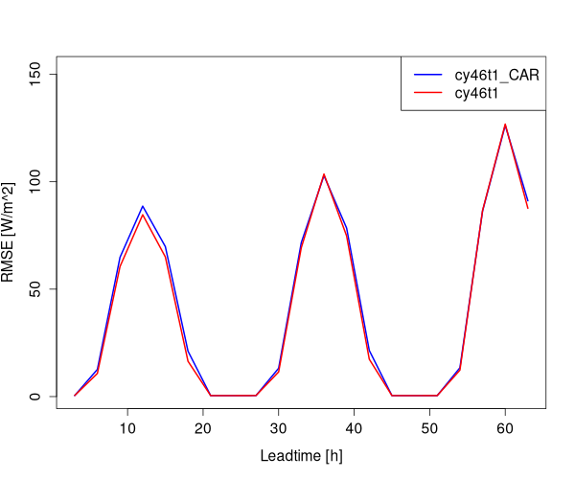
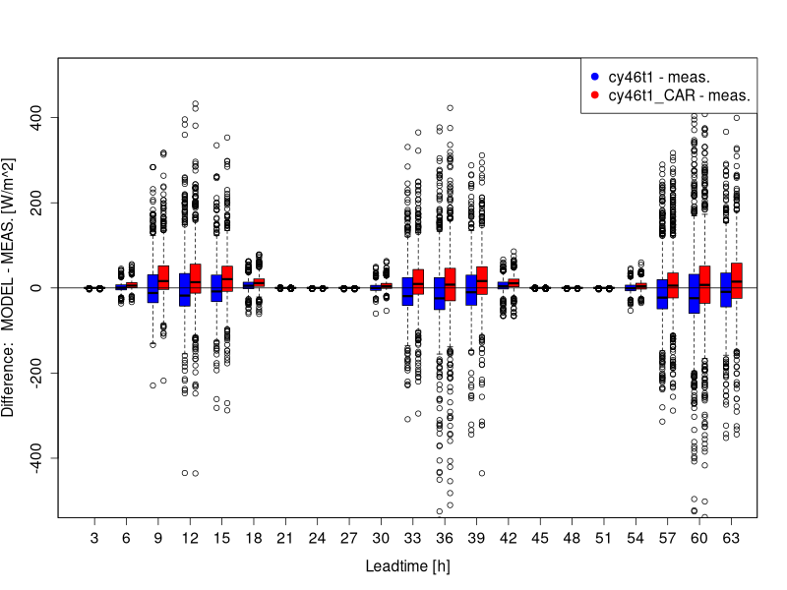
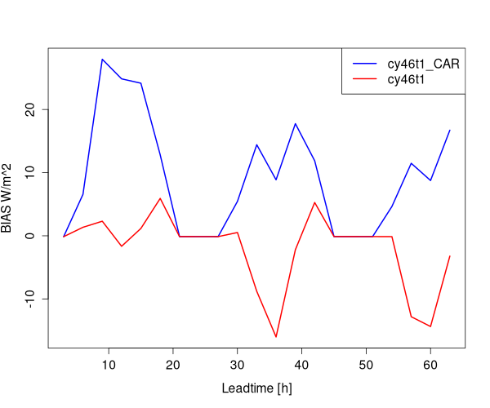
3. Results and verification
→ Verification – Sep. 2024
ALARO CY46 with new climatological aerosol fields – 11 species
Verification of global radiation at the surface (field: SURFRAYT SOLA DE).
3-hour data

Slide 20
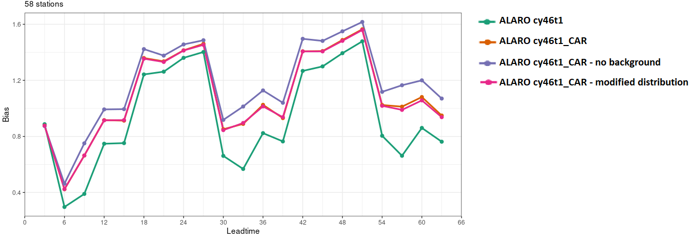
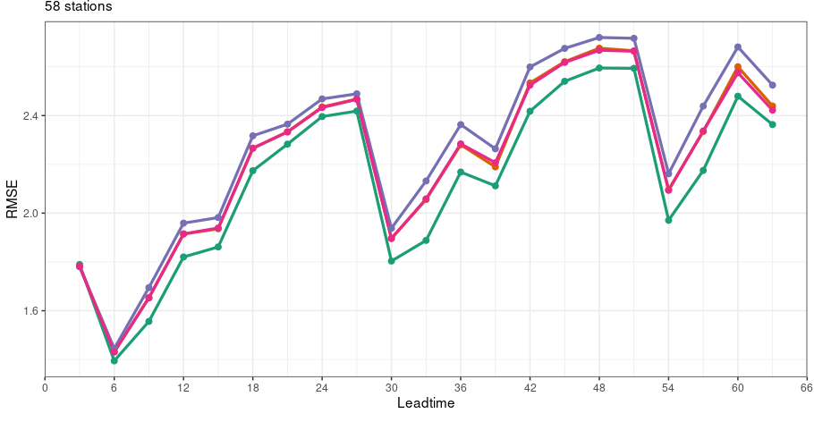
3. Results and verification
→ Verification – Sep. 2024
ALARO CY46 with new climatological aerosol fields – 11 species
Two extra experiments:
Switch off background aerosols (purple line):
! NUMGFL_AERO_OM2=8, ! no background
RBGST_MMR_OM2=0.,
RBGTR_MMR_OM2=0.,
→ Worse results!!!
Tuning vertical dispersion of the aerosols (pink line).
RAERO_GAMMA_EXP=1,1,1,2,2,1.7,1,1,1,1,1.1,
→ No significant impact !!!
Air temperature verification
BIAS
RMSE

Slide 21
Summary
CAMS aerosols were implemented to CY50t1.
CAMS 2D climatological aerosols can be added to climate files using updated procedure e923
(new subroutine EINCLI12)
The user can define which source of data they want to use:
  2D CAMS climatological aerosols
  3D n.r.t. CAMS aerosols
  combination of 2D climatological and 3D n.r.t. CAMS aerosols
CAMS aerosols types used in the forecast are defined in the namelist
The user can define tropospheric and stratospheric backgrounds.
The model with CAMS aerosols require some tuning – warm bias of air temperature in summer period
Procedure to use operationally CAMS n.r.t. aerosols is not yet ready – needed help of Meteo Frace!
Technical document how to use CAMS atmospheric aerosols in ALARO model will be available on RC-LACE webpage
(April 2025)

Slide 22
References
[1] Ana Sljivic, Jan Masek (2024). Vertical distribution of climatological aerosols.
https://www.rclace.eu/media/files/Physics/2024/radaecmr_subroutine-6.pdf
[2] Piotr Sekuła, Jan Masek (2023). Study of the radiation, cloud’s microphysics and atmospheric precipitation sensitivity by taking into account the atmospheric aerosols impact using the AROME model.
https://www.rclace.eu/media/files/Physics/2023/PS23P_CAR.pdf
[3] Piotr Sekuła, Jan Masek (2024). Technical document: Use of CAMS atmospheric aerosols in AROME/HARMONIE-AROME/ALARO.
https://redmine.umr-cnrm.fr/attachments/download/6098/Technical_document_CAMS_description.pdf

