Slide 1
Towards improved coupling and initialization of snow in ALARO + SURFEX
Authors: Gabriel Stachura (IMGW), Ján Másek (CHMI)

Slide 2
Outline
inclusion of snow in urban areas into total snow in an atmospheric model
initialization of multiple layer snow scheme based od single layer snow scheme in LBCs

Slide 3

snow in ALARO + SURFEX
so far surface in ALARO was treated with ISBA scheme, which involvs lots of simplifications
in SURFEX, tile/patch approach is applied
snow is treated separetly in every tile/patch
PATCH 1
bare ground
PATCH 2
rock
…
PATCH 10
grassland
…
PATCH 14
temperate broadleaf evergreen
…
PATCH 19
shrub
Notes:
SO far in ALARO Surface was treated

Slide 4
snow in ALARO + SURFEX
snow is treated separetly in every tile/patch
snow in urban areas (buildings/roads/gardens)
snow on ice-covered sea
snow on ice-covered lake
snow on bare ground, open land, in a forest etc.
PATCH 1
bare ground
PATCH 2
rock
…
PATCH 10
grassland
…
PATCH 14
temperate broadleaf evergreen
…
PATCH 19
shrub
Notes:
SO far in ALARO Surface was treated

Slide 5
snow in ALARO + SURFEX
then fluxes are aggregated and passed to an atmospheric model
snow in urban areas (buildings/roads/gardens)
snow on ice-covered sea
grid-box aggregation
ALARO
snow on ice-covered lake
snow on bare ground, open land, in a forest etc.
Notes:
SO far in ALARO Surface was treated

Slide 6
snow in ALARO + SURFEX
during model integration it works like that (physics is correct)
when it comes to saving to the output file, only snow from nature is taken
this may matter for DA or when ALARO forecasts are used as LBCs in some other model
snow in urban areas (buildings/roads/gardens)
snow on ice-covered sea
grid-box aggregation
ALARO
snow on ice-covered lake
SURFRESERV.NEIGE
snow on bare ground, open land, in a forest etc.
Notes:
SO far in ALARO Surface was treated

Slide 7
snow in ALARO + SURFEX
this may matter for DA or when ALARO forecasts are used as LBCs in some other model
our goal was to include also snow from TEB
snow in urban areas (buildings/roads/gardens)
snow on ice-covered sea
grid-box aggregation
ALARO
snow on ice-covered lake
SURFRESERV.NEIGE
snow on bare ground, open land, in a forest etc.
Notes:
SO far in ALARO Surface was treated

Slide 8
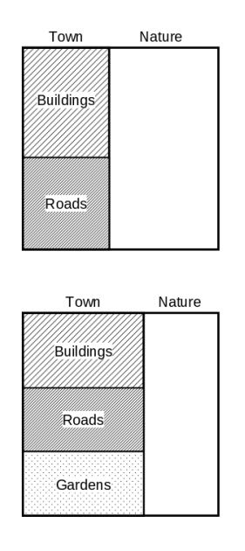
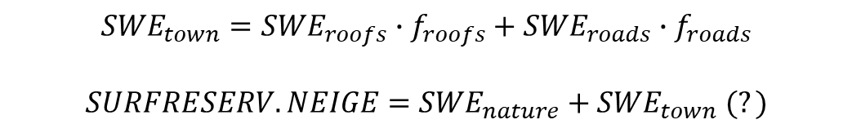
snow in TEB
snow in urban areas can occur in TEB on:
building roofs - single-layer snow model
impervious surfaces (roads) - single-layer snow model
gardens (if key LGARDEN is activated) – ISBA
in our experiment LGARDEN=F. Then:
? – probably scalling by fraction of town is needed (yet to be investigated)
$${SWE}_{town}={SWE}_{roofs}∙f_{roofs}+{SWE}_{roads}{∙f}_{roads}$$
$SURFRESERV.NEIGE=$ ${SWE}_{nature}+{SWE}_{town} (?)$
f - fraction
source: SURFEX scientific documentation
Notes:
SO far in ALARO Surface was treated

Slide 9
code inspection and modification
(here model physics is calculated)
get surface variables from SURFEX
get surface variables from TEB
Notes:
SO far in ALARO Surface was treated

Slide 10
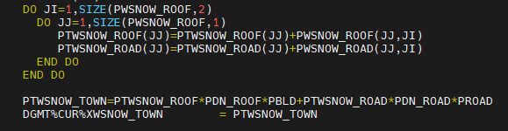

code inspection and modification
in DIAG_MISC_TEB_n:
vertical summation of SWE for roofs and roads
aggregation for urban area (PTWSNOW_TOWN)
save it to TEB miscellaneous diagnostics SURFEX structure (DGMT)
fetch it in GET_VAR_TOWN_n:
Notes:
SO far in ALARO Surface was treated

Slide 11
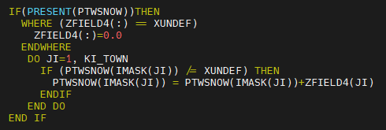
code inspection and modification
in GET_SURF_VAR_n:
SWE from town (ZFIELD4) is added to current total SWE (coming only from nature)
in total, 15 subroutines had to be modified
the change can be switched on/off under a namelist key LSURF_MISC_BUDGET in NAM_DIAG_TEBn
Notes:
SO far in ALARO Surface was treated

Slide 12
Experiment setup
Model cycle | CY46t1as
SURFEX version | 8.0+
ECOCLIMAP | 2.6
NPATCH | 1
CISBA | 2-L
TEB | on
CSNOW | D95
initial date | 2021-01-12
forecast timestep | 90
forecast length | 72h
data assimilation | off

Slide 13
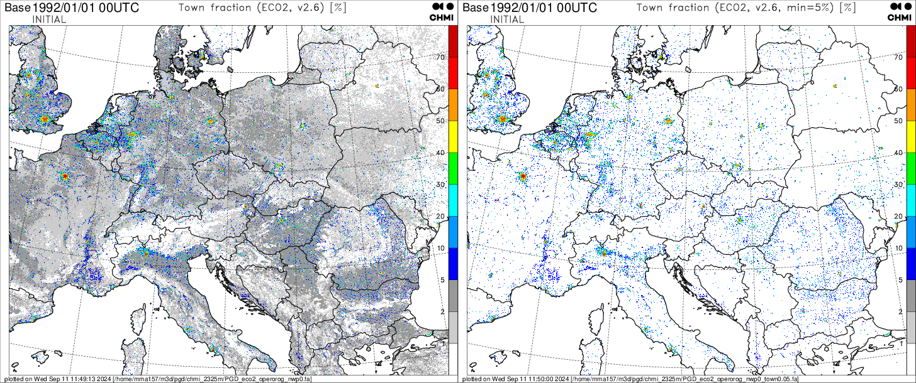
Results
our initial results were flawed by an erroneous accumulation of snow in places with little town fraction (<5%)
we transformed them to nature

Slide 14
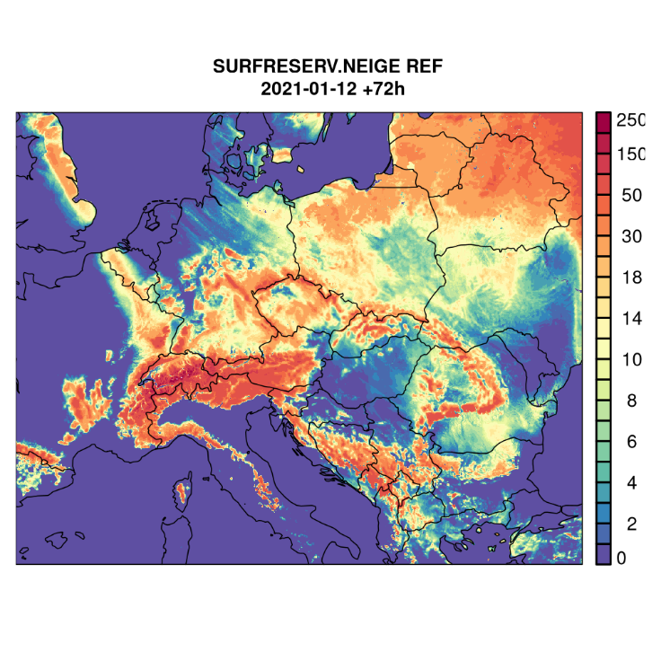
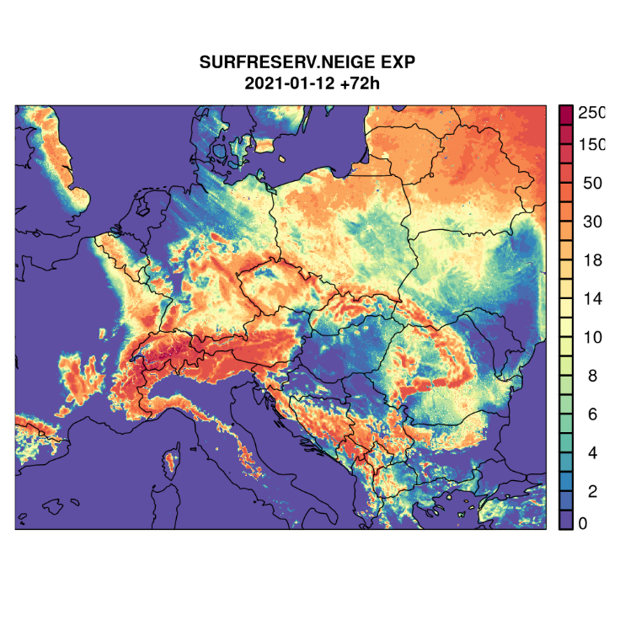
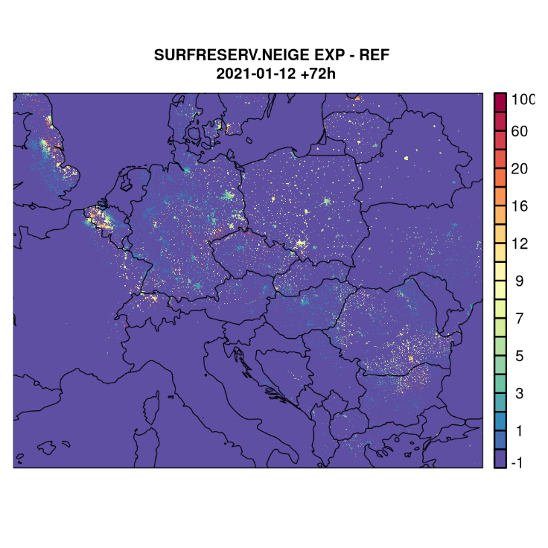
Results
difference in SWE is confined to urban areas
Spatial distribution of snow water equivalent [kg/m^2] in a reference and experimental run and the difference between them.

Slide 15
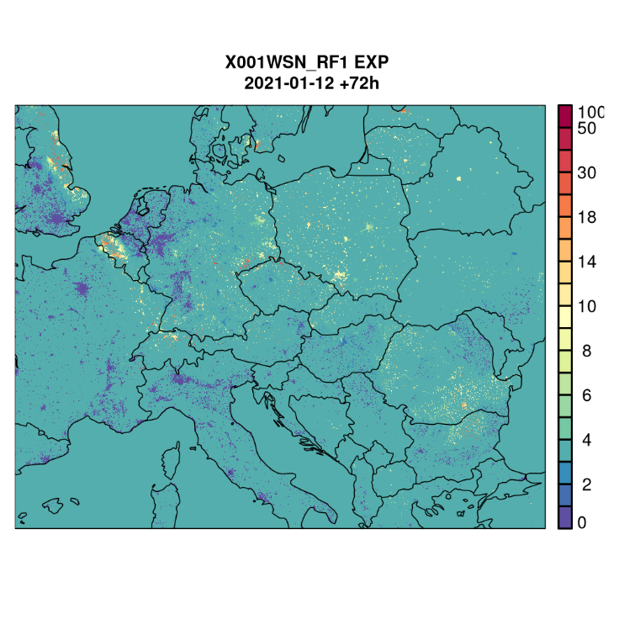

Results
Spatial distribution of SWE on roofs in the reference and the experimental run

Slide 16
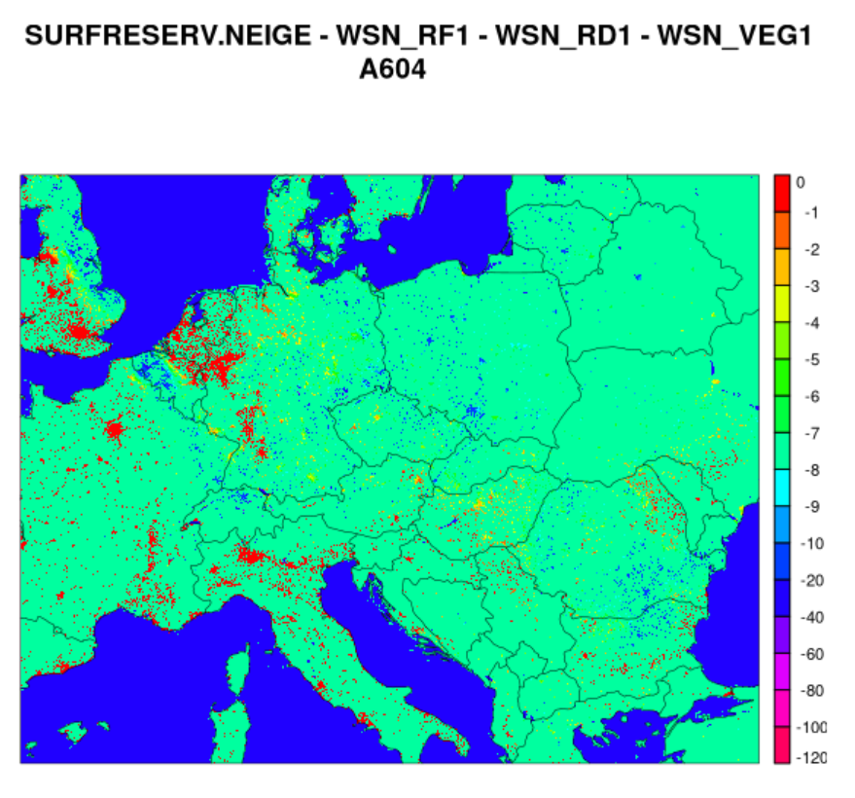
Results
EXP
Difference between SURFRESERV.NEIGE and SWE from SURFEX fields (town + vegetation)
probably SWE from town should be scaled to gridbox

Slide 17
Snow initialization in ES
global models provide us LBCs which involve single layer snow schemes
to use multiple layers in LAMs, snow properties have to be somehow distributed/interpolated
our goal was to make it work in Explicit Snow Scheme
number of layers
layer thickness
layer density
layer snow age [days]
layer heat content
based on existing tools to modify FA files in CHMI, a very basic external program was created

Slide 18

Snow initialization in ES
based on existing tools to modify FA files in CHMI, a very basic external program was created
number of layers is defined in a namelist
layering according to a module MODE_SNOW3L (to ensure numerical stability)
density: either verically uniform or increasing with depth
snow age of every layer defined in a namelist
snow heat content derived from surface temperaturę based on formula
we produced modified initial files but forecast failed due to some bug in formulation of snow heat content

Slide 19
Snow initialization in ES
we were advised by ACCORD-SURFEX group that it is preffered to develop such solutions within SURFEX code
in HIRLAM they already process LBCs from ECMWF to a multiple snow scheme
we won’t develop the external tool anymore

Slide 20
Thank you for your attention.

