Slide 1



PGD Generation and Running ALARO-SURFEX in Daily Cycling Mode.
Debasish Mahapatra, Kwinten Van Weverberg

Slide 2
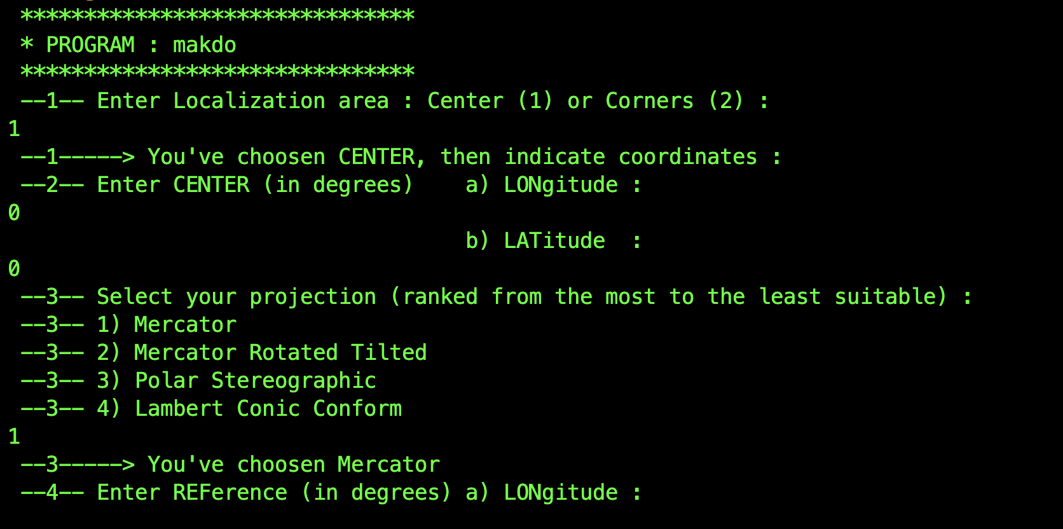
PGD Creation
PINUTS Preparation:
Creating .Q (Quadratic) and .L (Linear) namelists manually by Running MAKDO utility separately for each mode.
Entering domain information like reference lat/lon and resolution

Slide 3



Step 1 - Initial PGD Creation: Manually modifying the make_pgd_923_model script with domain-specific values. This step creates the first PGD files.
Step 2 - CLIM Processing: Manually editing the job_923_model script. This script creates the ”Clim Files”.
Step 3 - PGD Update: Manually updating the update_pgd job script. This step updates the PGD files created in the 1st step with the physiography. This is also where we update the ALBEDO, LAI and Roughness from MODIS data.

Slide 4
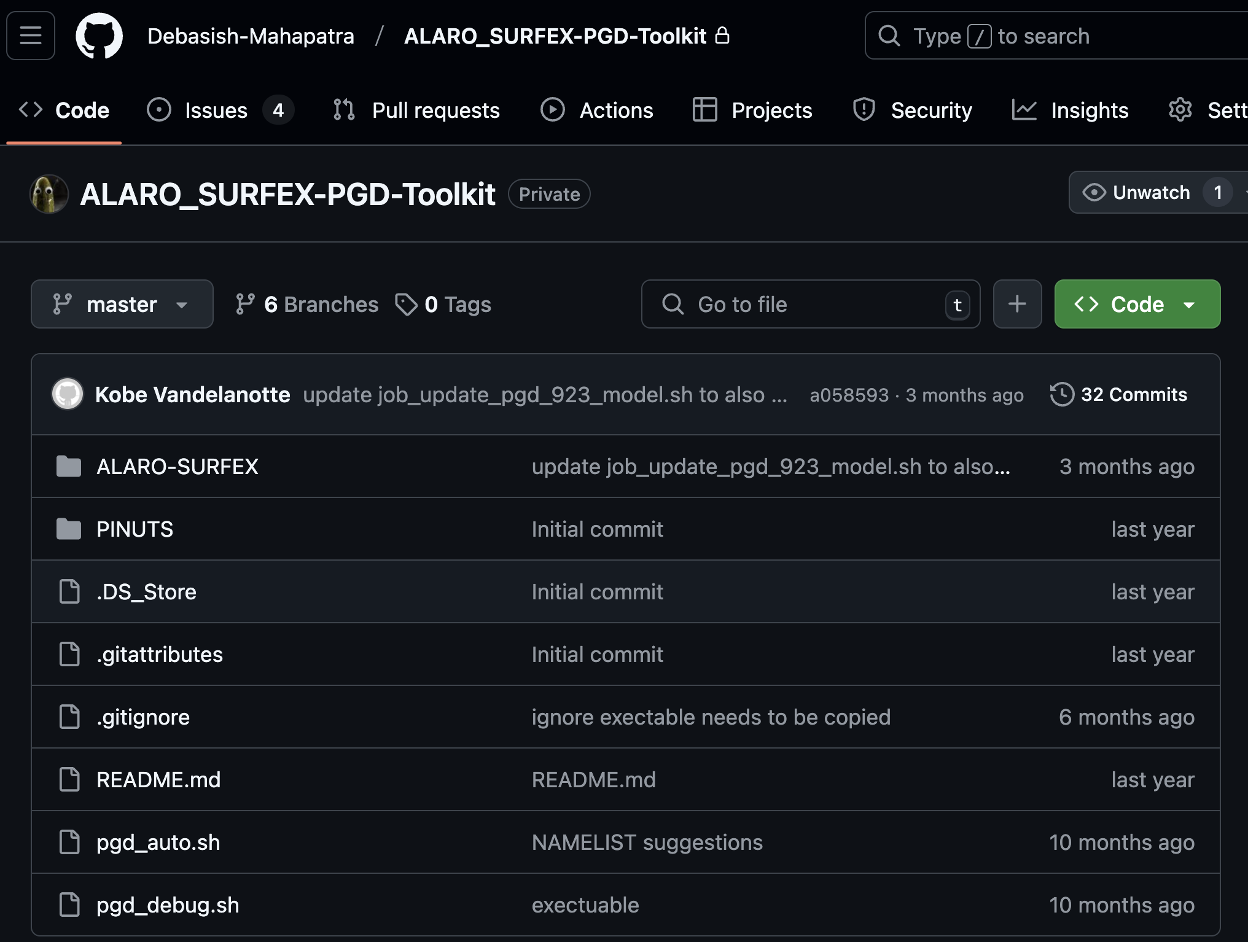


This is a Time-consuming repetitive tasks and is Prone to human error during script modifications.
https://github.com/Debasish-Mahapatra/ALARO_SURFEX-PGD-Toolkit

Slide 5
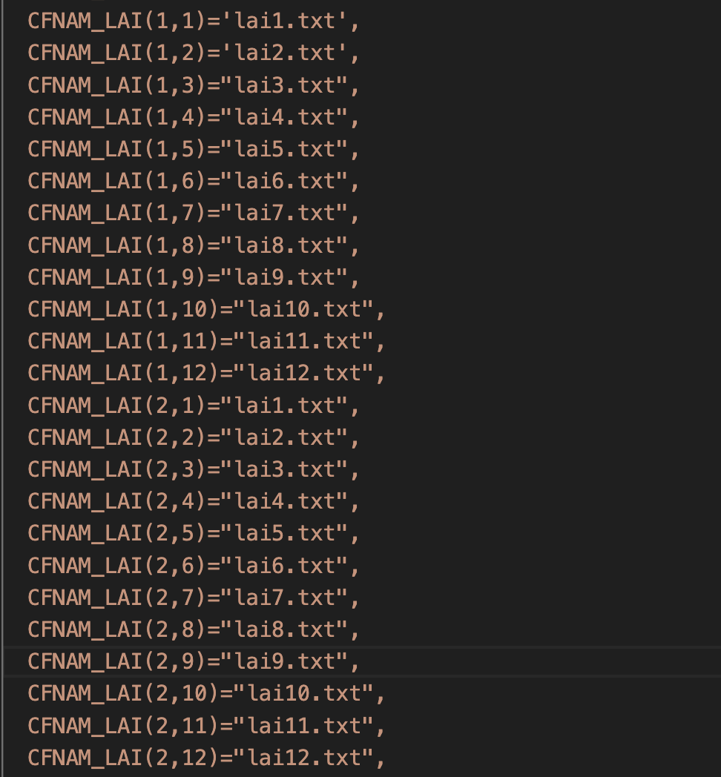
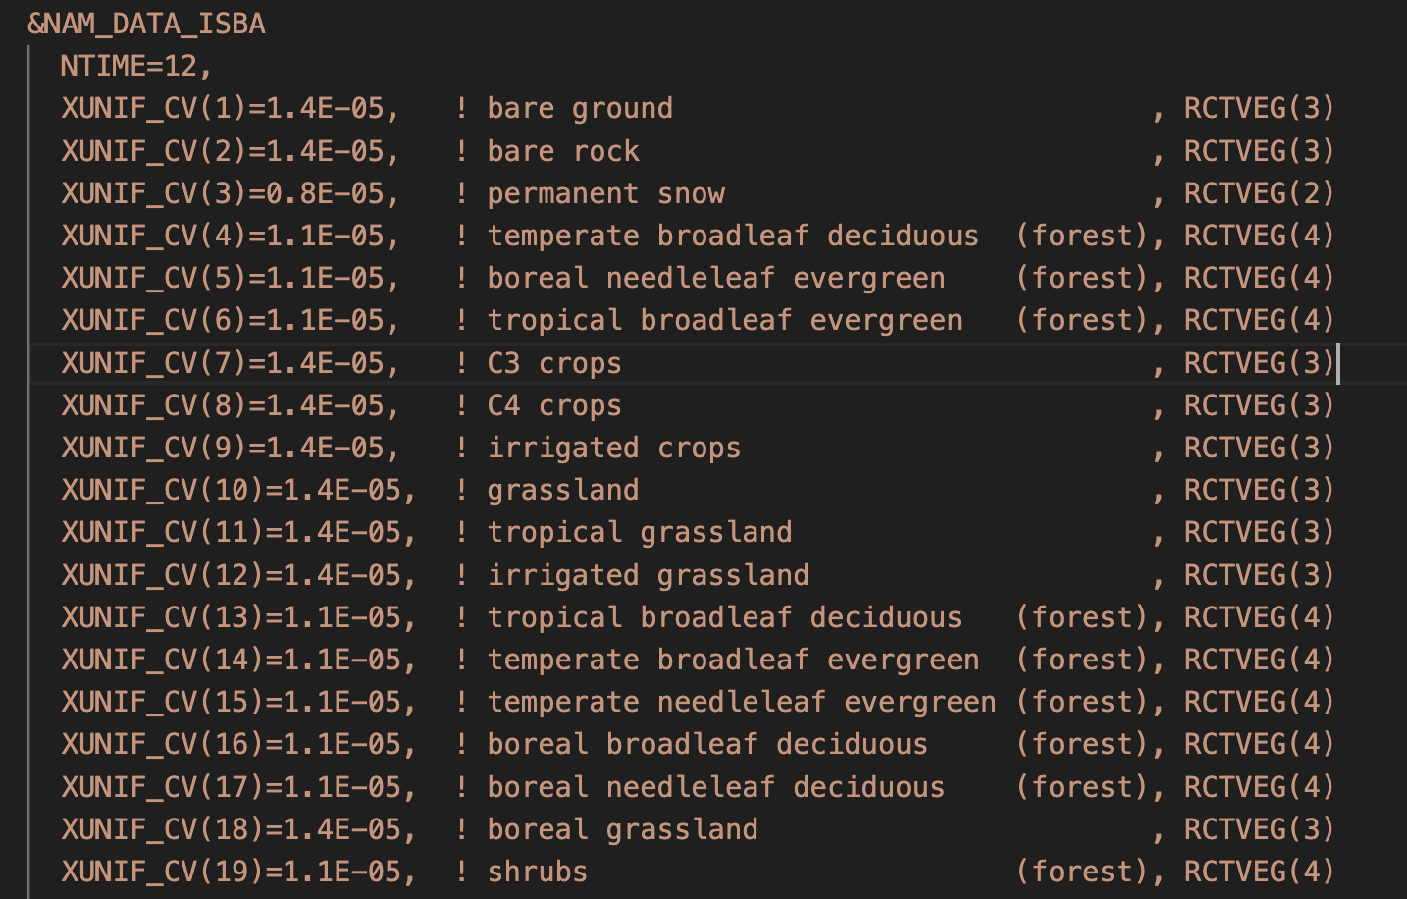
PGD Creation with Modis data (SURFEX V8.0)
Edit the “&NAM_DATA_ISBA” section of the PGD_UPDATE step
NTIME= is a switch to determine the time dimension (1 = annual mean, 2 = winter/summer, 12 = monthly, 36 = per 10-days). We choose 12 here (monthly).
1
2
CFNAM_LAI = Namelist variable with dimensions (number of PFTs, ntime), for each element of this 2D array you need to provide a filename.
There are 19 PFTs (plant functional types) possible per grid point. In our case, since we have spatially distributed fields, we provide the same filename for each PFT, but we do provide a different file for each month.
CFTYPE_LAI = namelist variable with same dimensions as CFNAM_LAI, but just stating the file format of the files above (in our case: ASCII, so you need to specify 'ASCLLV').
For ROUGHNESS the CFNAM_Z0 namelist option have dimensions like the CFNAM_LAI, so you can provide separate values per month within the same PGD file if you wish.

Slide 6
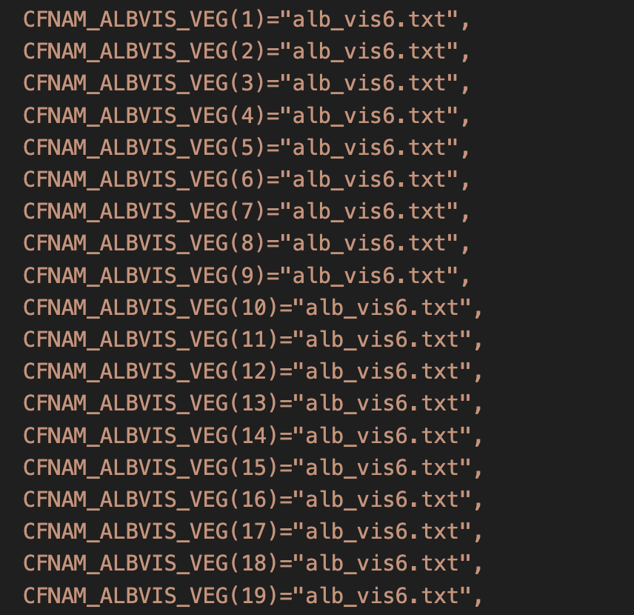
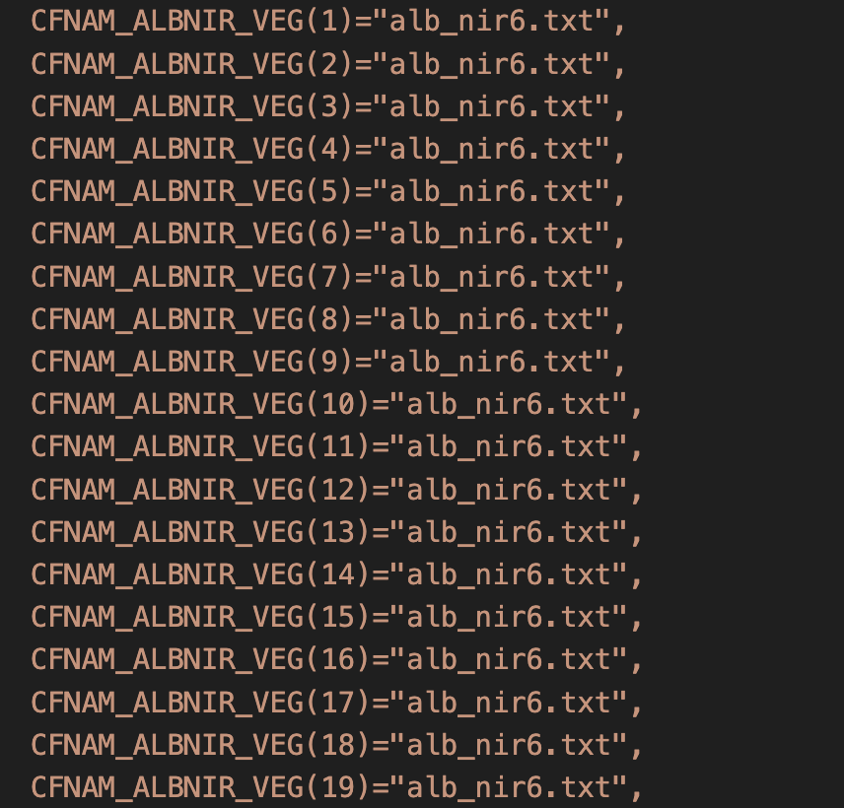
For spatially distributed ALBEDO
For Albedos, the CFNAM_ALBVIS_VEG and CFNAM_ALBNIR_VEG only have dimensions of 'number of PFTs), but not for 'ntime'. This is the reason why we need to recreate the PGD file for each month separately, rather than having a single PGD that contains all the monthly information. For each monthly PGD, you point to the albedo file for the respective month here.

Slide 7
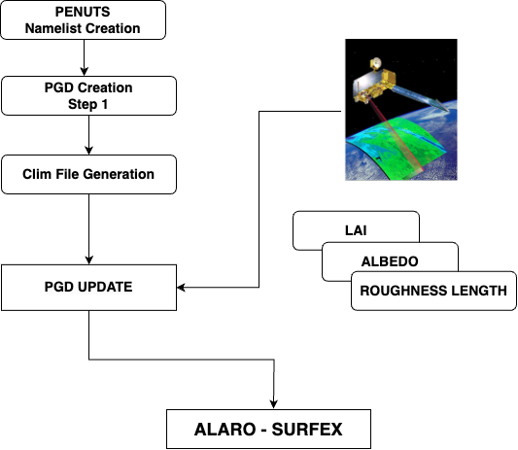
Overview
ASCII

Slide 8
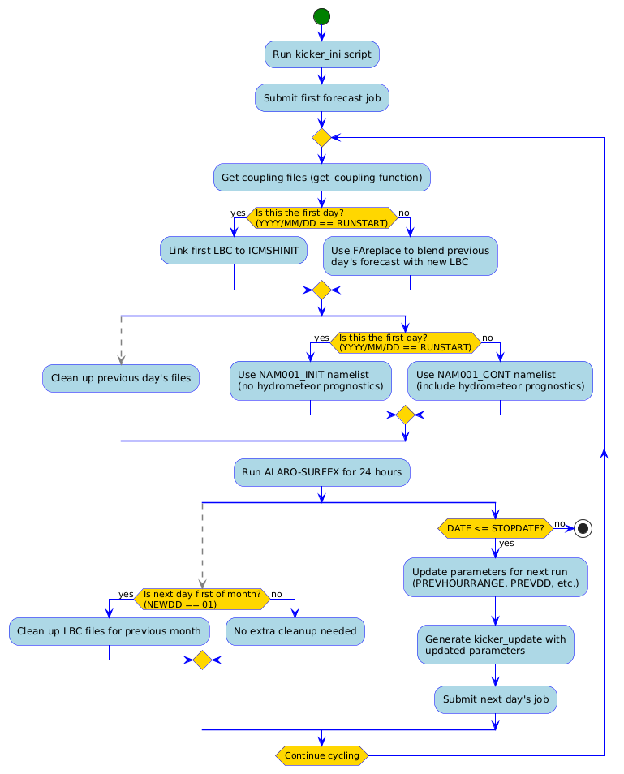
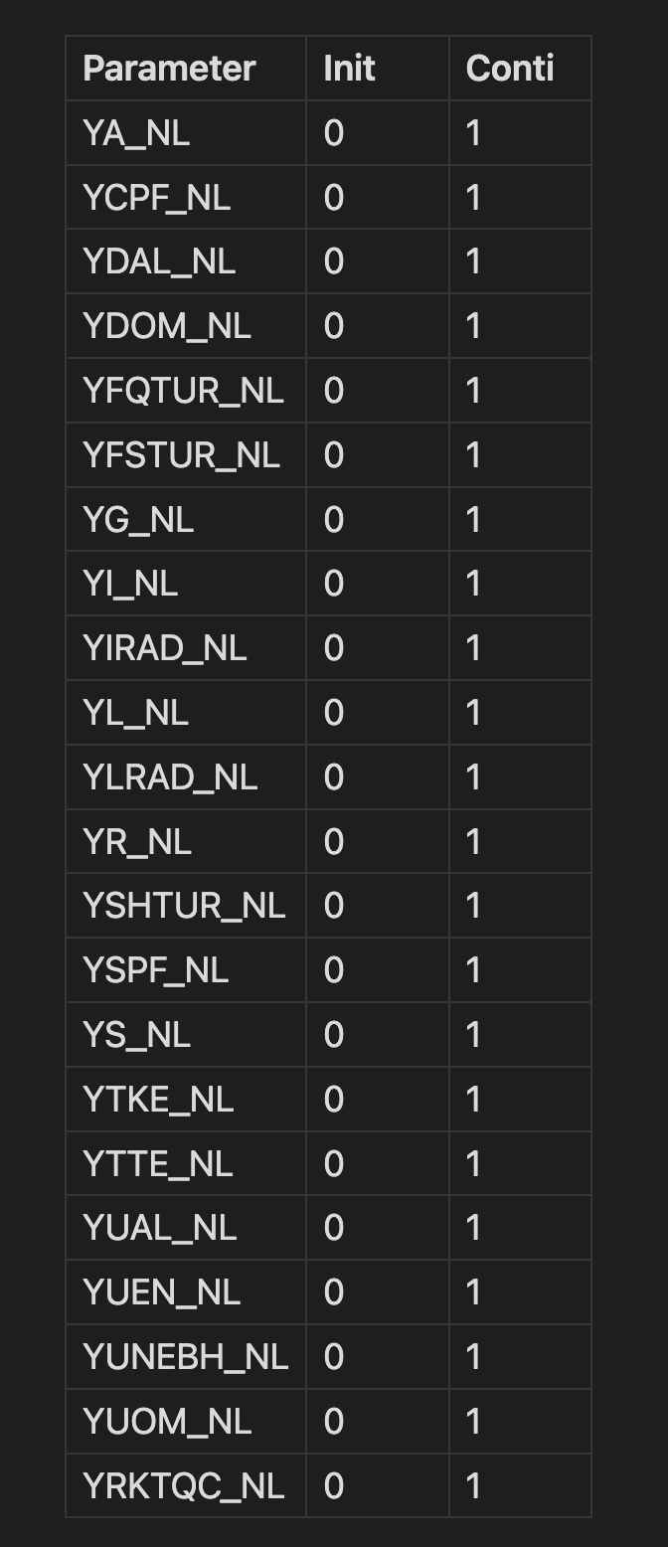
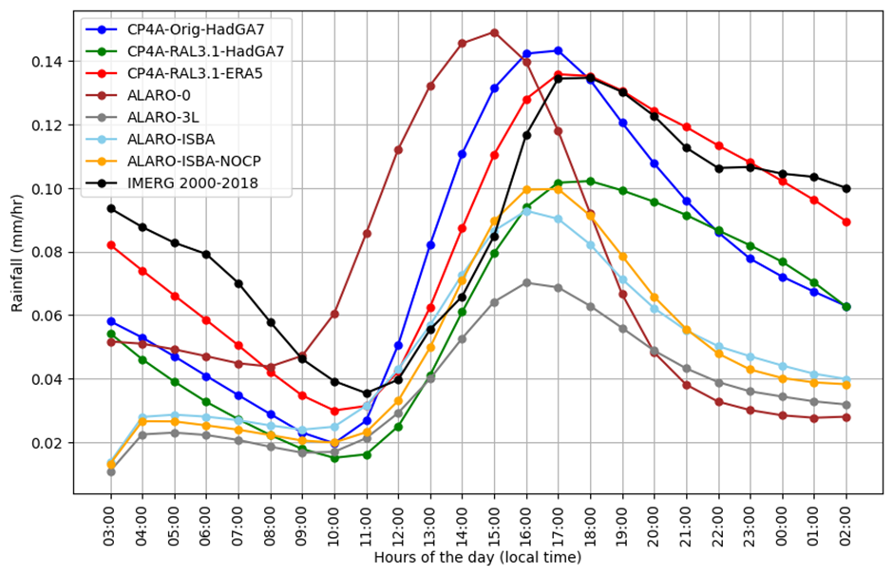
Daily cycling with ALARO_SURFEX

Slide 9
THANKS

