Slide 1



First Results from ALARO-SURFEX Simulations over the Amazon Sensitivity Experiment Design and Issues Faced.
Debasish Mahapatra, Kwinten Van Weverberg, Michiel Van Ginderachter

Slide 2
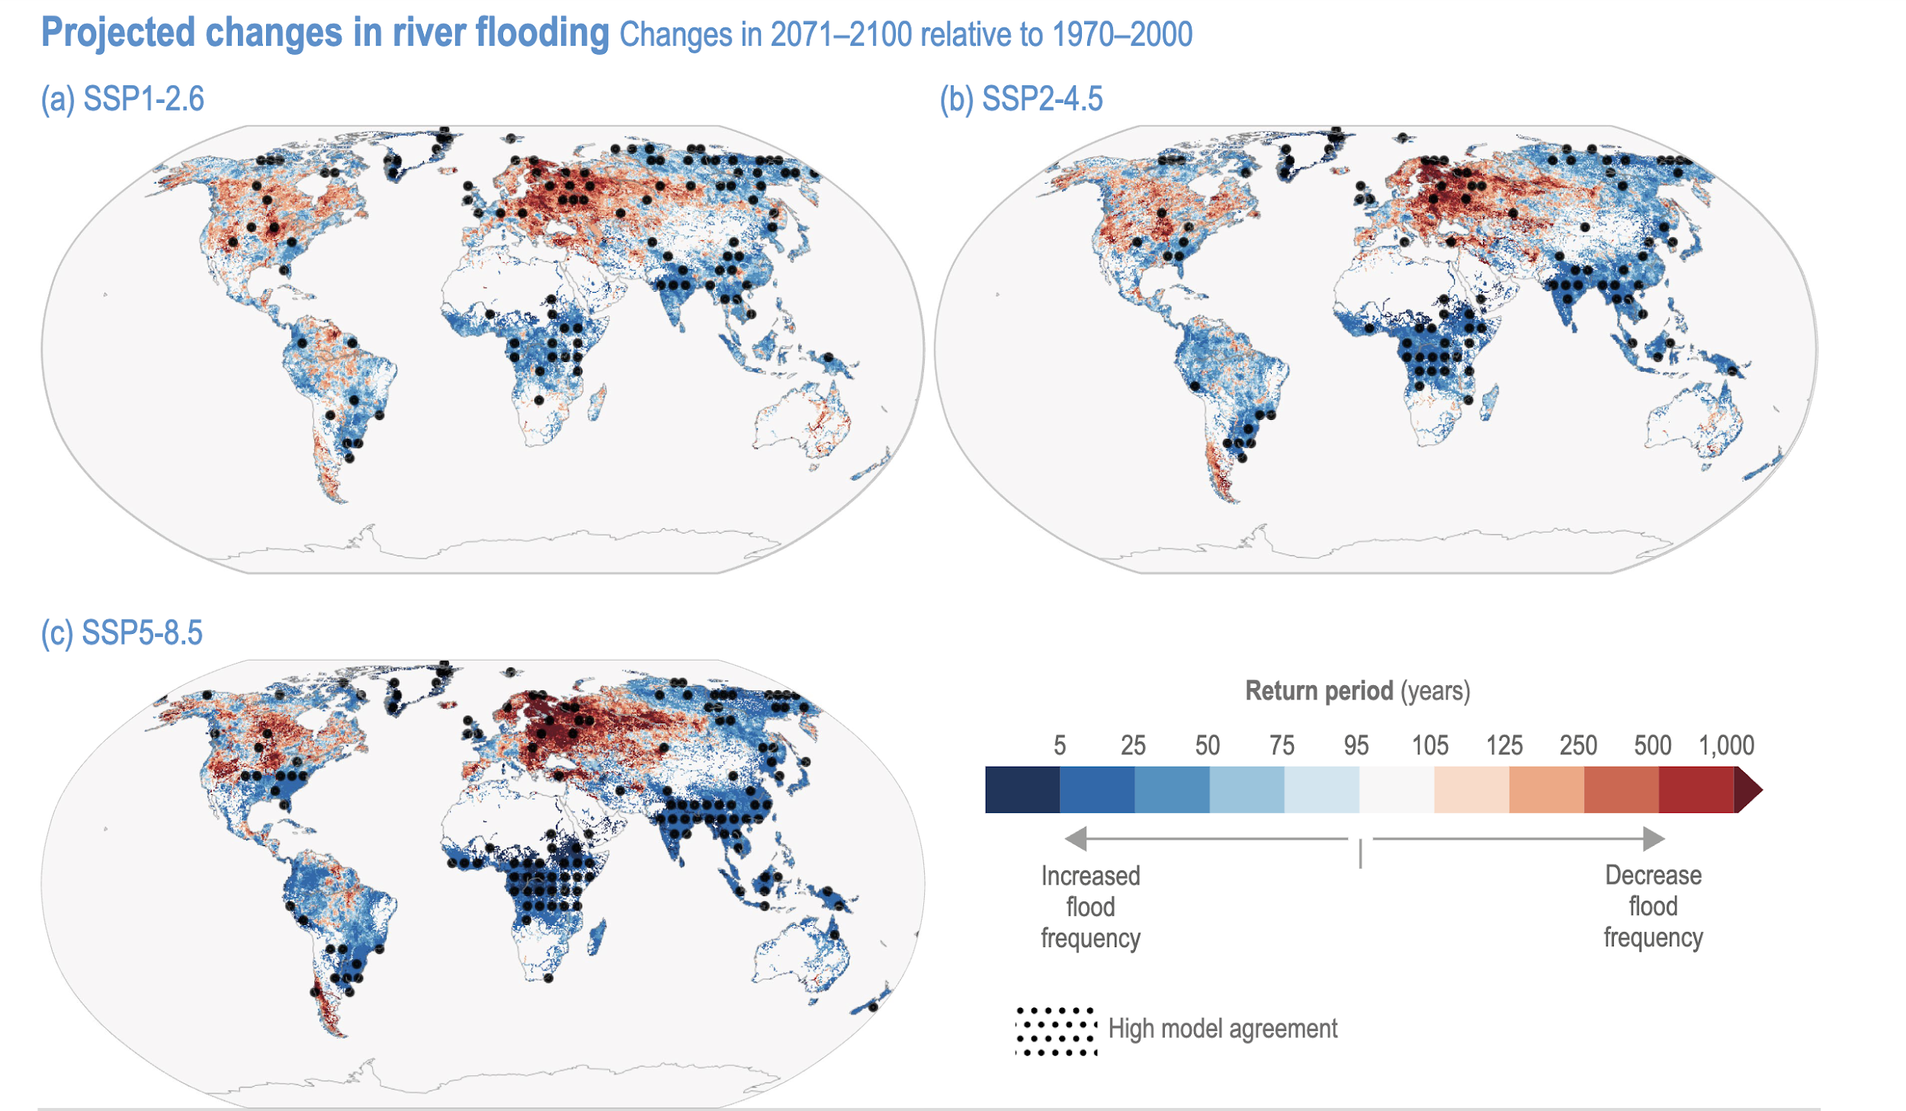
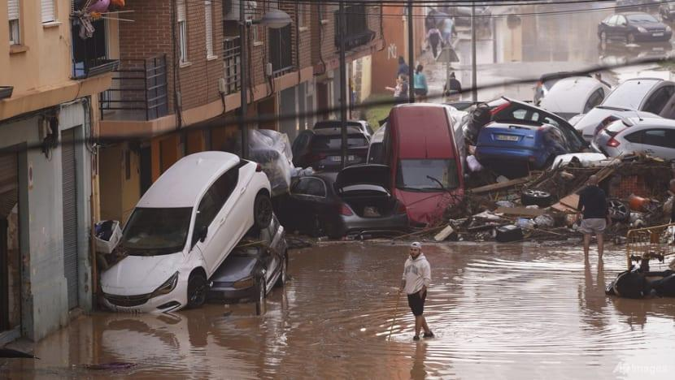
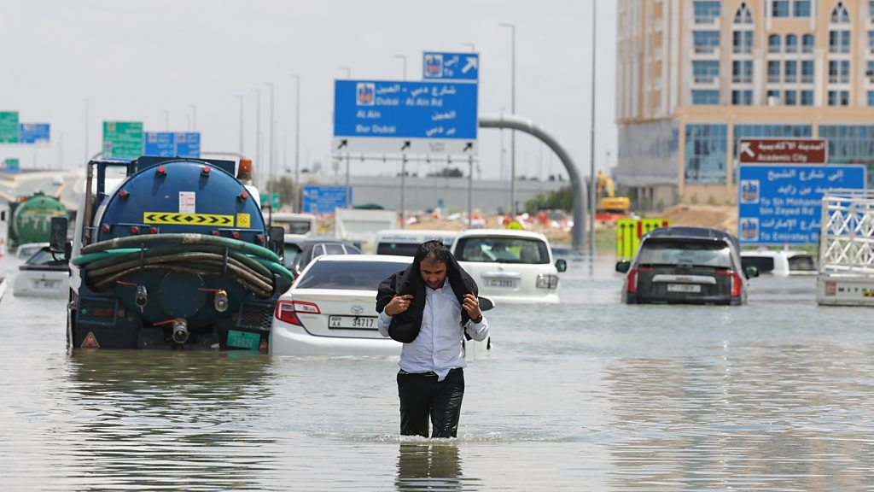
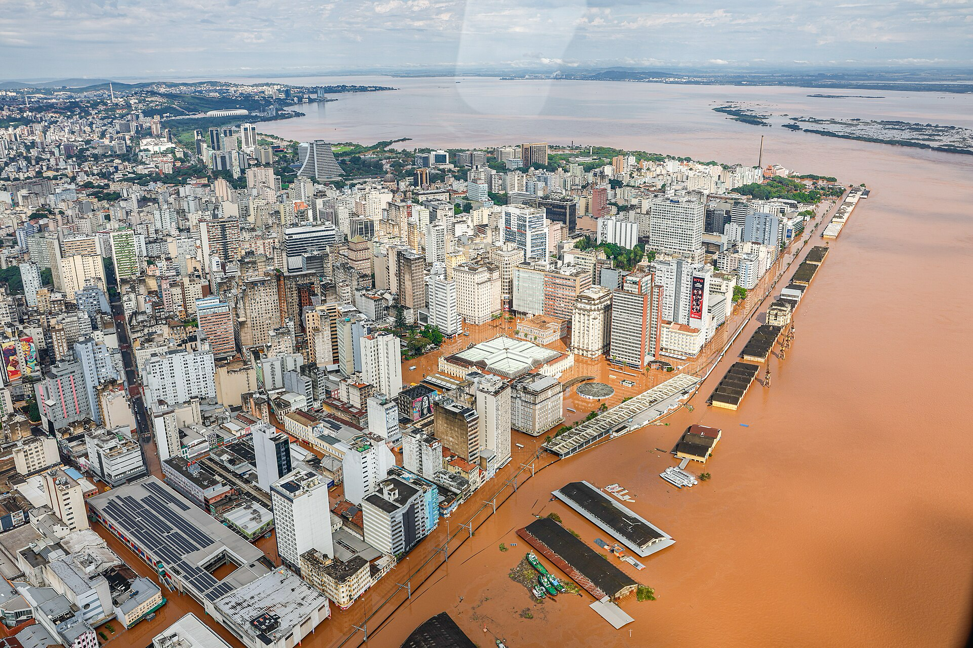
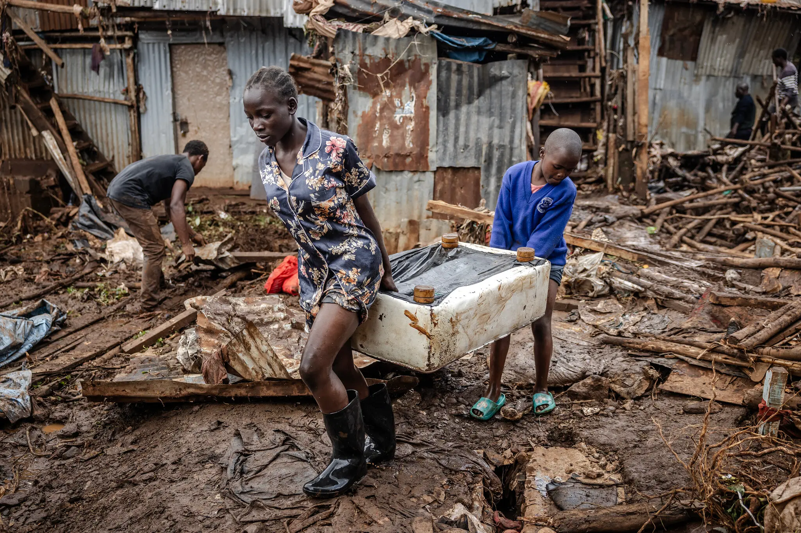
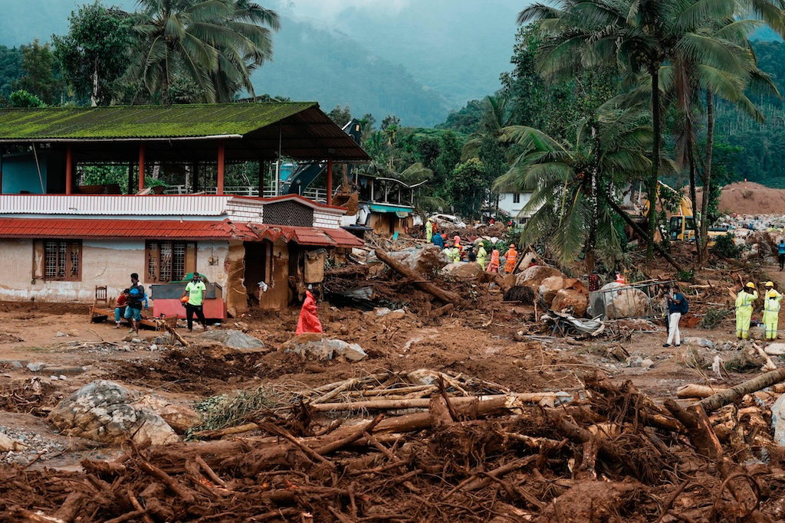
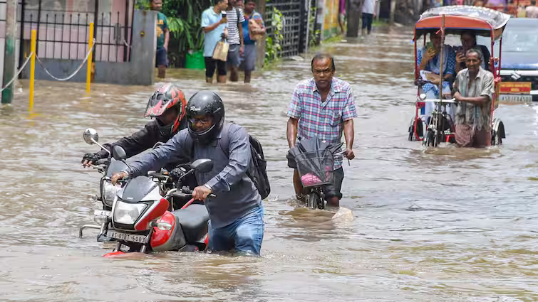
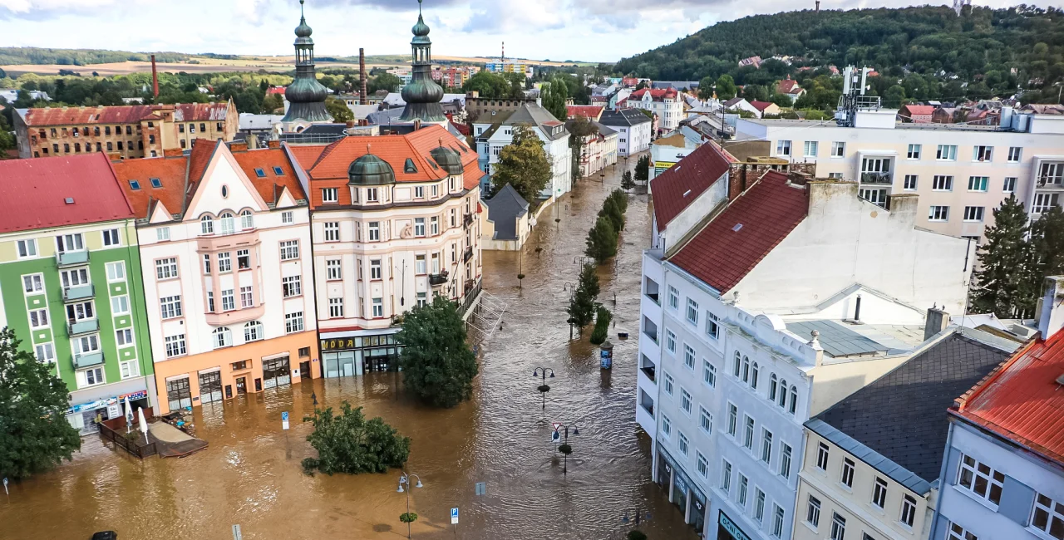
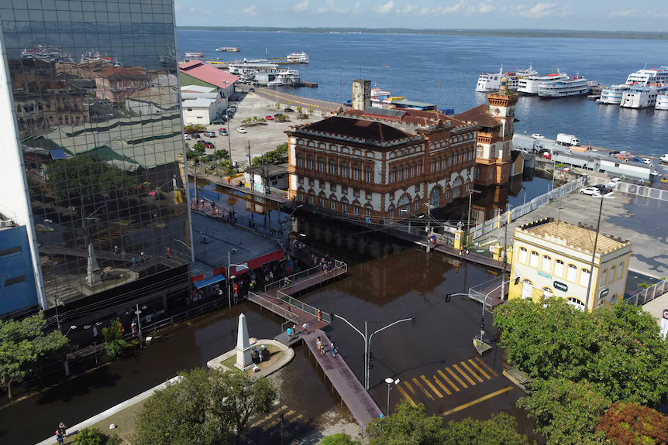
Porto Alegre 2024
KENYA 2024
WHY
SPAIN 2024
UAE 2024
MANAUS 2024
INDIA 2024
Czechia 2024
IPCC AR6 – Ch 4: WATER

Slide 3
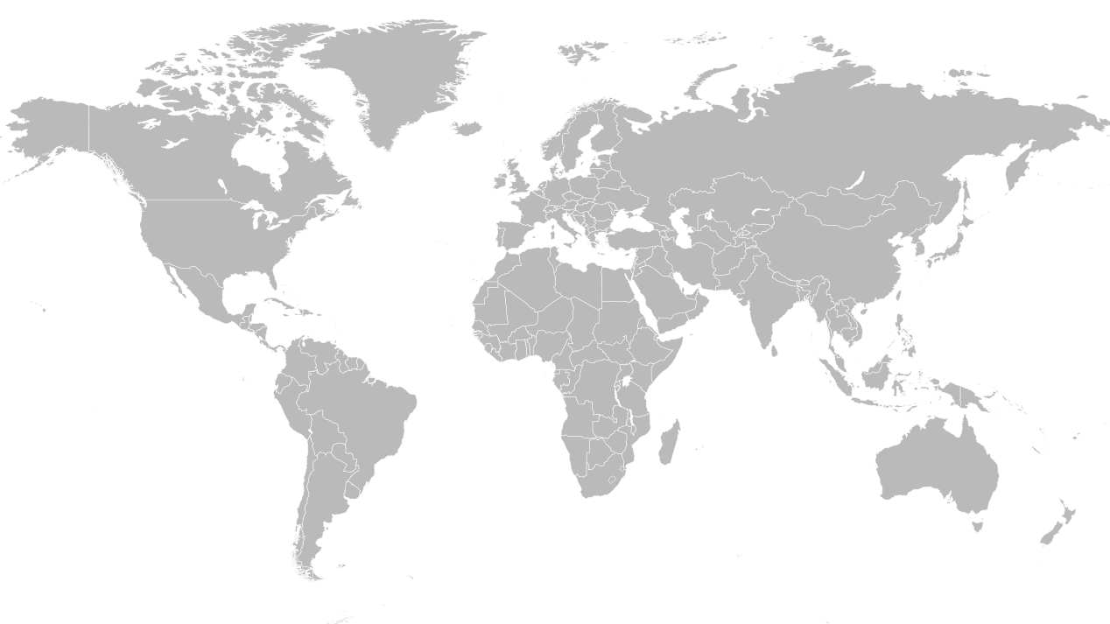
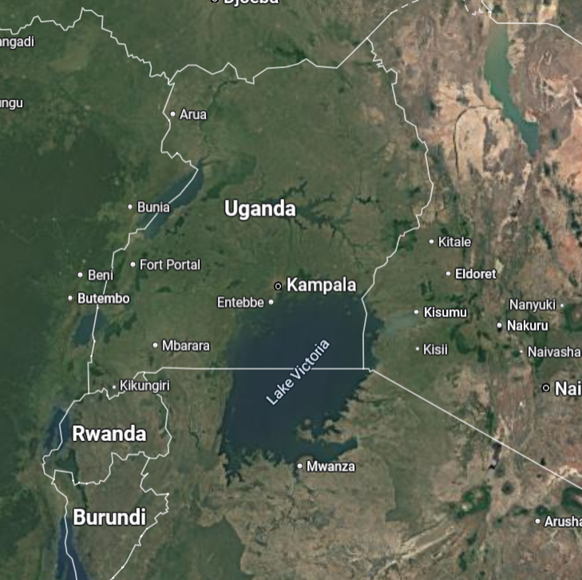
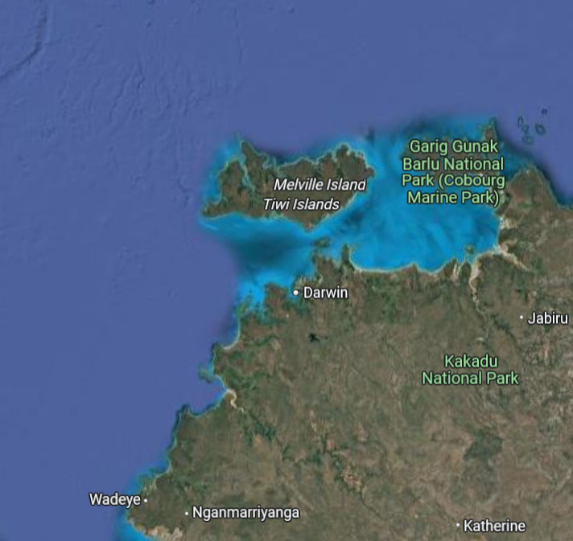
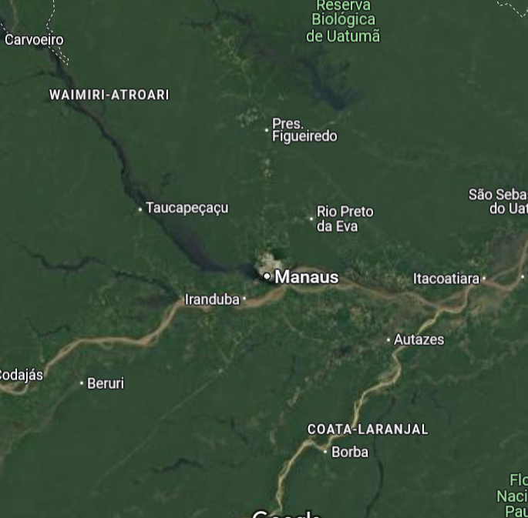
Study domains.

Slide 4

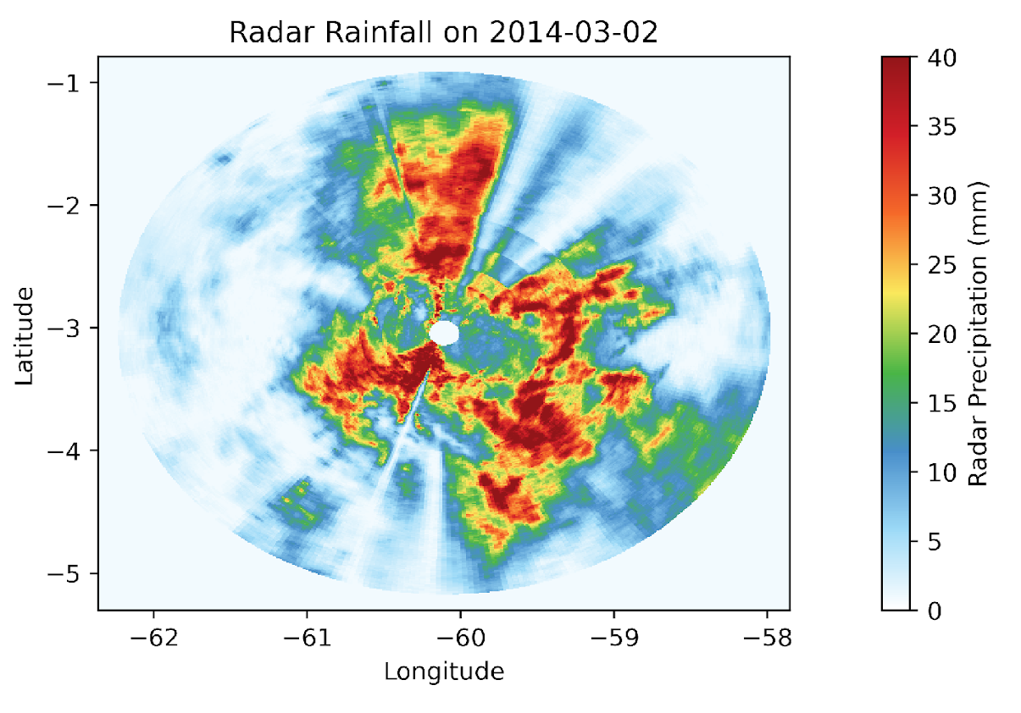
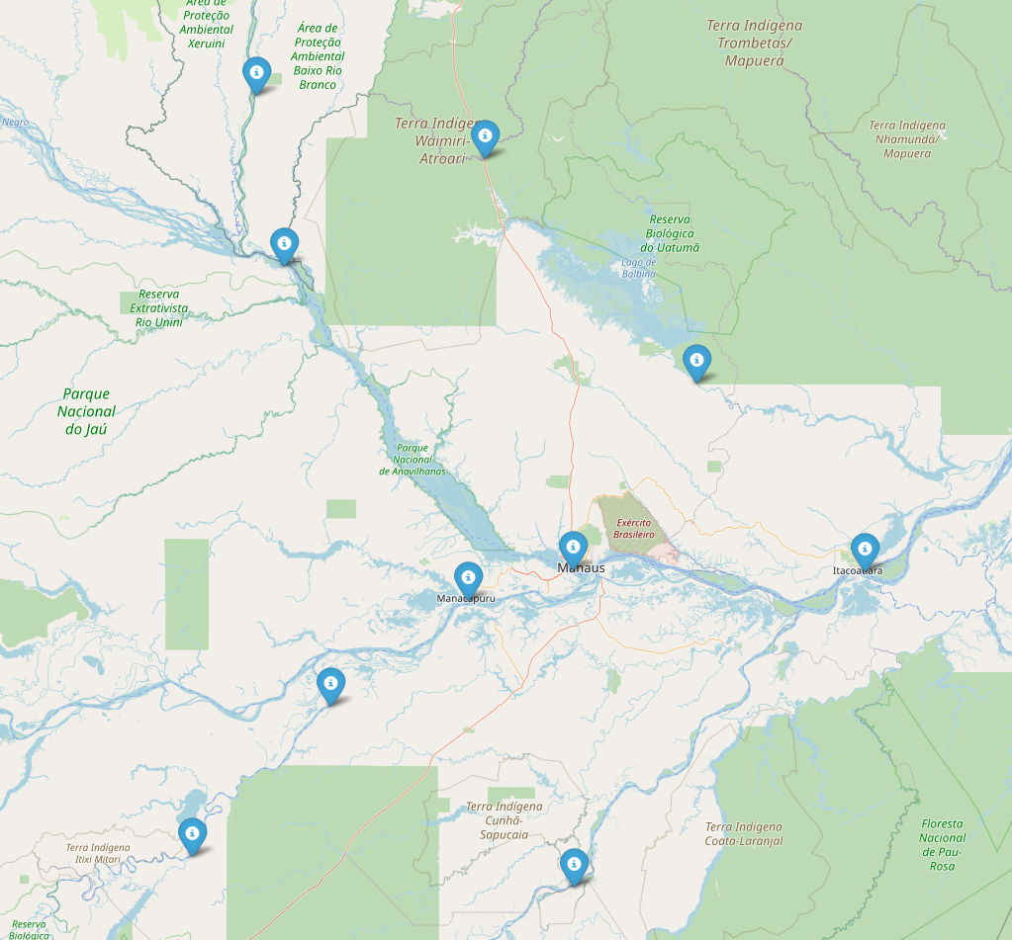
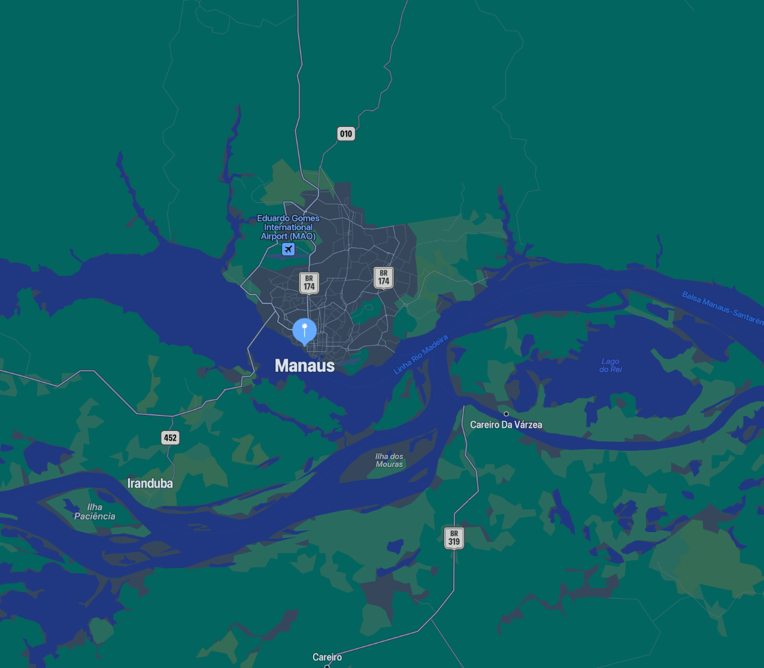
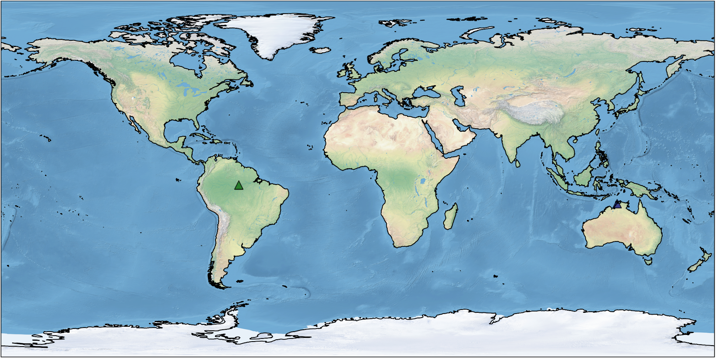
GO AMAZON-MANAUS

Slide 5
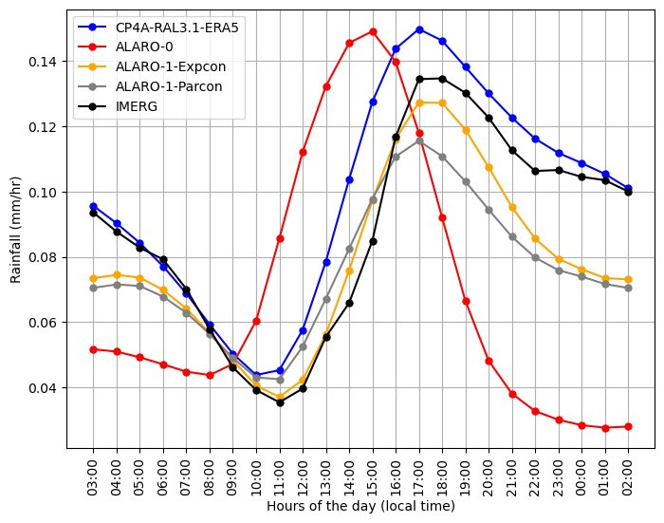
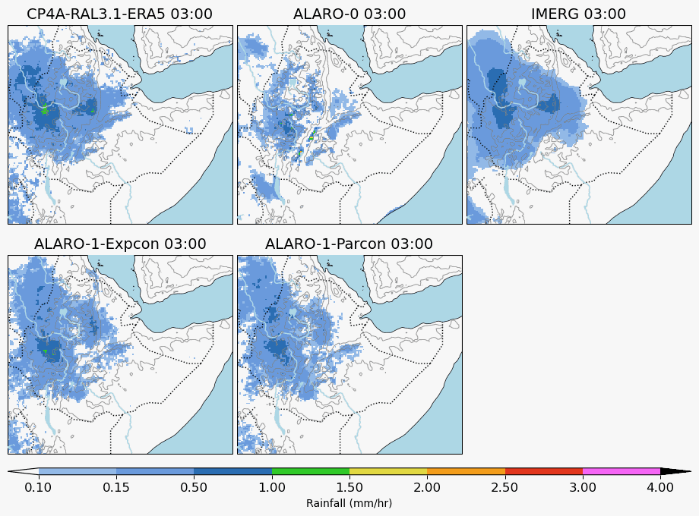
Earlier experience from Ethiopia
Negash et.al; 2024

Slide 6
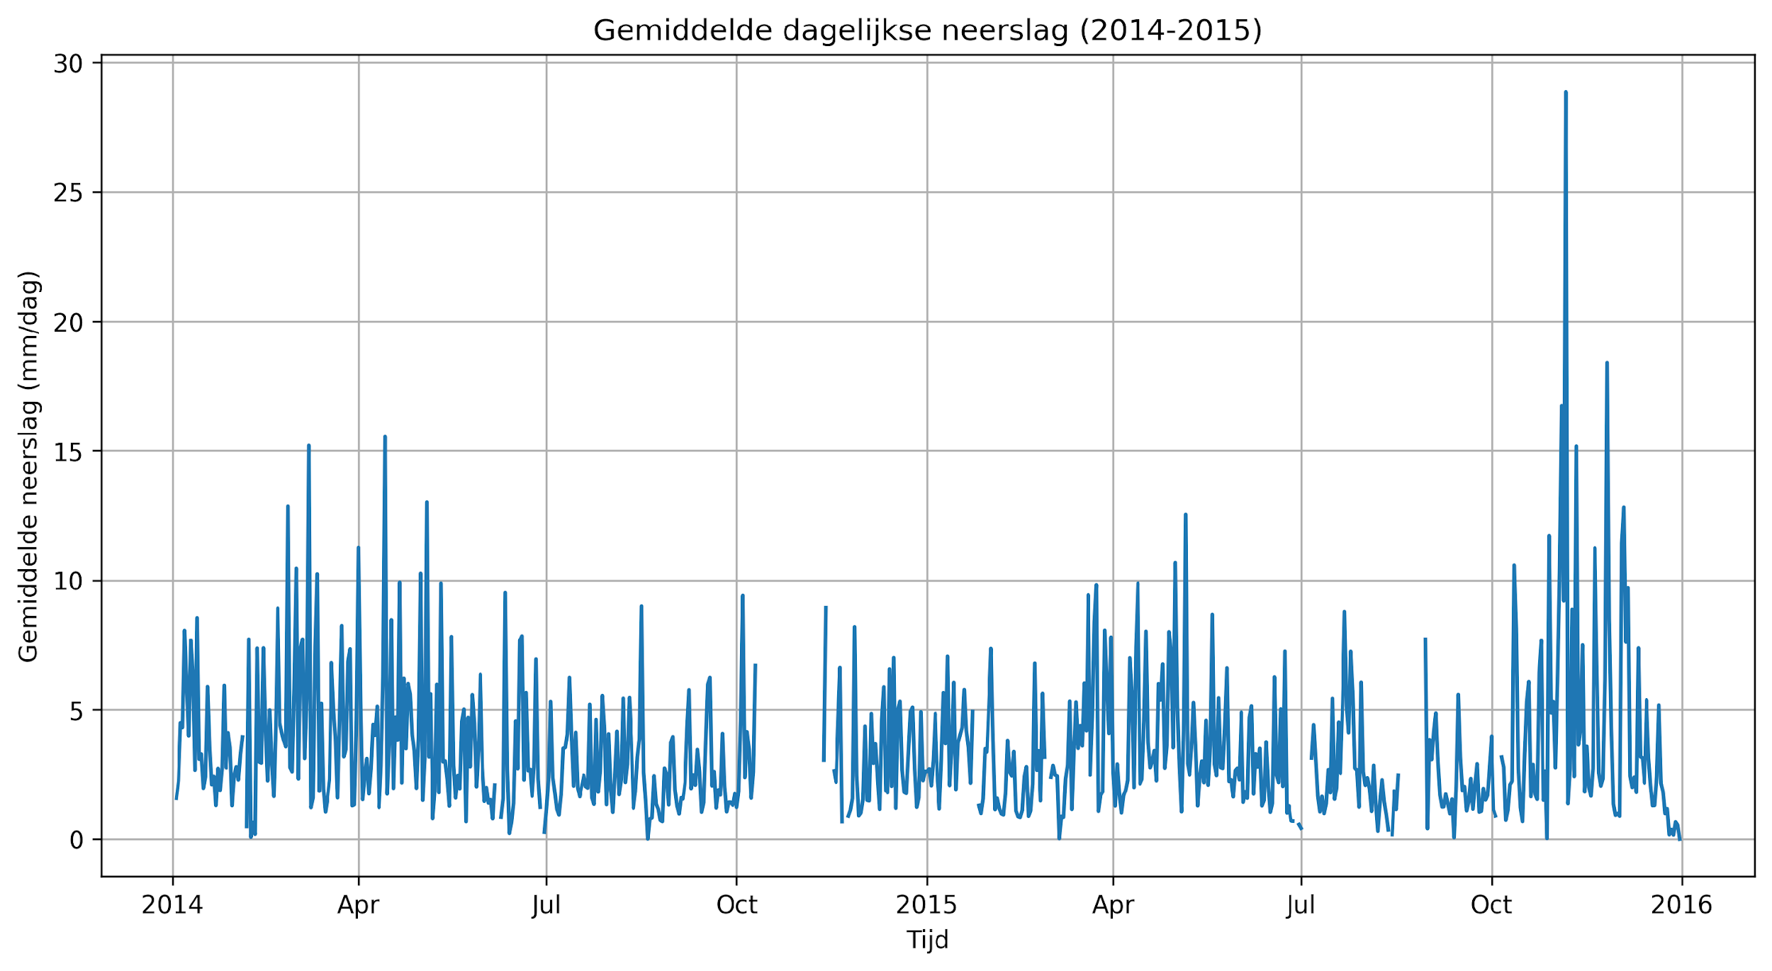
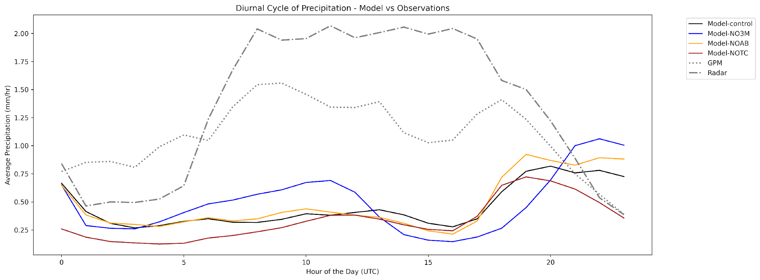
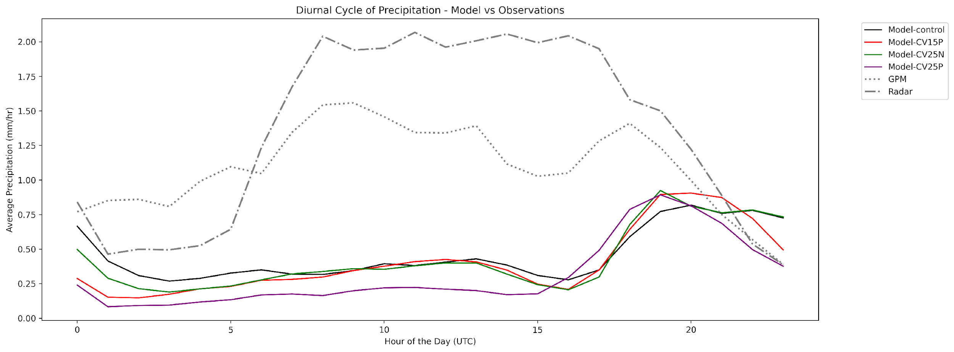
Spin up -24 hours. 5 Rain events in 2014 & 2015
Resolution – 4km Driven by Era5
Event based simulations.
NOTC: LCOEFKTKE = False
NOAB: LAB12 = False
NO3M: 3MT = False
CV15P: RMULACVG = 15
CV25N: RMULACVG = -25
CV25P: RMULACVG = 25
06/11/2015
08/03/2014
26/11/2015
14/04/2014
04/11/2015

Slide 7
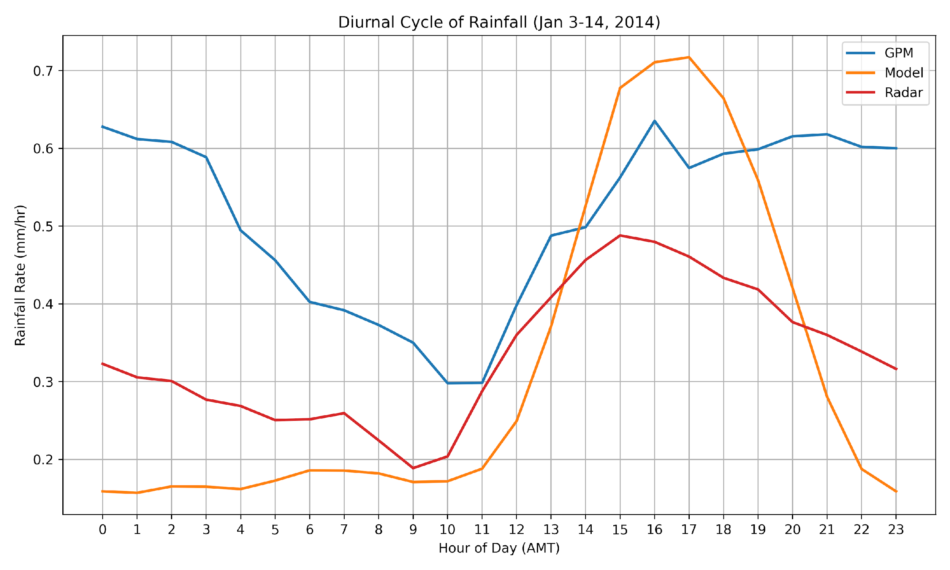
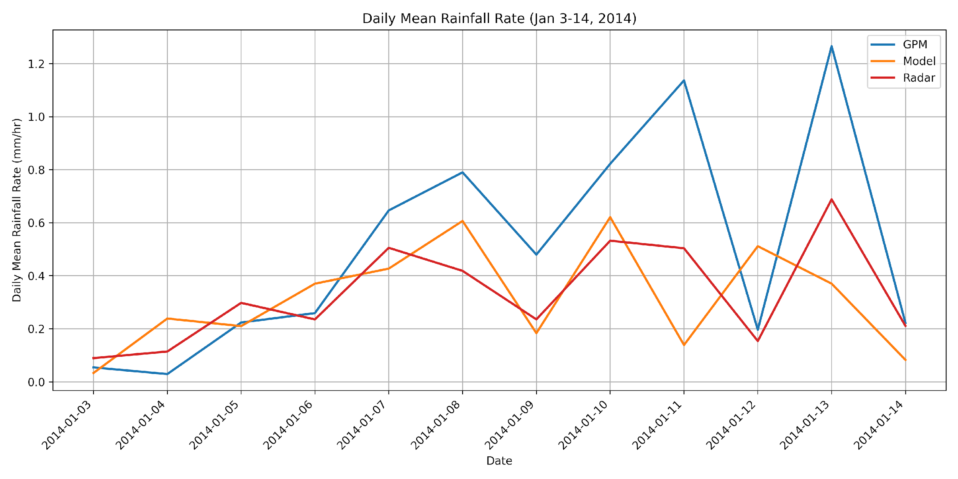
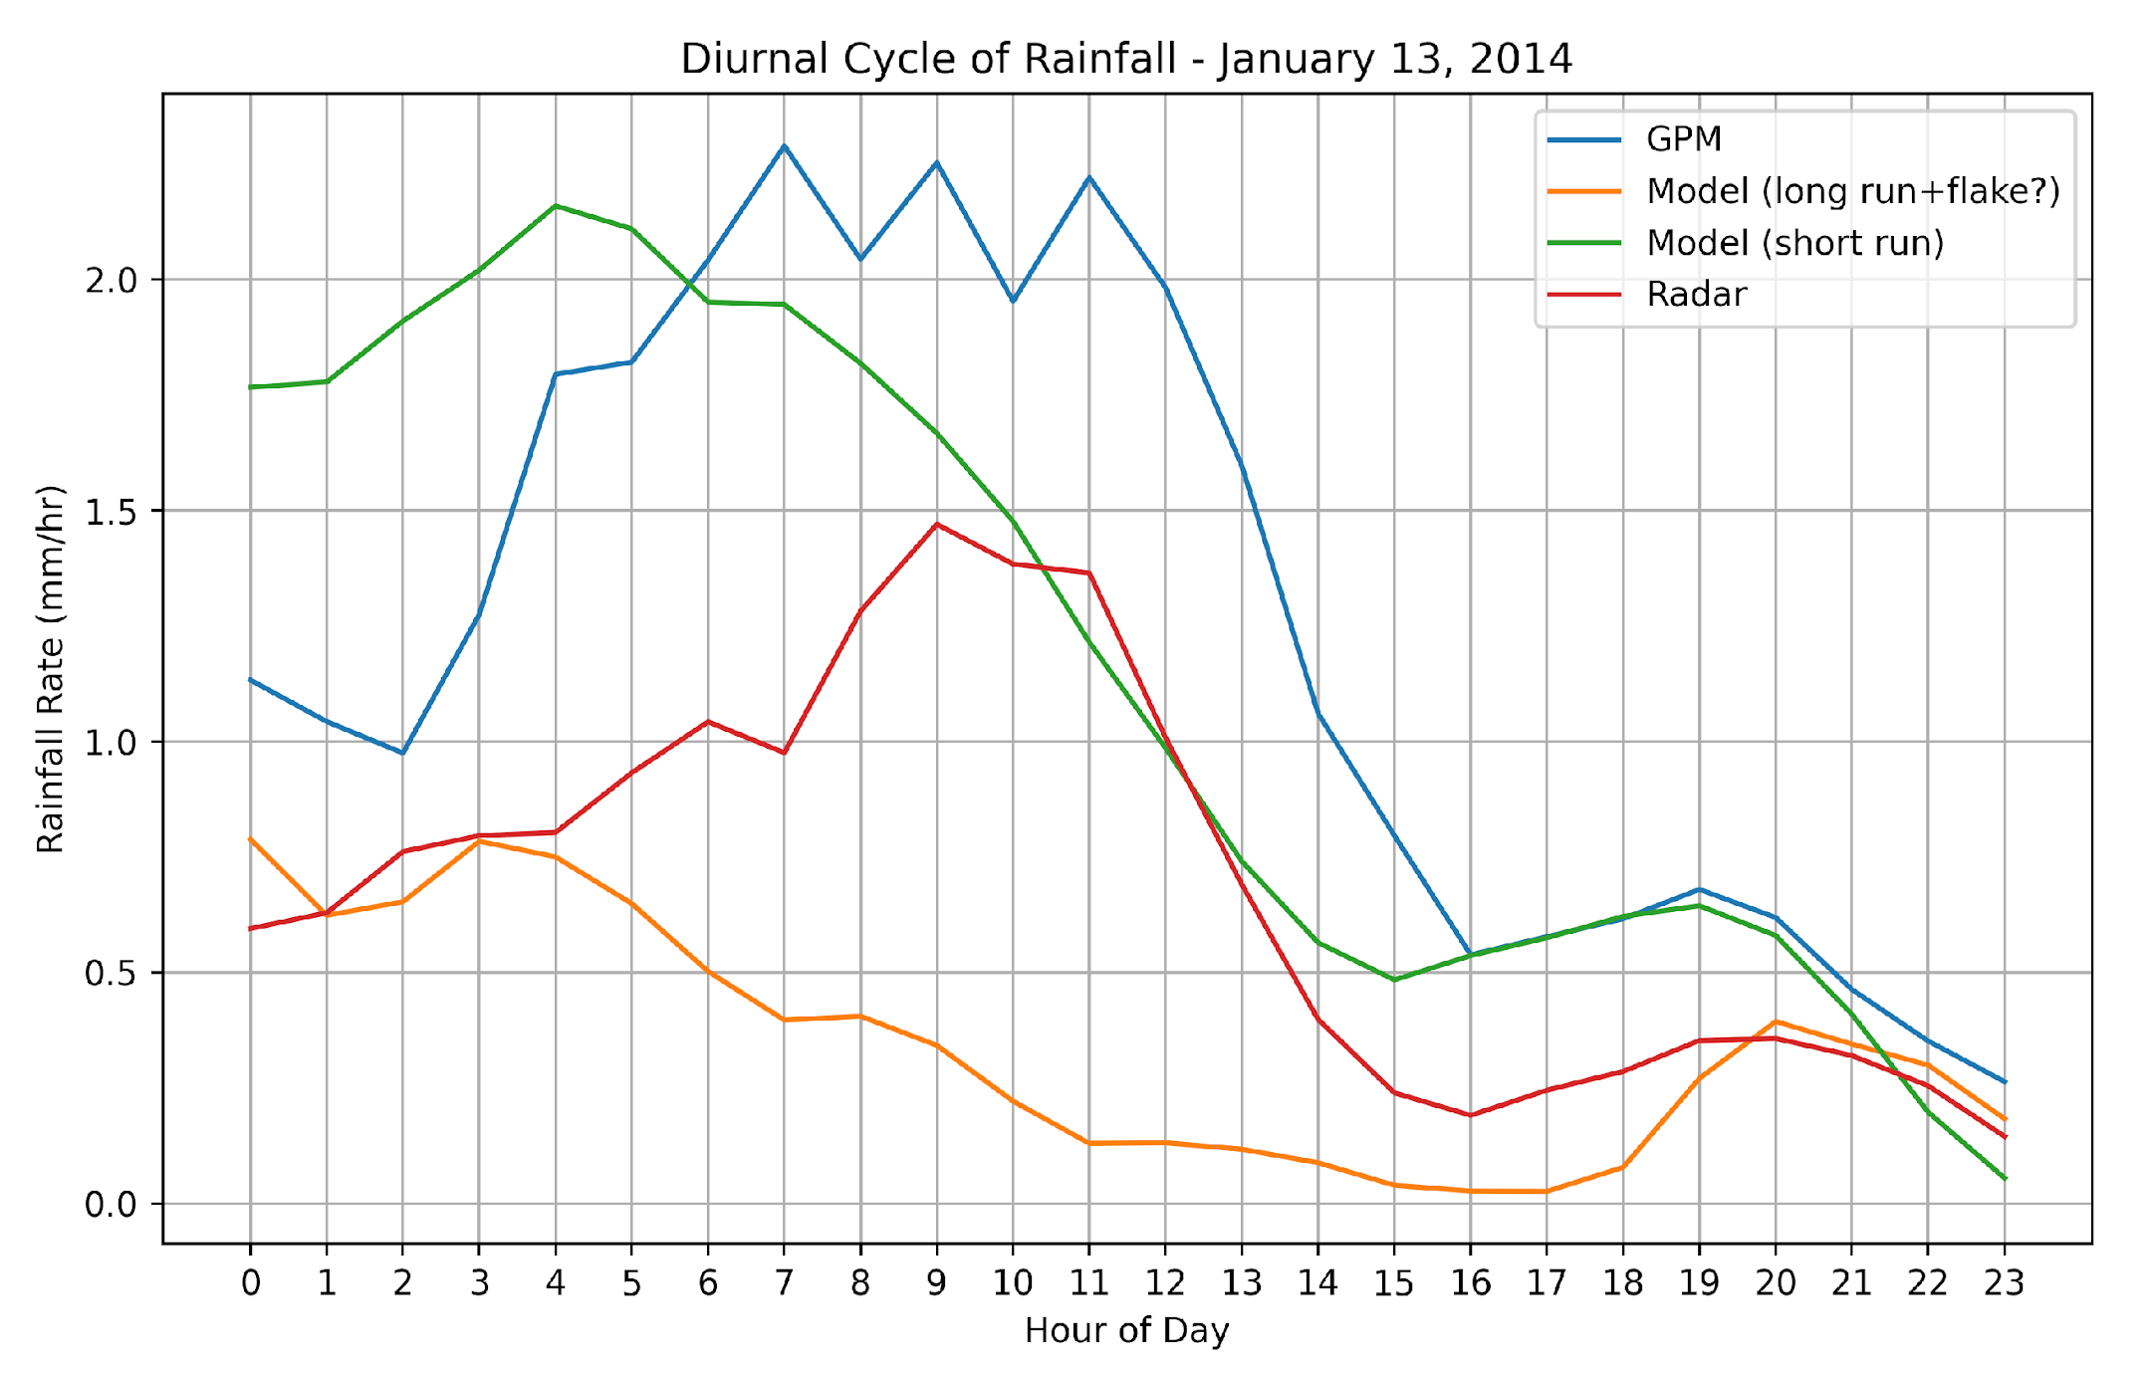
Results from the 1st test (control) simulations over Manaus
Results from the 1st test (control) simulations over Manaus
L3MT=.T.,
LCOEFKTKE=.T.,
RMULACVG=5.5, ! -25 in cy43
Flake is On
Soil – 14 layer soil moisture scheme
Spin-up = 4 months
Notes:
Question:
Should I add the namelist selections we used here, and Which ones?

Slide 8
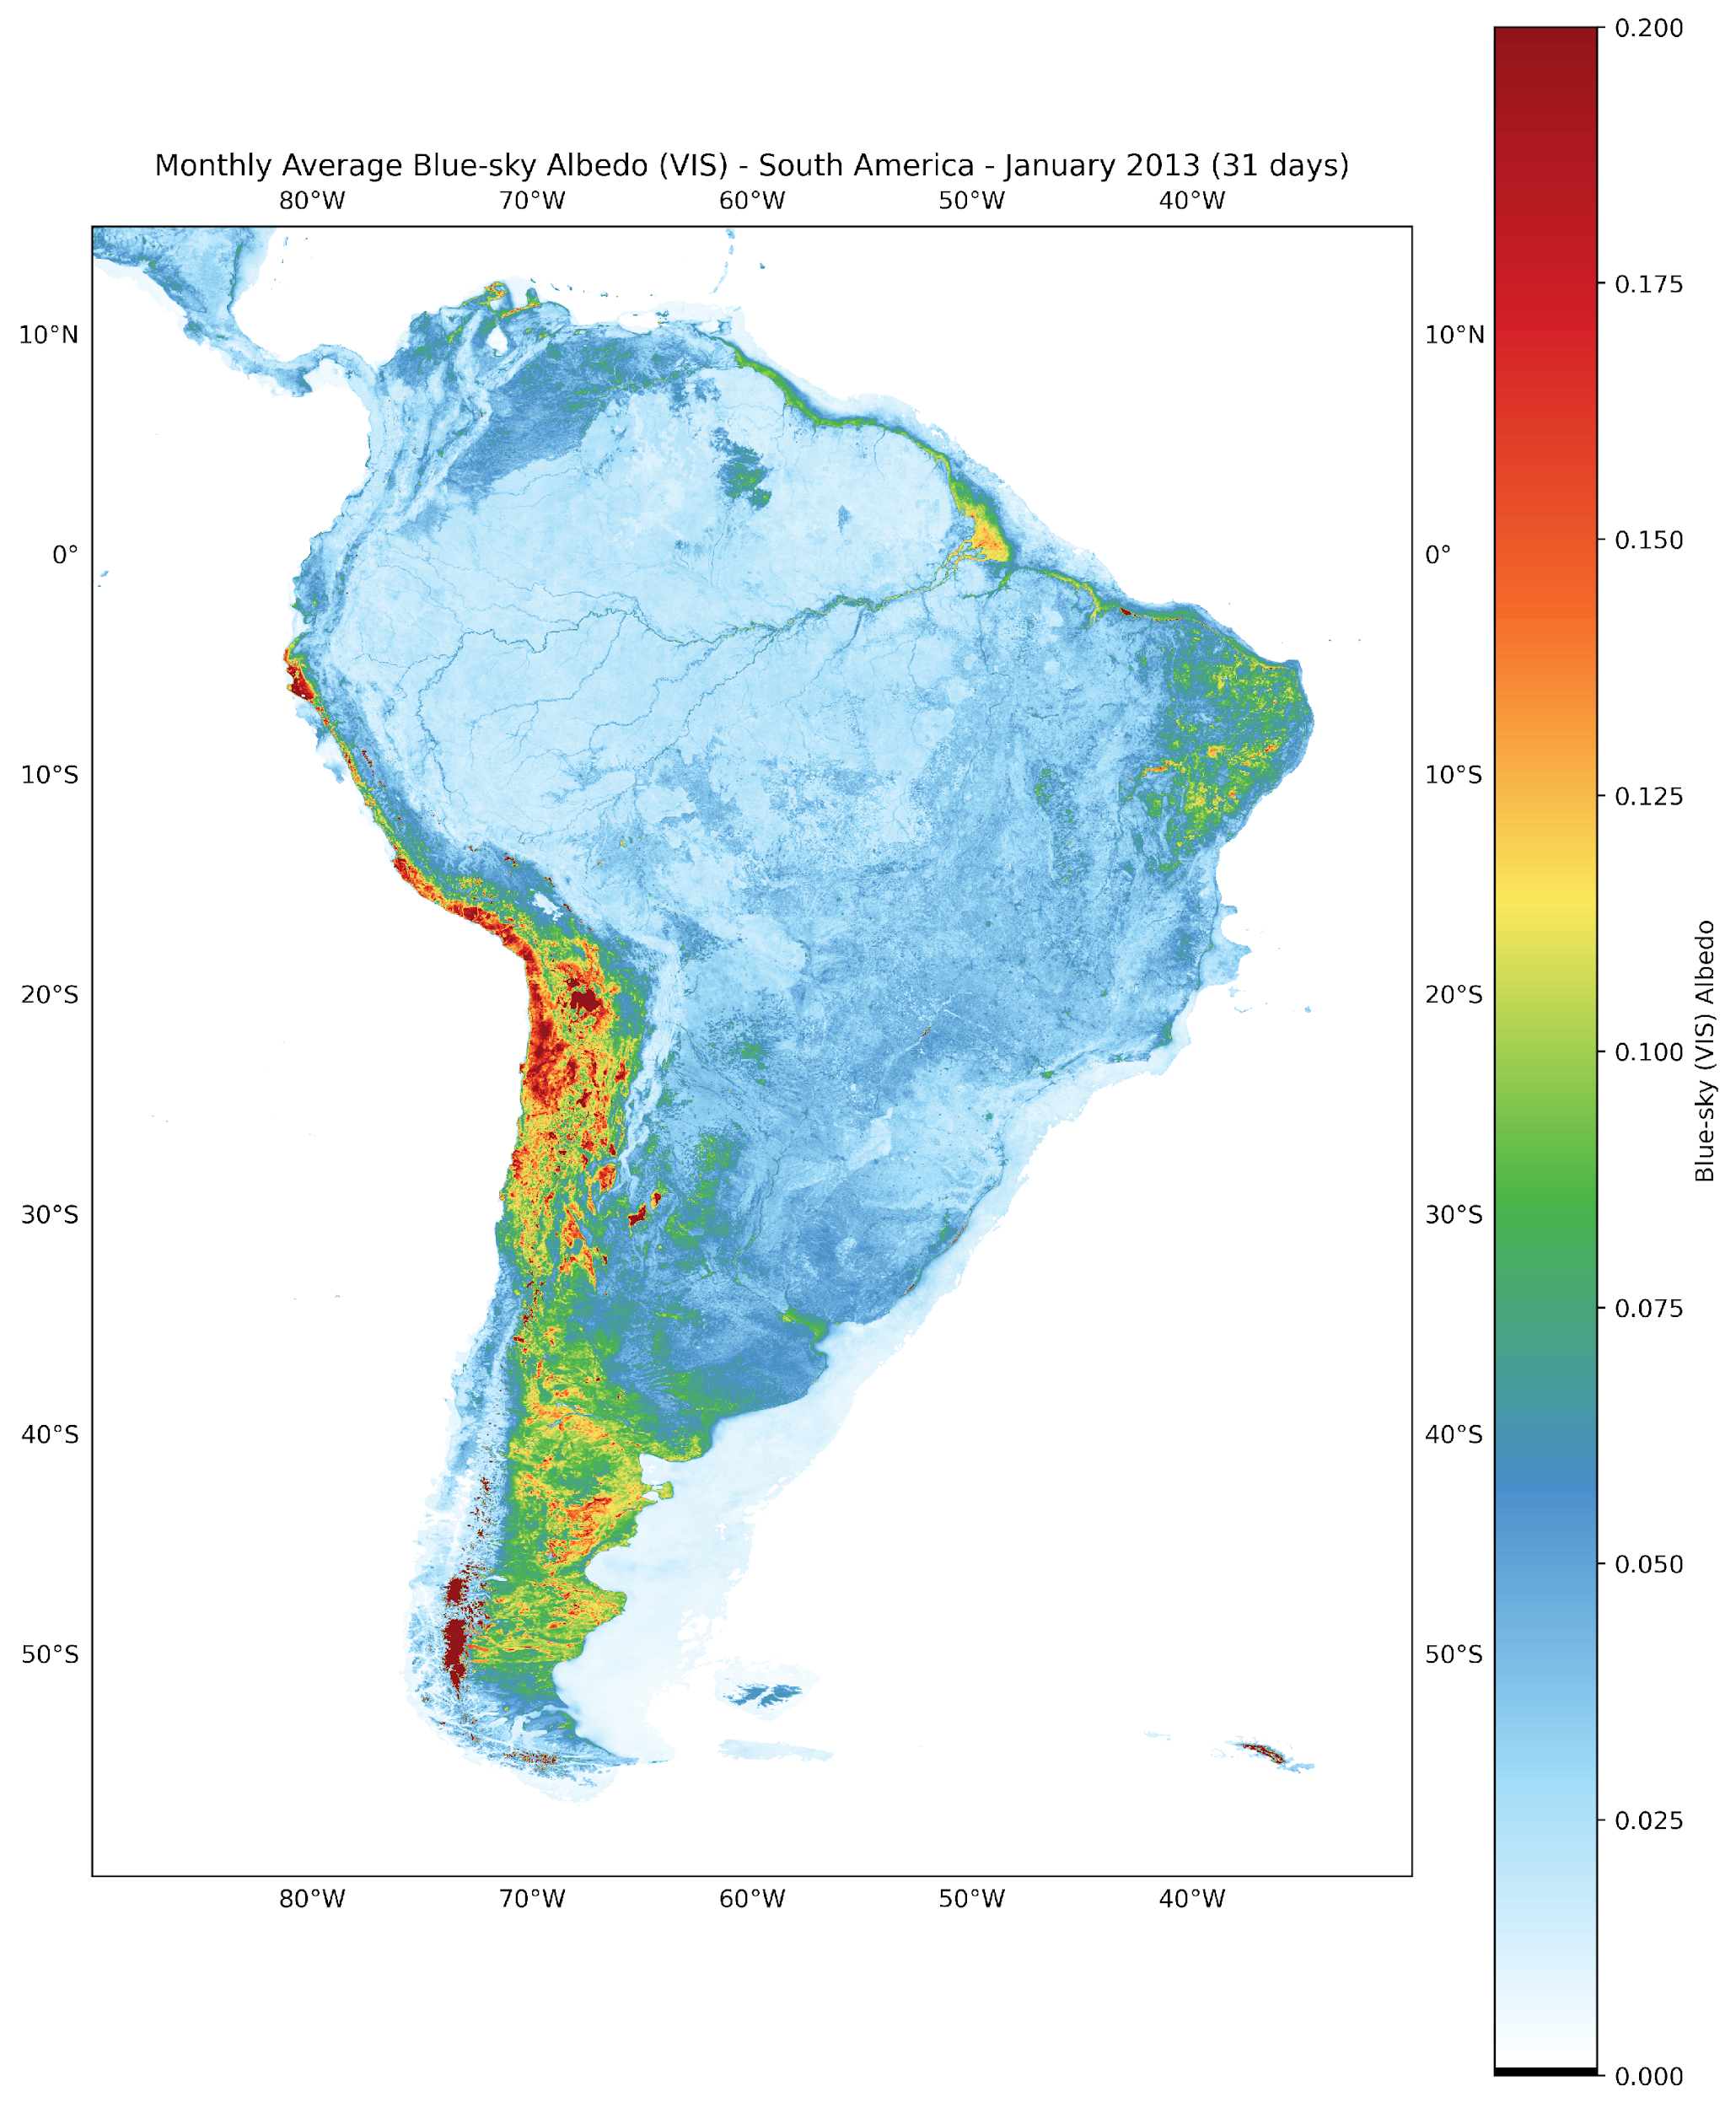
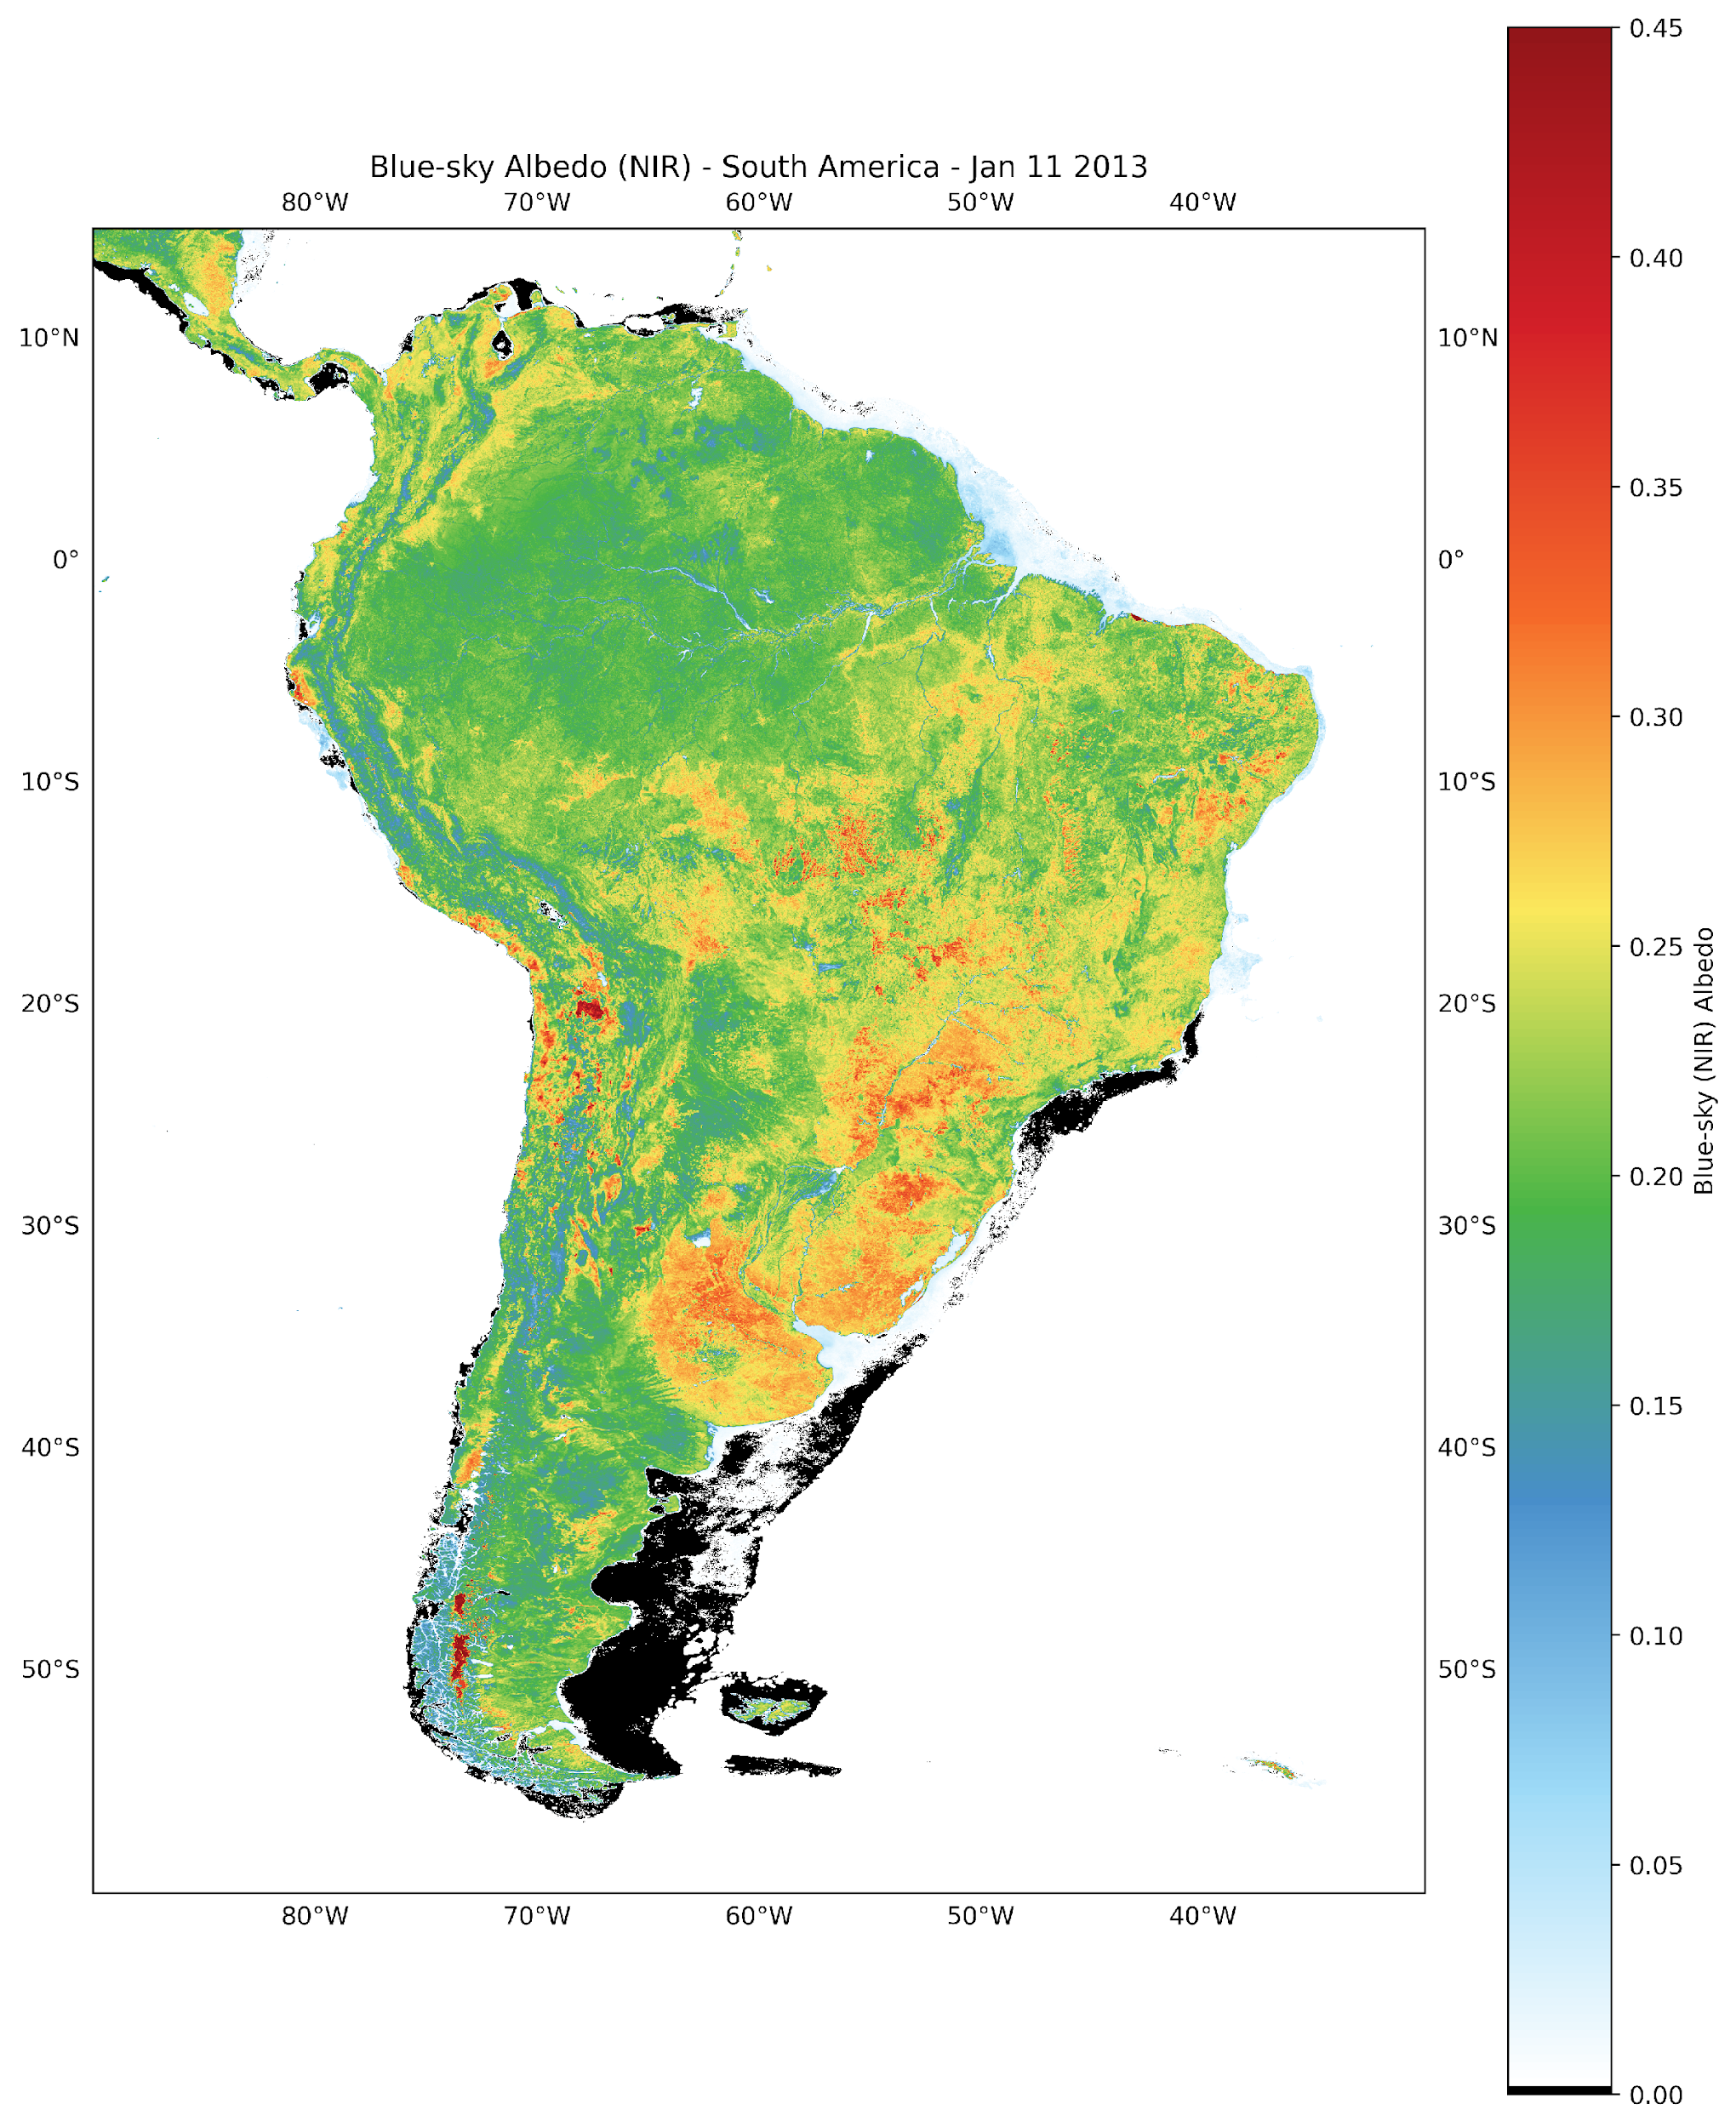
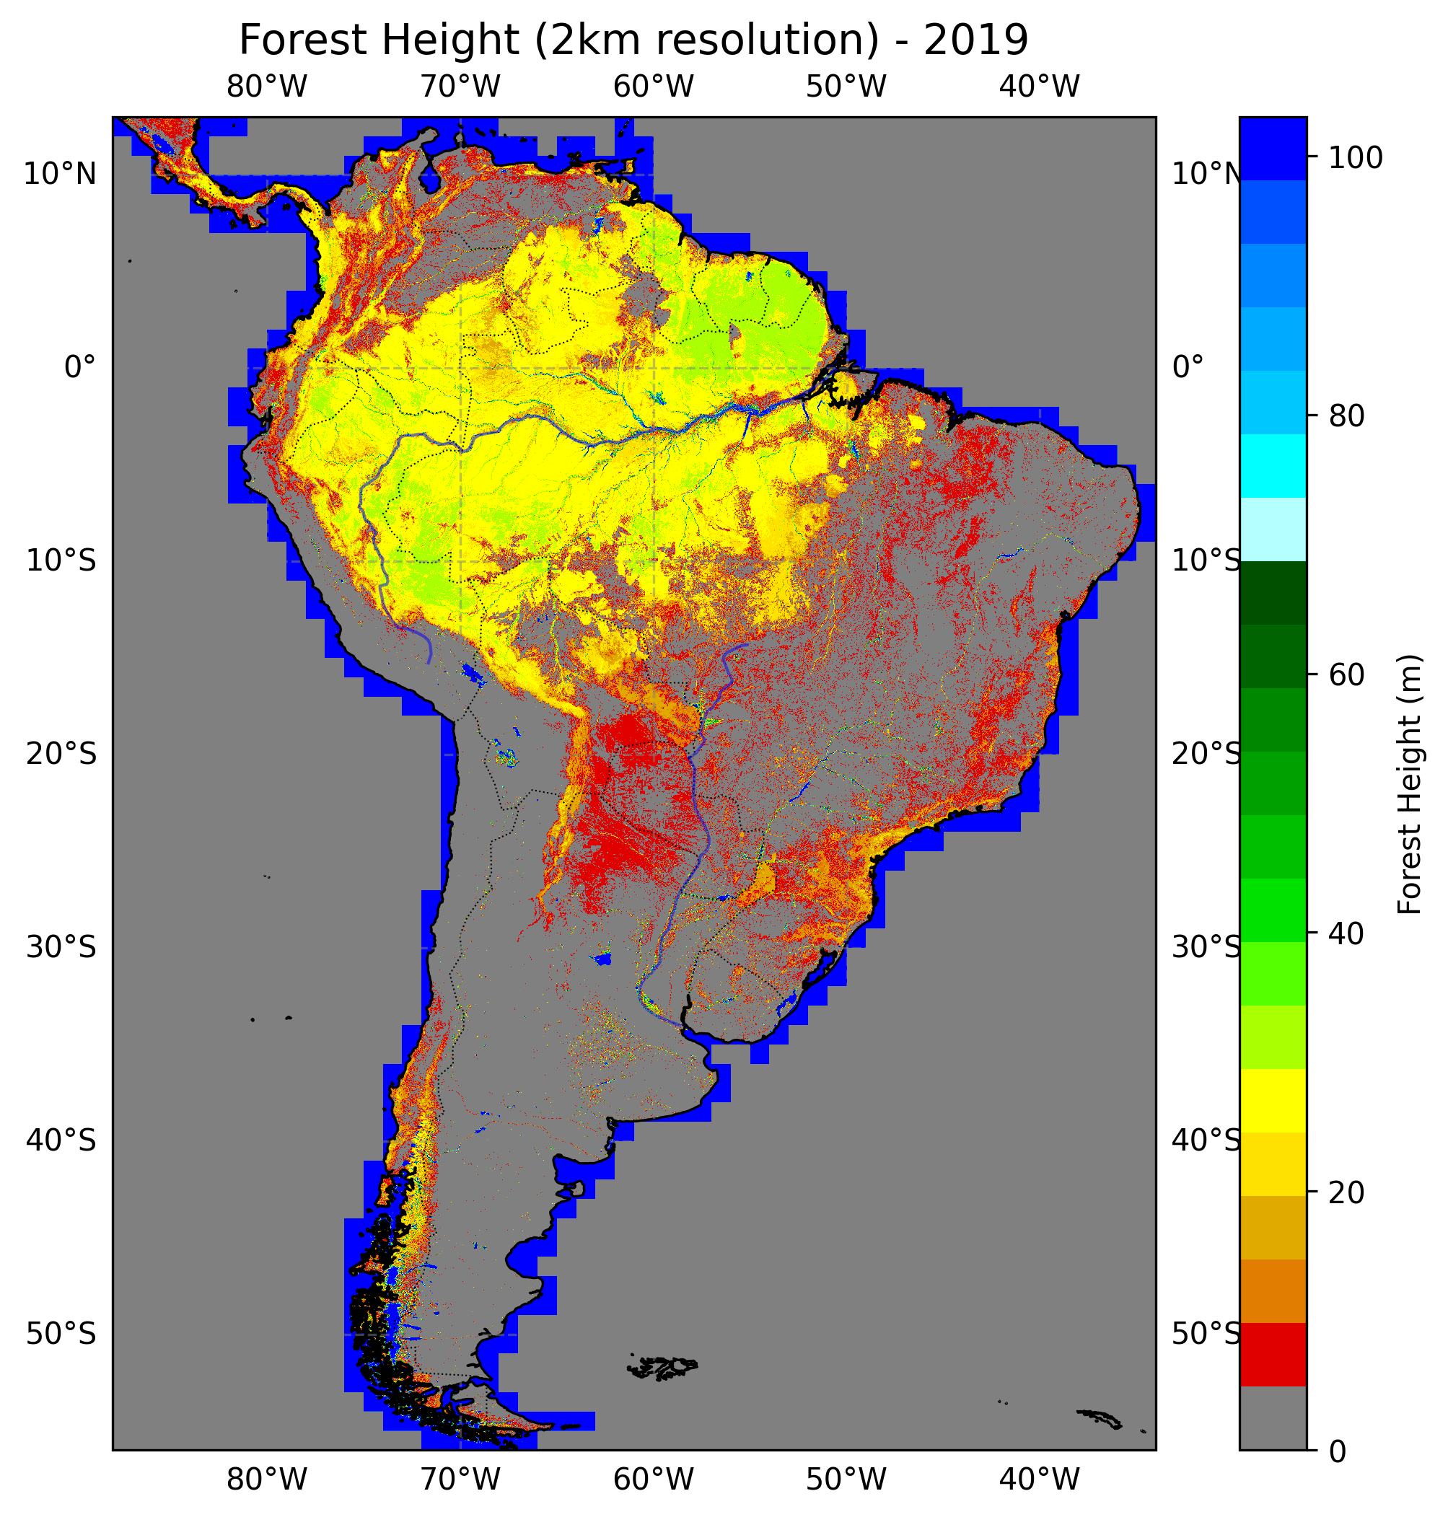
PGD creation with Monthly varying ALBEDO, Roughness and LAI

Slide 9
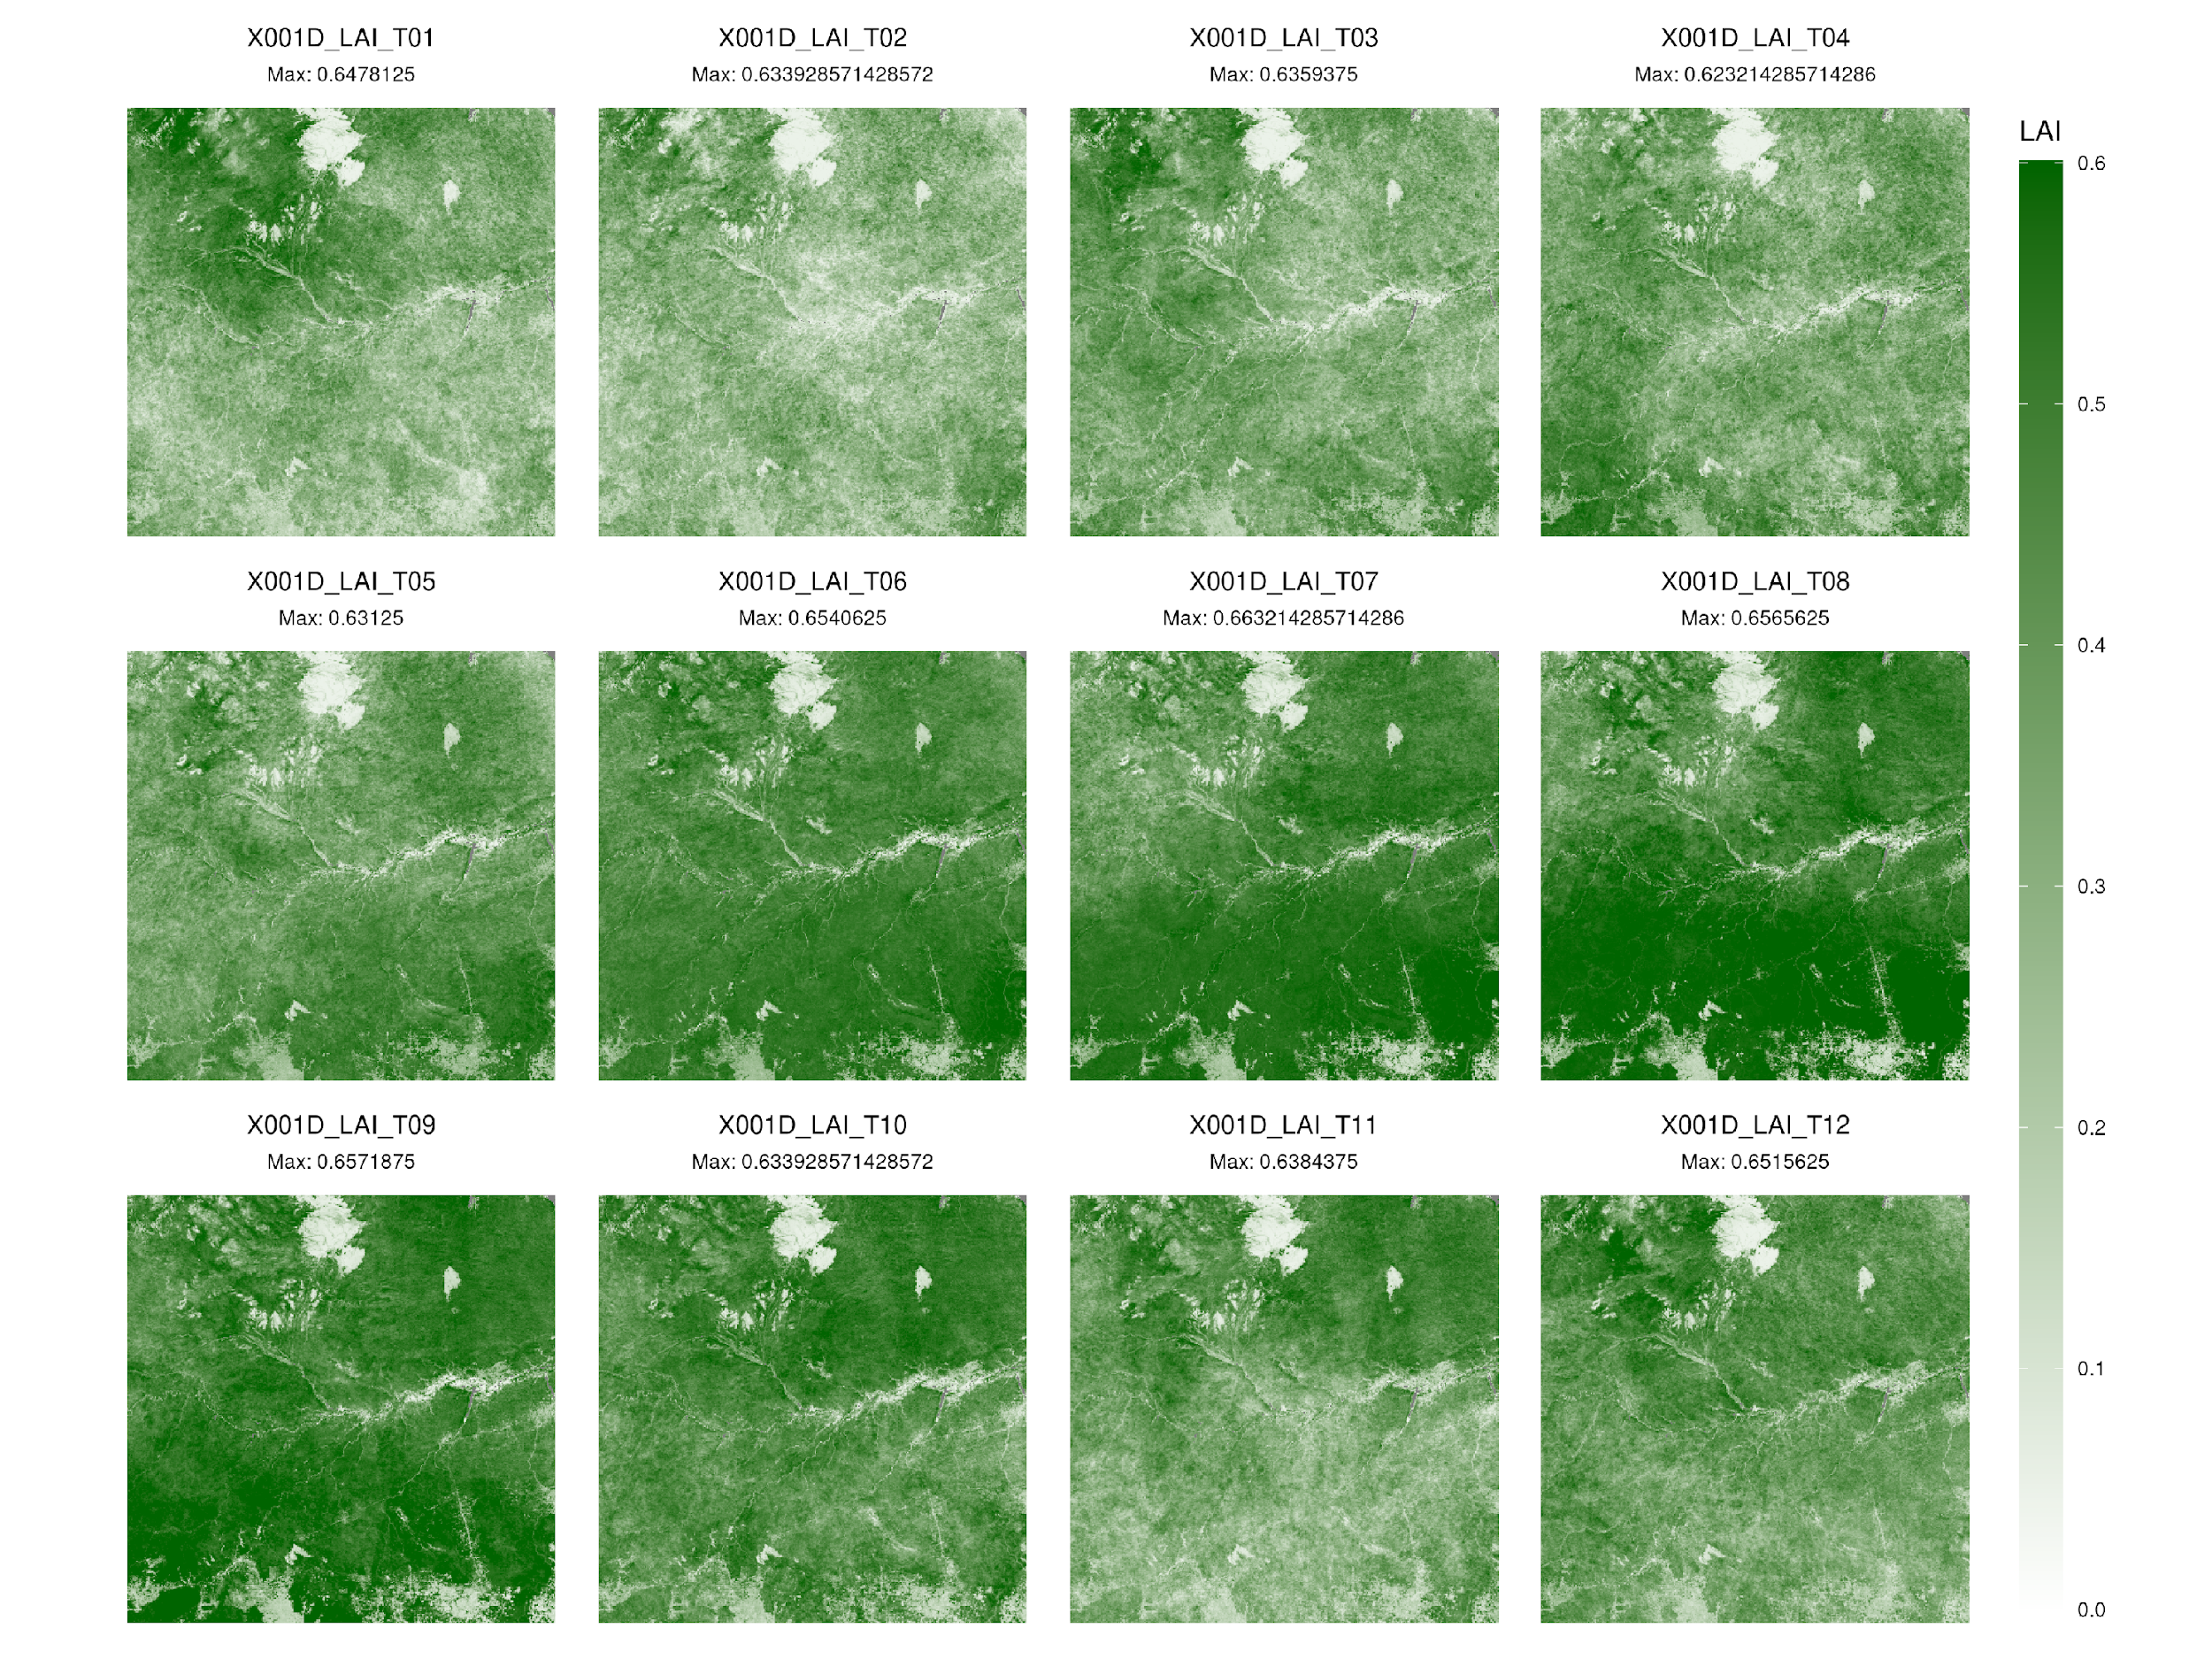
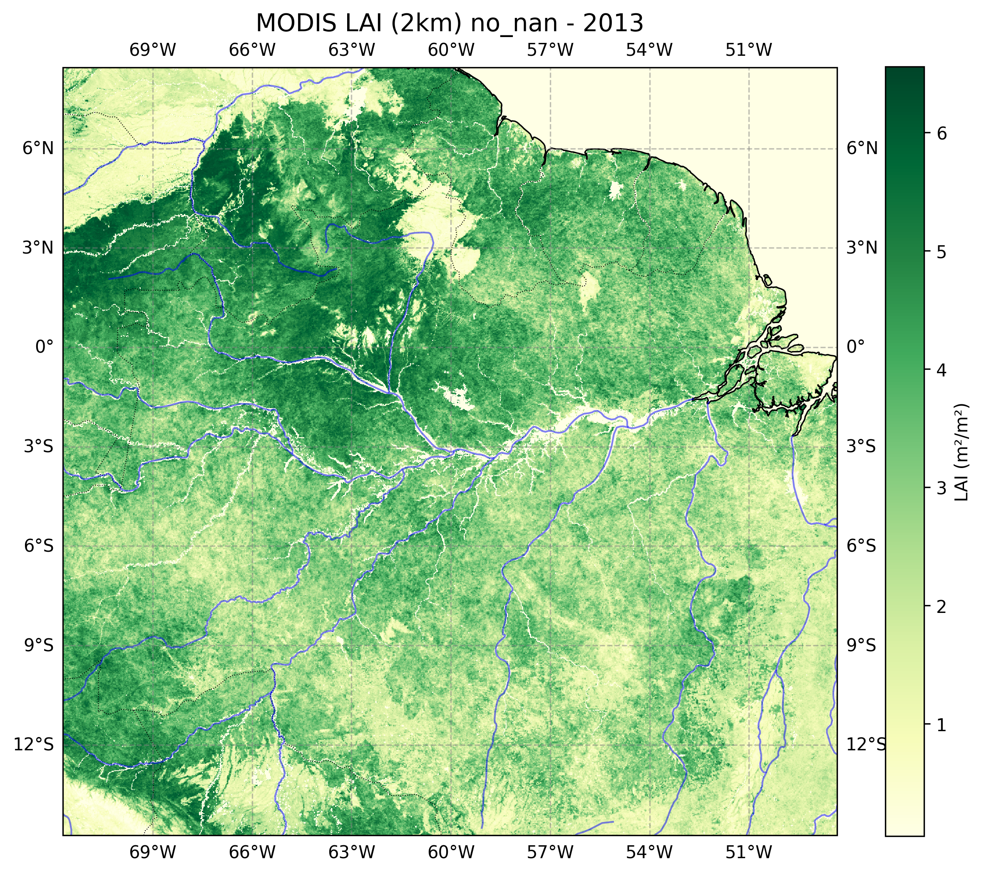
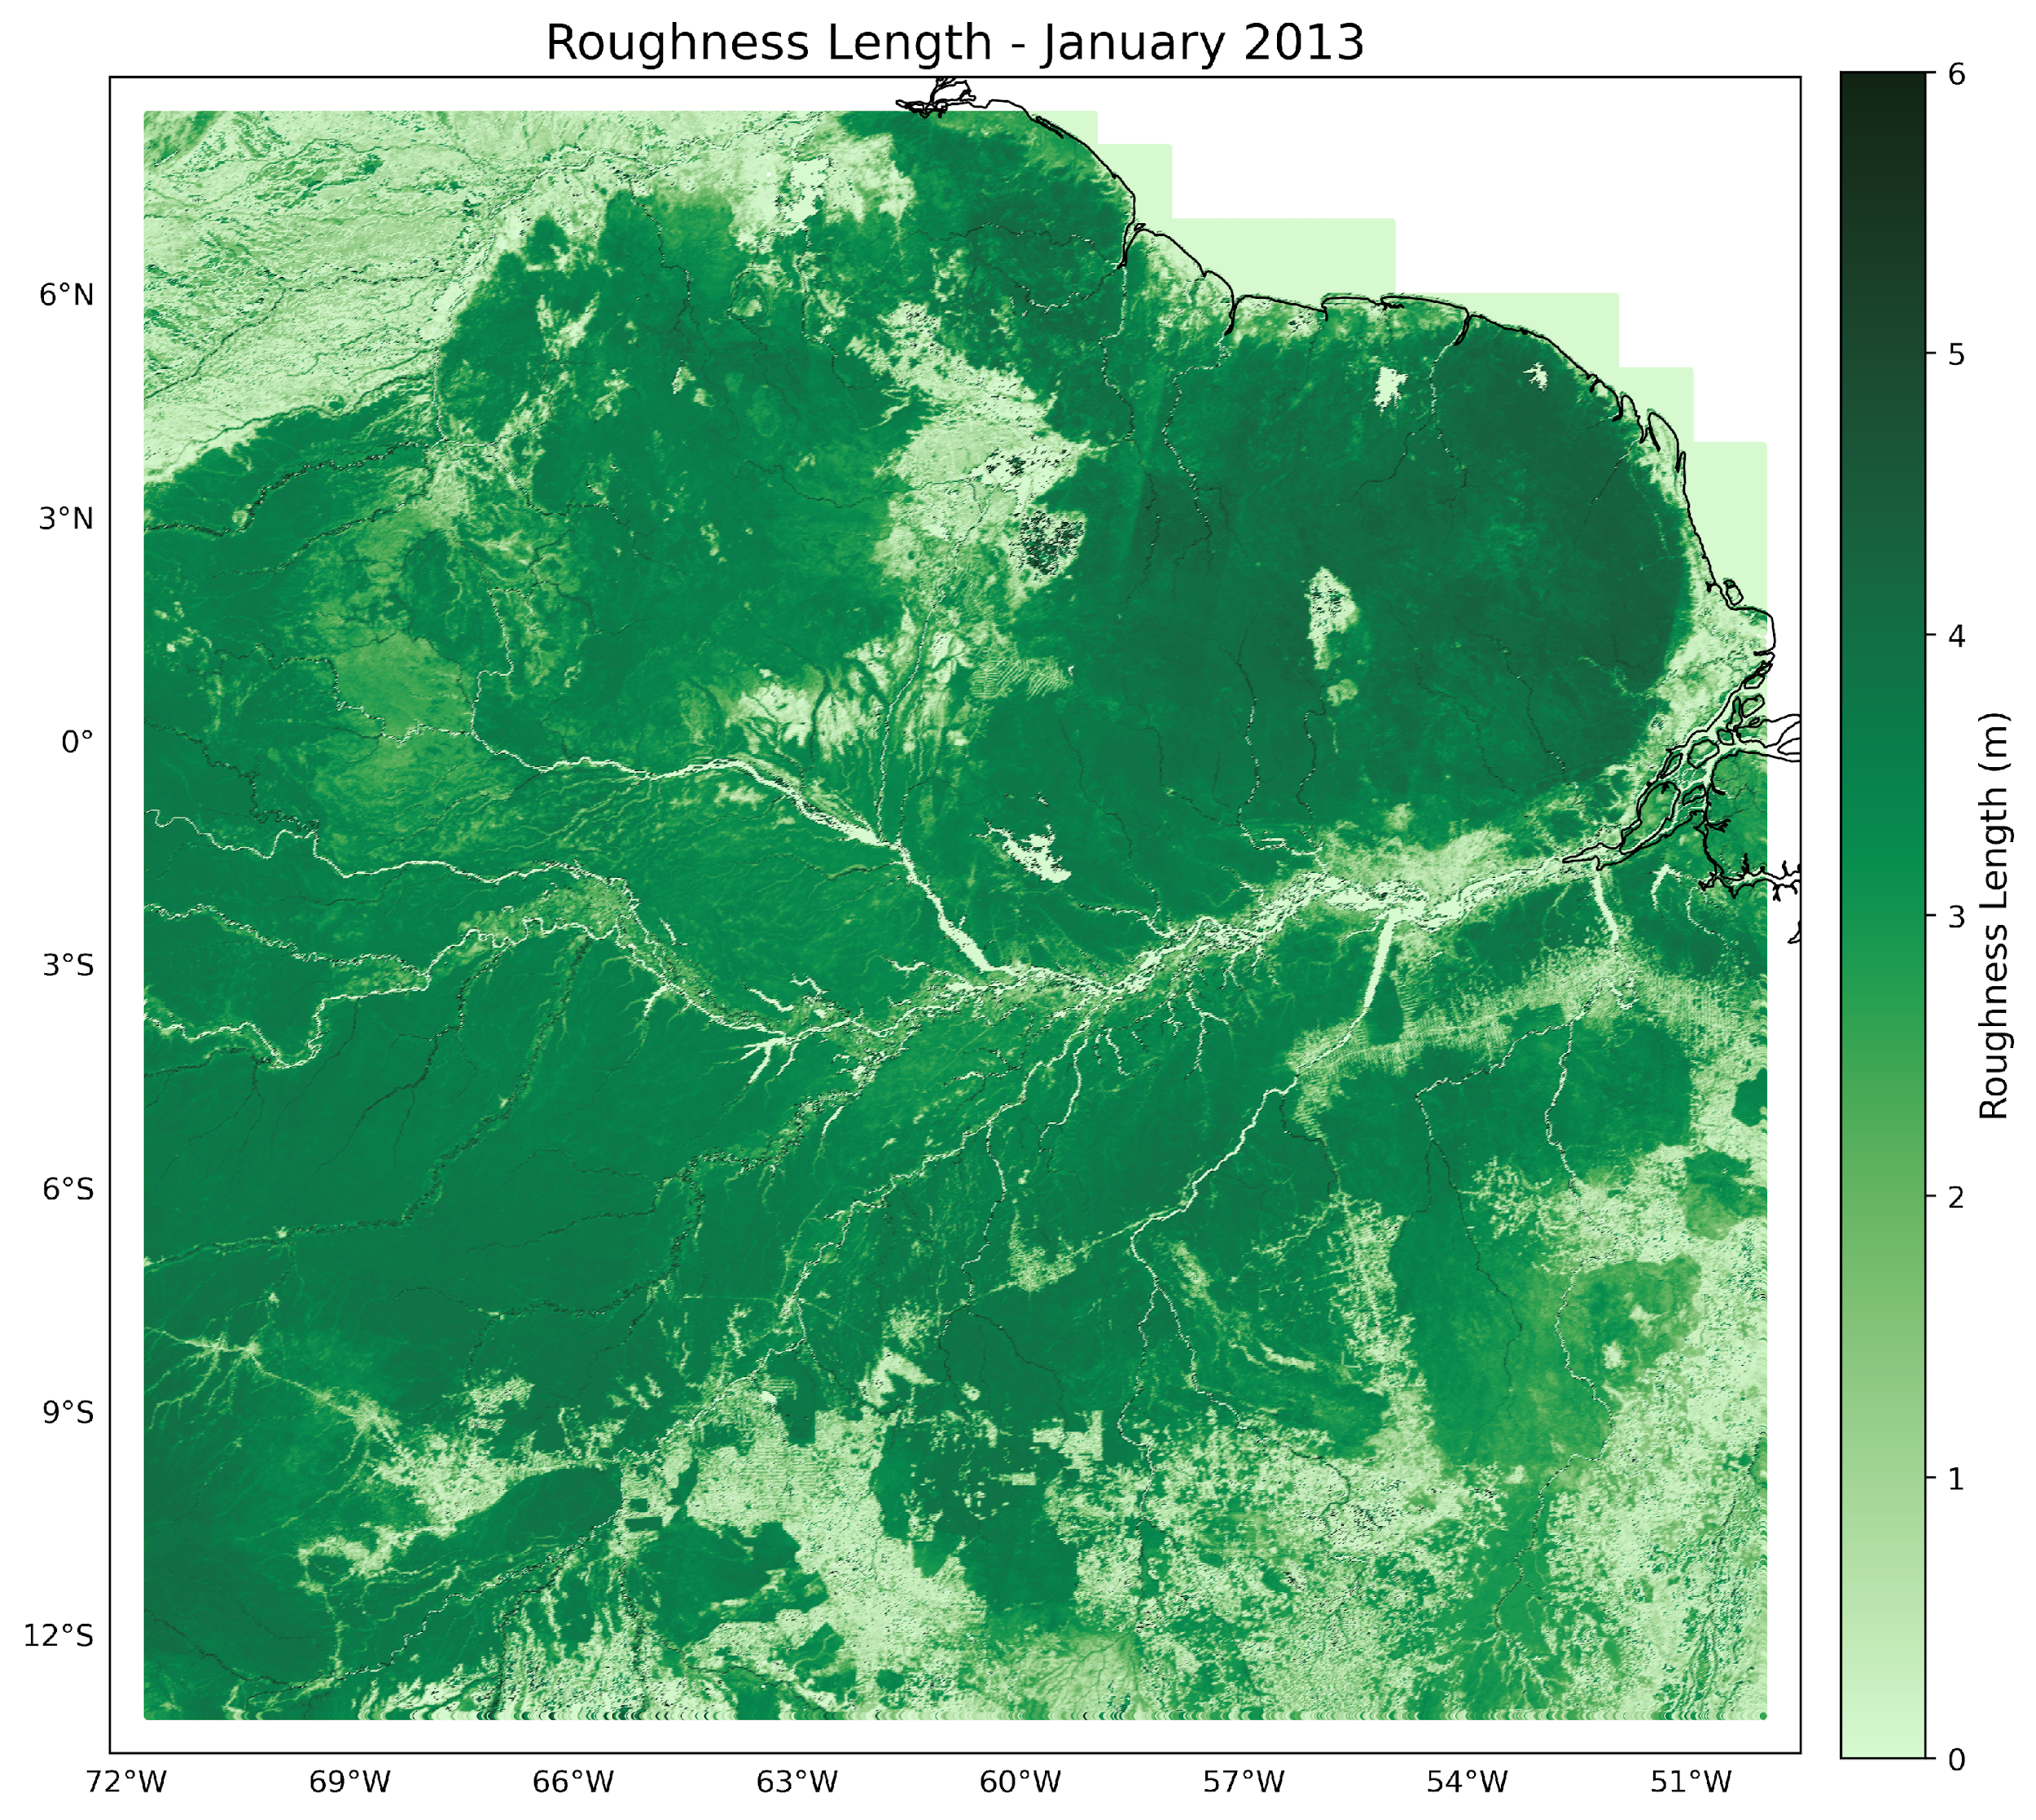

Slide 10
Problems faced.
While prep and PrepSurf works.
Both 4 nodes and 8 nodes fails for the main forecast
The model only works with up to 2 nodes and 256 cores.
&NAMPAR0 NPROC=1024, NPRGPNS=4, NPRGPEW=256, NPRTRW=256, NPRTRV=4, /
Leads to a segmentation fault.

Slide 11
Thanks.

