Slide 1
Possible use of machine learning techniques in ALARO
Bogdan Bochenek

Slide 2
Bias correction and postprocessing
Applications
ML WG summary
Ideas for studies/implementation
  EPS
  Deterministic

Slide 3
Why we should consider ML?
Relatively easy to publish or find grants/financing
Young people can be interested by this subject
ML specialist from Universities can help
Suitable for GPU machines
Plans to use ML
(ACCORD/ECMWF/NOAA)

Slide 4
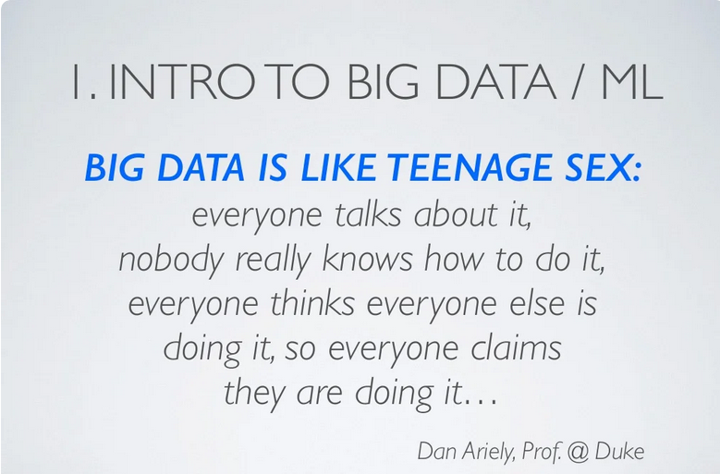
Why we should consider ML?

Slide 5
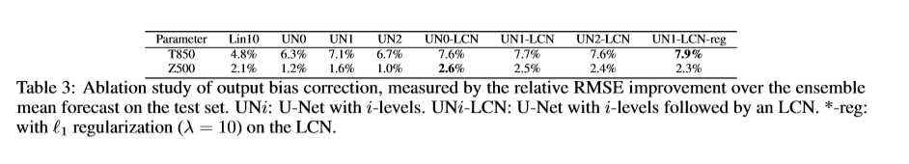
Bias correction/postprocessing
Multimodel with Random Forest (P. Sekula)
Subgrid wind speed (A. Simon)
Numerous publications and implementation around the Word:
Deep Learning for Post-Processing Ensemble Weather Forecasts

Slide 6
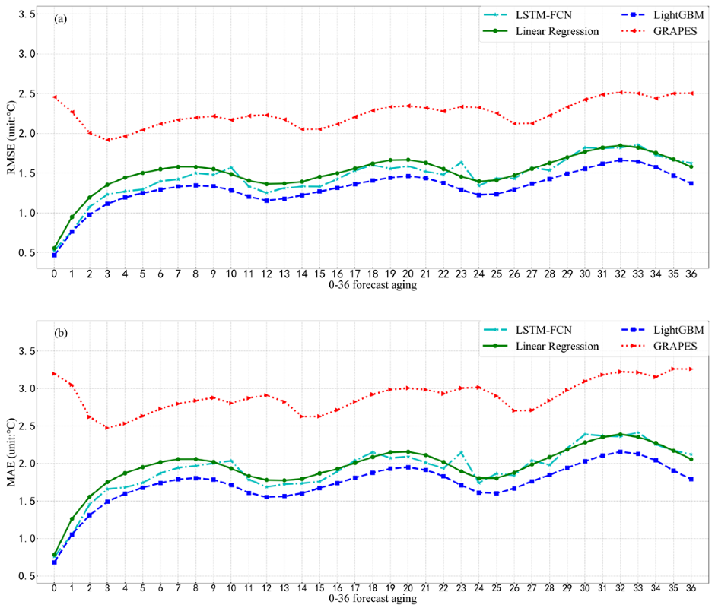
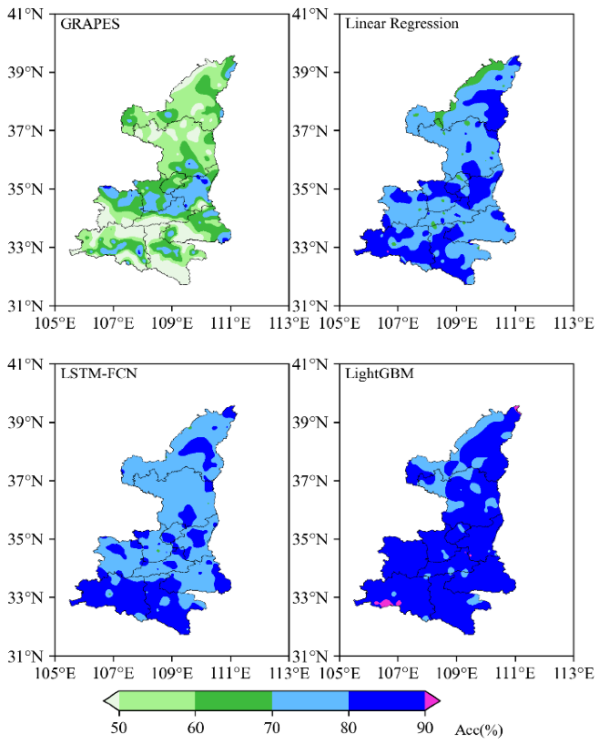
Bias correction/postprocessing
Temperature Forecasting Correction Based on Operational GRAPES-3km Model Using Machine Learning Methods

Slide 7
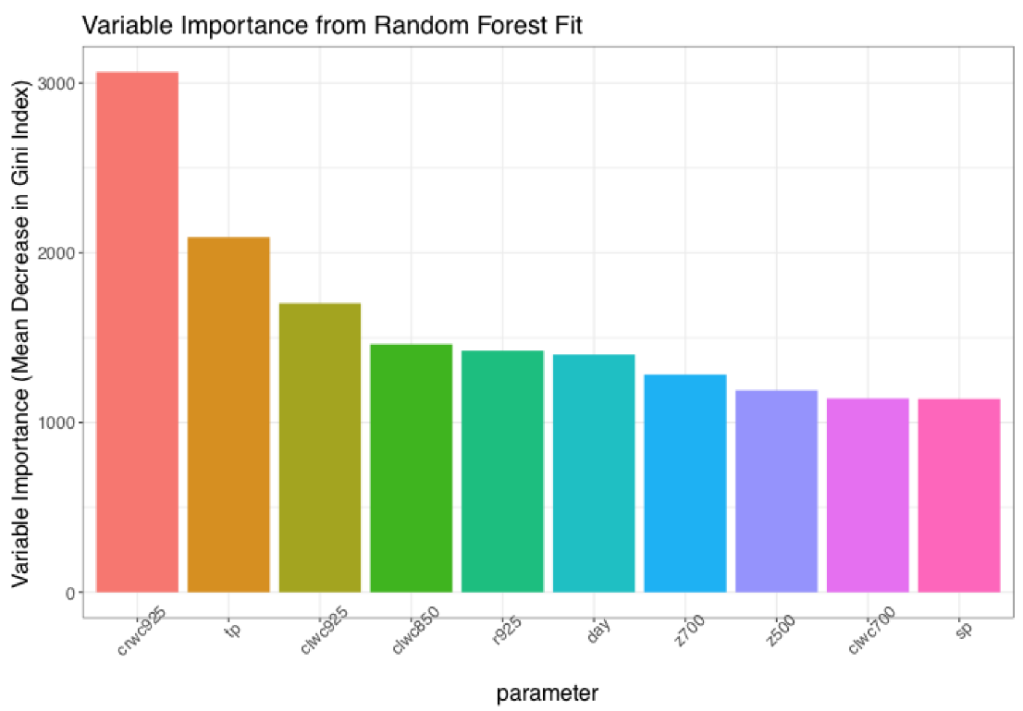
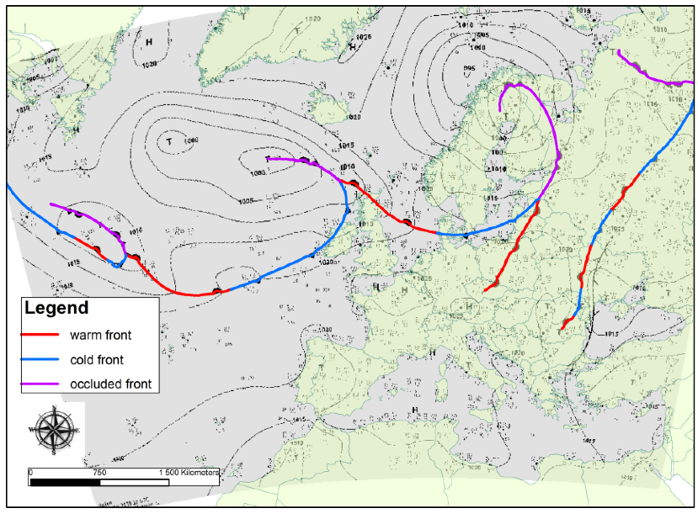
Applications – weather fronts
  Machine Learning-Based Front Detection in Central Europe

Slide 8
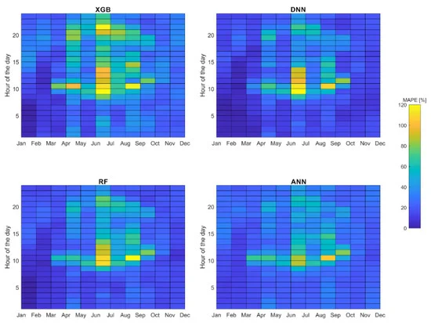
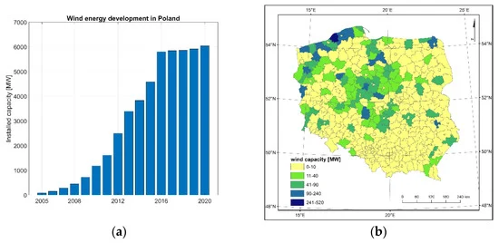
Applications – renewable energy
Day-Ahead Wind Power Forecasting in Poland Based on Numerical Weather Prediction

Slide 9
Applications – renewable energy
Comparison of power curve and ML forecasts
2 months of 10 minute data from wind farm
ALARO forecasts
​ | r​ | MAPE​ | BIAS​ [kW] | RMSE​ [kW]
Power curve (measurements)​ | 0.99​ | 0.24​ | 69​ | 135​
Random Forest (forecast) ​ | 0.95​ | 0.25​ | -12​ | 216​
Power curve (forecast)​ | 0.77​ | 1.54​ | 137​ | 478​

Slide 10
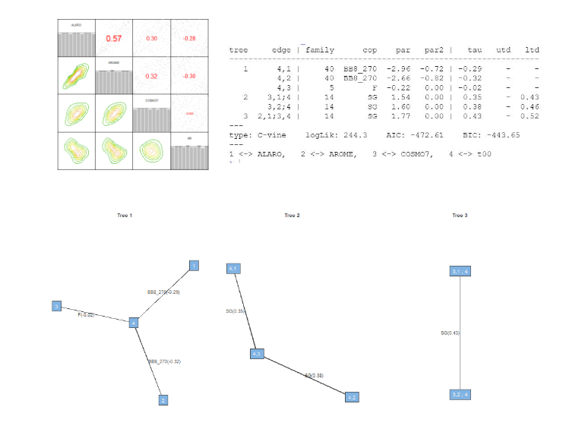
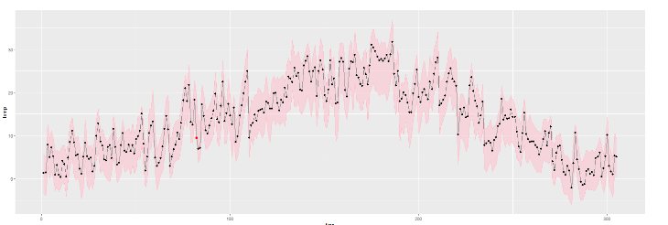
Applications – extreme events (copula)

Slide 11
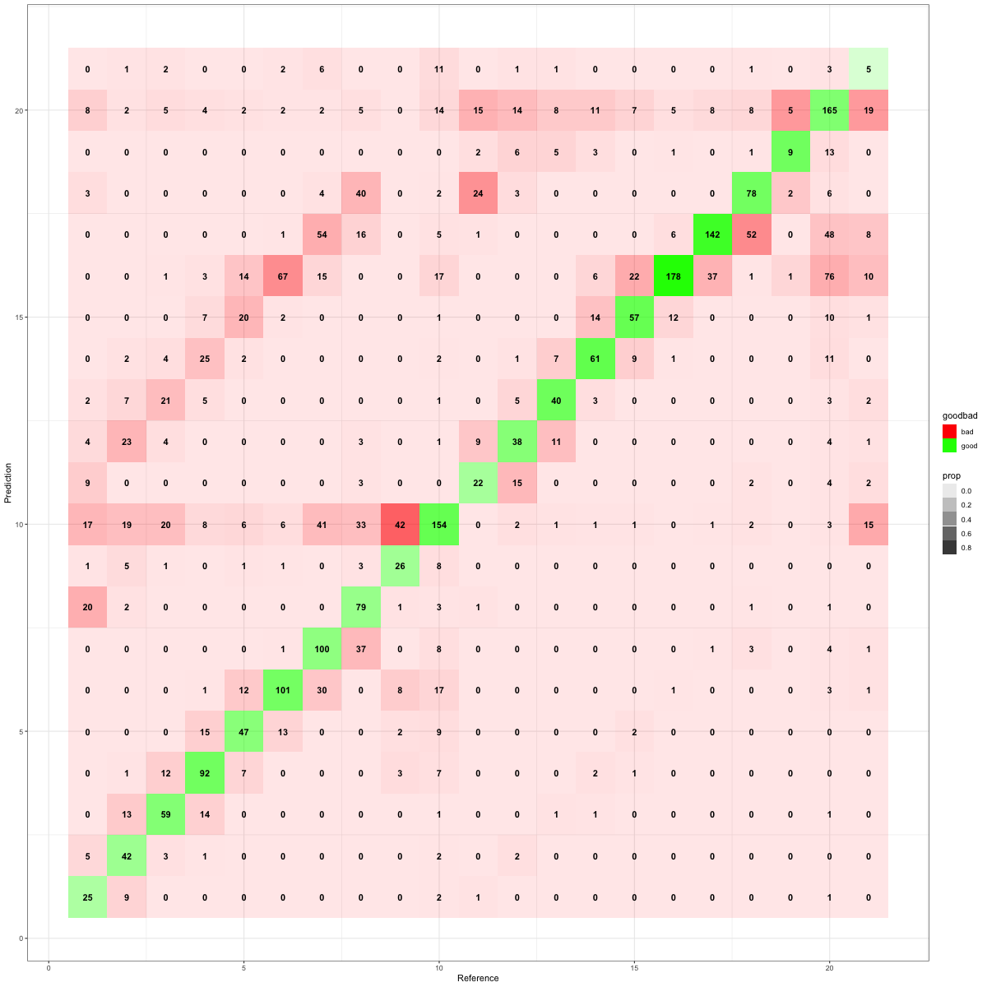
Applications – circulation types with CNN
Manual calendars of circulation types in Europe
Niedźwiedź, 2021
Lityński, 1969
ERA5 reanalysis:
Temperature, wind, geopotential, vorticity (isobaric levels)
Precipitation, cloudiness (Surface)
Model to predict circulation type based on NWP forecasts
Usefull for othe applications

Slide 12
Applications – replace NWP completely?
WeatherBench: A Benchmark Data Set for Data‐Driven Weather Forecasting
Based on ERA5, predict some fields for shorter or longer leadtimes
Verification scores comparable to IFS with similar resolution
Huge ensemble of forecasts (10^3 members) computed in less the 1 second with GPU

Slide 13
ML WG summary
https://opensource.umr-cnrm.fr/projects/accord/wiki/Minutes_of_meetings_of_WG-ML
3D effects in radiation, cloud effects (shading)
Turbulence
Physiography data sets
Model parameter tuning
Probabilistic forecasting
Data assimilation

Slide 14
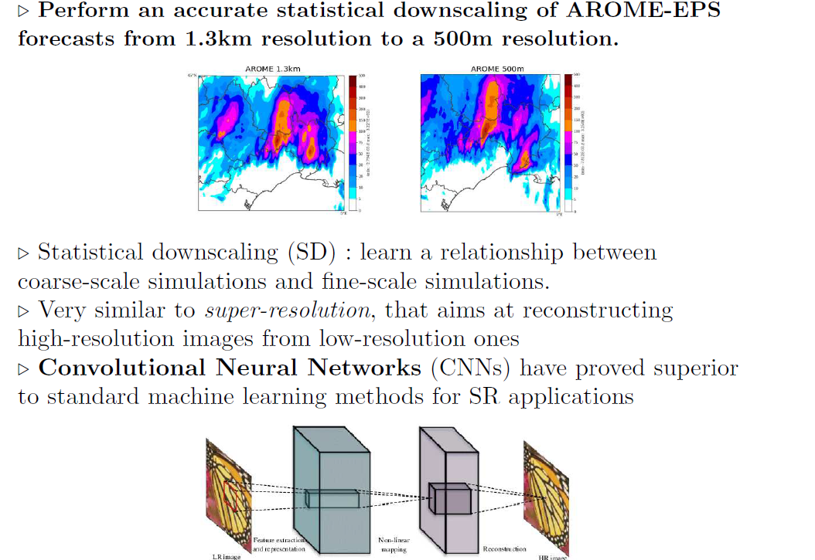
Ideas for studies/implementation
AROME EPS plans with ML

Slide 15
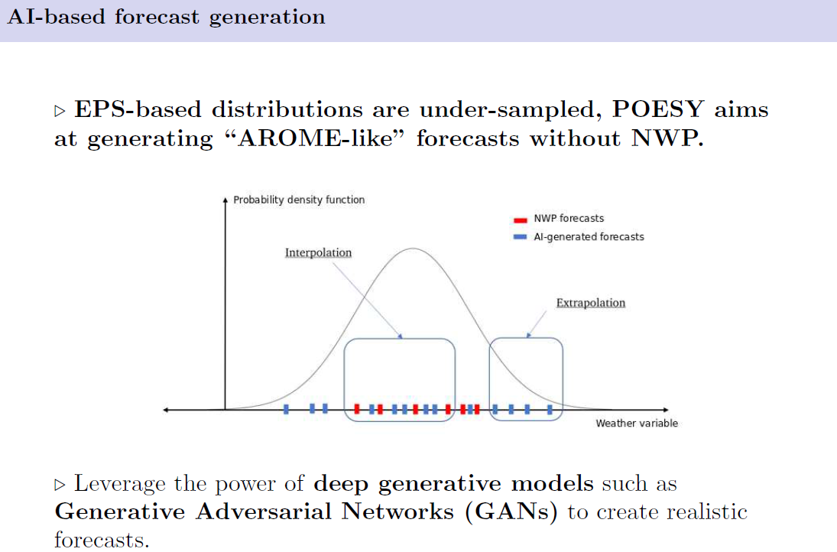
Ideas for studies/implementation
AROME EPS plans with ML

Slide 16
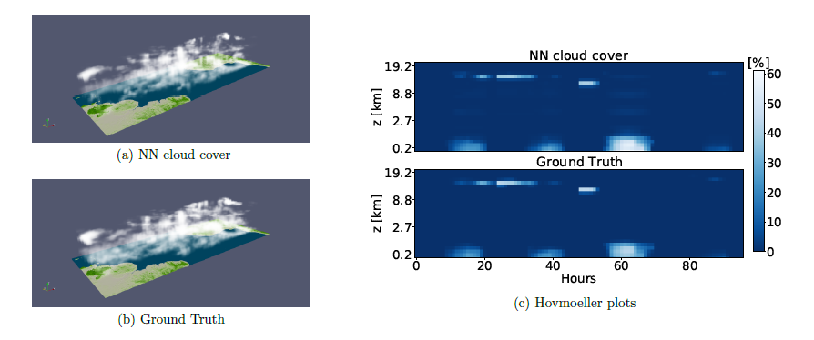
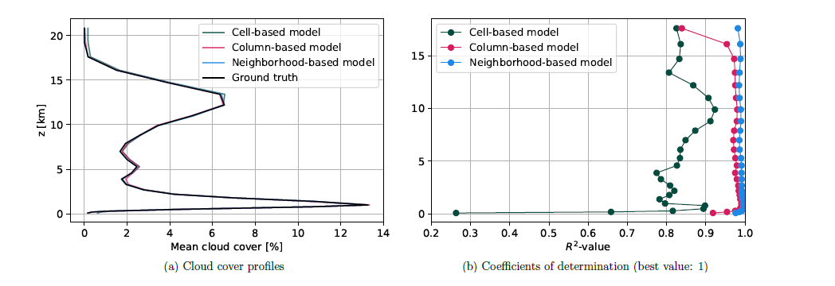
Ideas for studies/implementation
Deep Learning Based Cloud Cover Parameterization for ICON
cloud cover parameterization is based on the idea of training a supervised deep learning scheme to estimate the coarse-grained cloud cover using coarse-grained high-resolution thermodynamical variables as inputs

Slide 17
Ideas for studies/implementation
Machine Learning Emulation of Urban Land Surface Processes
urban neural network (UNN) trained on the mean predicted fluxes from 22 ULSMs at one site
When compared to a reference (Town Energy Balance; TEB in WRF), the UNN has greater accuracy relative to flux observations, less computational cost, and requires fewer input parameter
WRF-UNN is stable and more accurate than the reference WRF-TEB

Slide 18
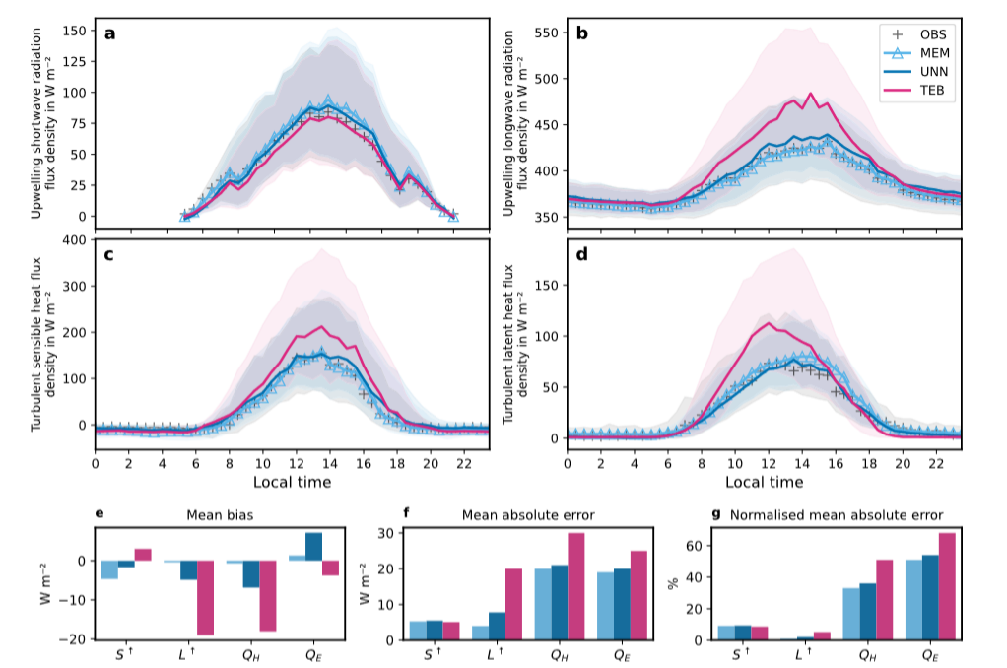
Ideas for studies/implementation
Offline (16-months. N = 8 865) simulated (MEM, UNN, TEB) and observed (OBS) 30-min flux densities (lines) with interquartile range (shading)

Slide 19
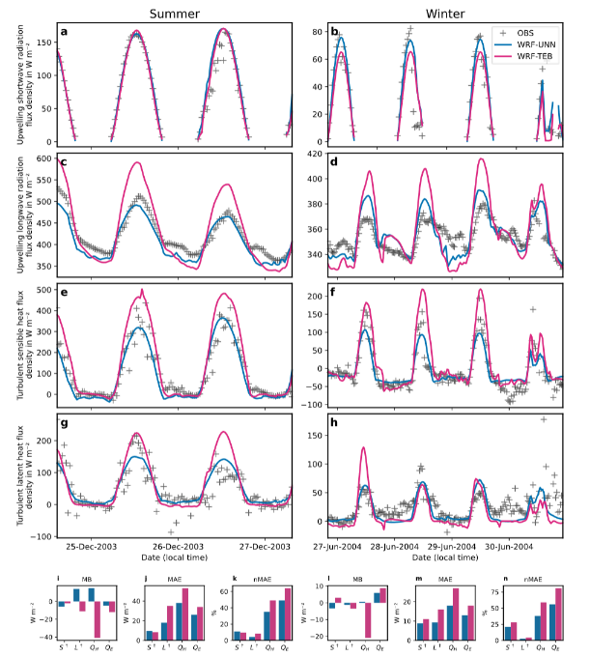
Ideas for studies/implementation
Online simulations

Slide 20
Thank you for your attention.

