Slide 1
ALARO Experiences at CHMI
Radmila Brožková on behalf of CHMI team

Slide 2
Operational changes since last ALARO WD
Changes in the model (not in DA):
  In the turbulence scheme TOUCANS:
    Diffusion of conservative variables with the total cloudiness as used in the microphysics;
    New numerical treatment when using two prognostic energies;
  Orographic roughness from GMTED2010 (and consequently switching off the GWD scheme), vegetation roughness from ECOCLIMAP II;
  Prognostic graupel in ALARO microphysics;
  Another choice of d4 variable in NH (ND4SYS=2).

Slide 3
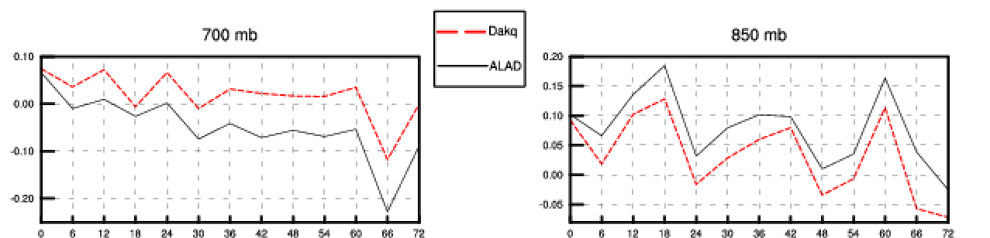
New diffusion of conservative variables
Improvement in temperature bias, and also in humidity bias (not shown)

Slide 4
New roughness and GWD switch off
Improvement of 10 m wind speed, bias in the night comes mainly from
switching off the GWD scheme. See the talk at the AHW 2020.

Slide 5
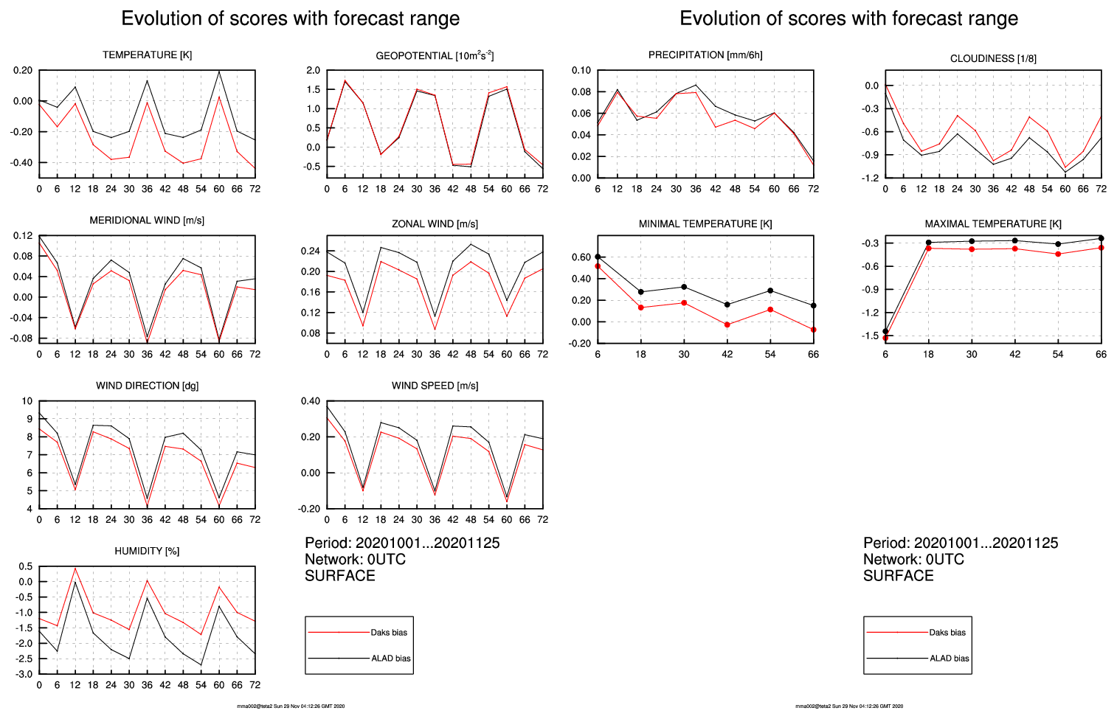
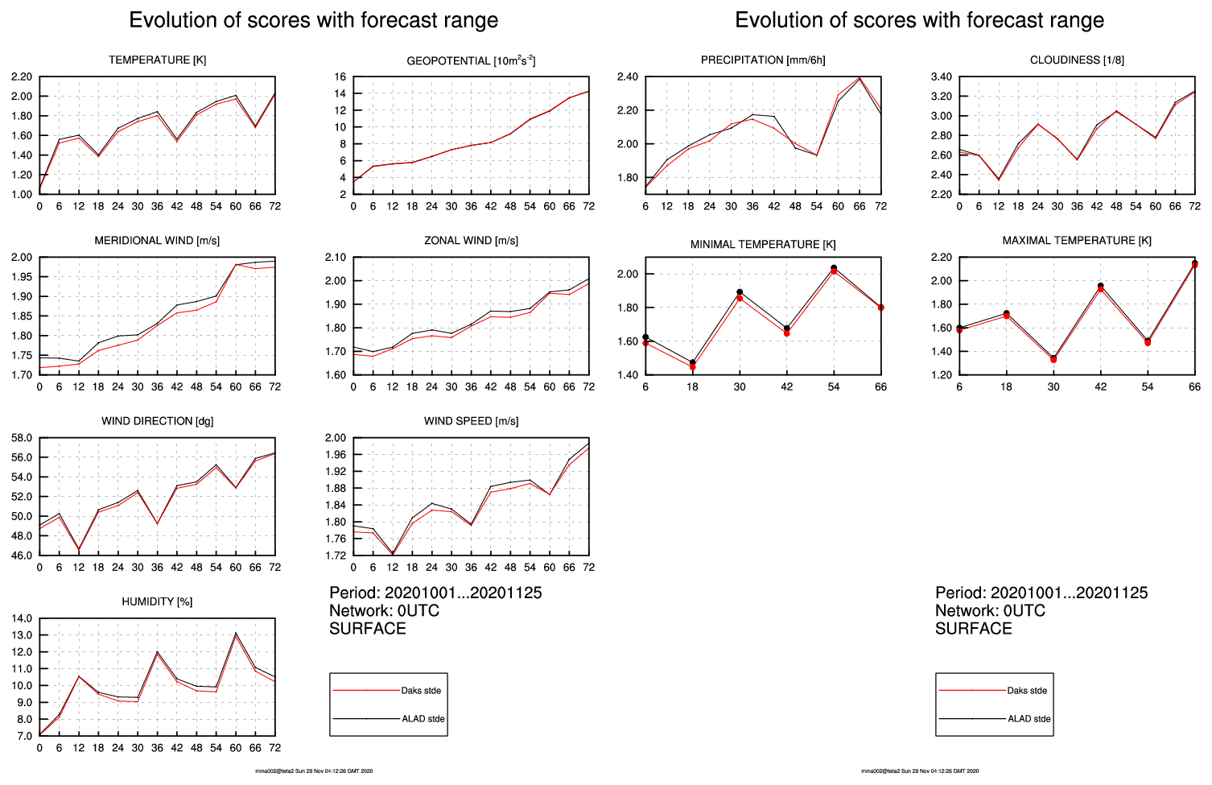
New numerical treatment of TKE & TTE
There is less mixing in stable conditions: colder temperature, weaker wind
STDEV error is lowered for all parameters. What about cold bias …

Slide 6
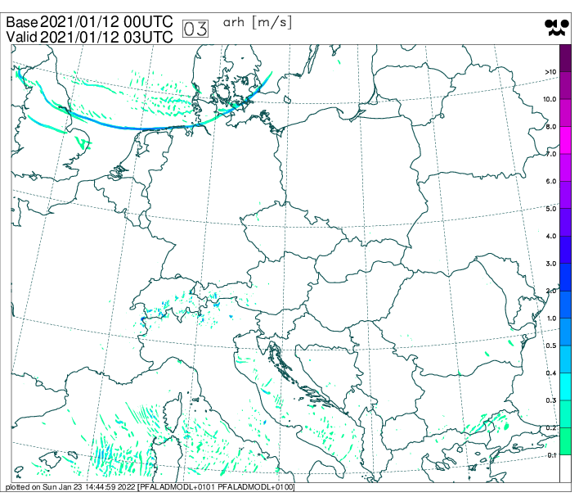
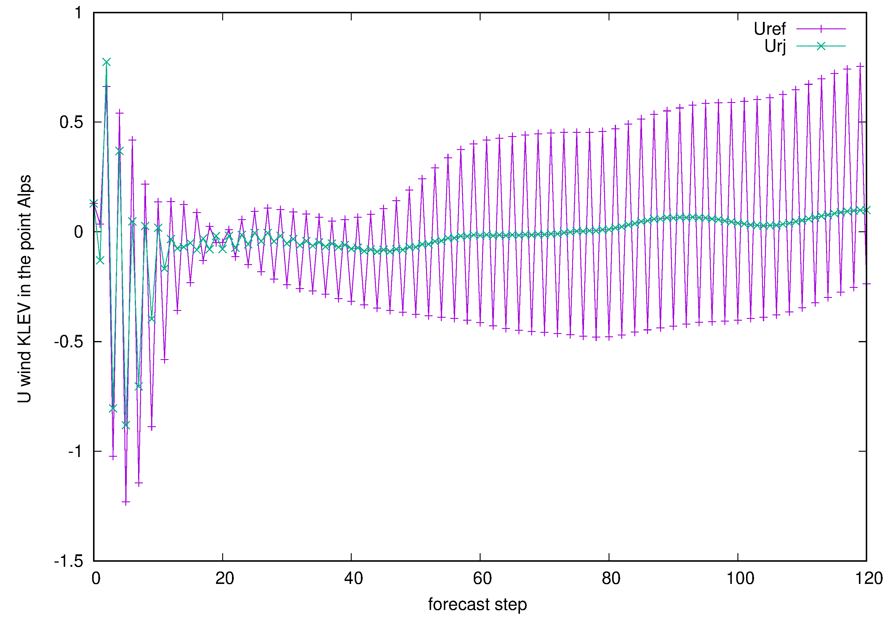
ND4SYS choice in dynamics
Setting ND4SYS=2 leads to a smoother solution in steep mountains close to
the ground. Left: U wind difference at KLEV over a time-step, see the Alps.
Right: Example of U evolution in one point near Mont Blanc.

Slide 7
Operational changes since last ALARO WD
New products:
  Maximum reflectivity Zmax, brightness temperatures of MSG SEVIRI channels IR (10.8 μm) and WV (6.2 μm);
  Precipitation type: most dangerous and most frequent;
  Universal Thermal Comfort Index UTCI;
  Lightning density.

Slide 8
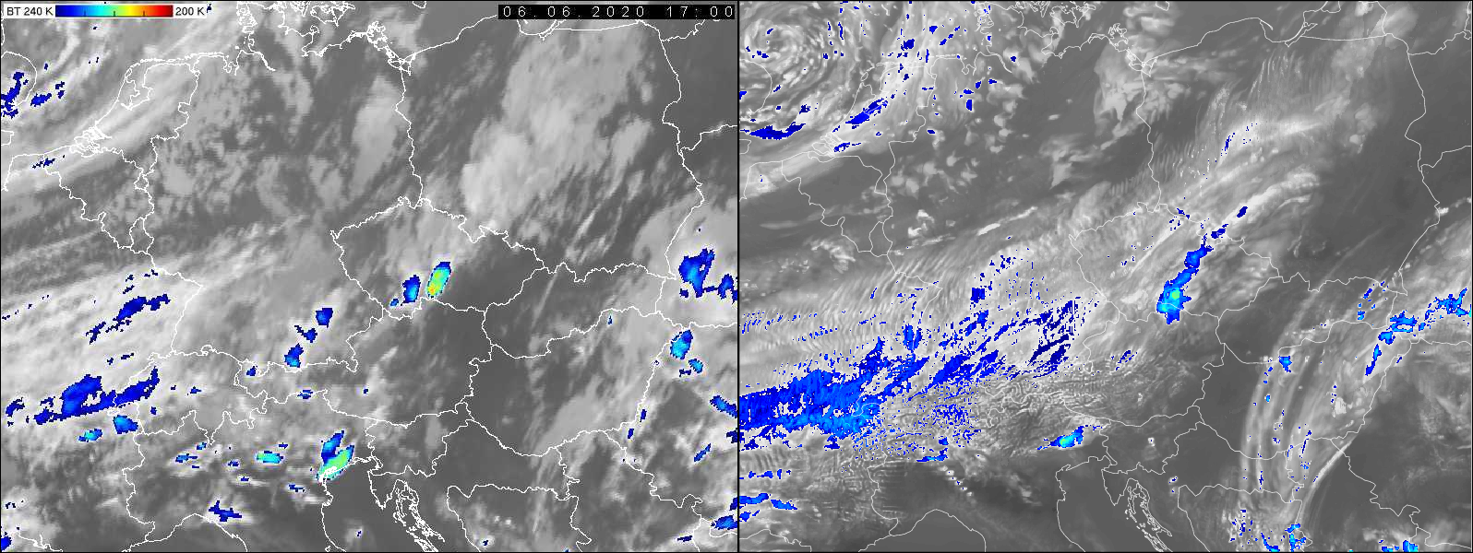
Verification of IR BT 10.8 μm (1/3)
Satellite image on left, model simulation on right. For not so deep clouds
the comparison looks good.

Slide 9
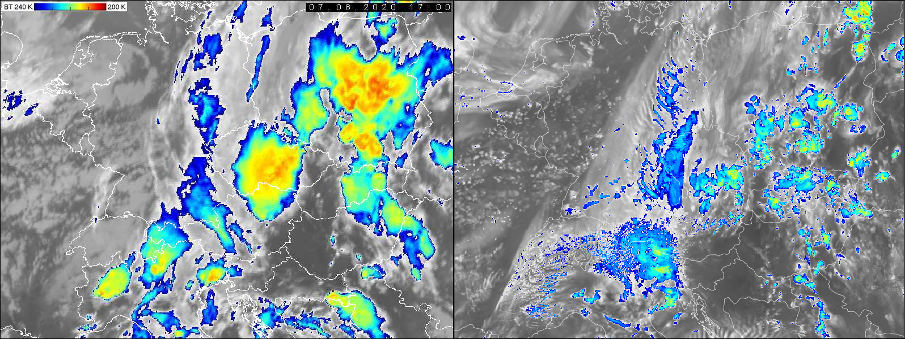
Verification of IR BT 10.8 μm (2/3)
In case of developed thunderstorms model IR BT are too warm.

Slide 10
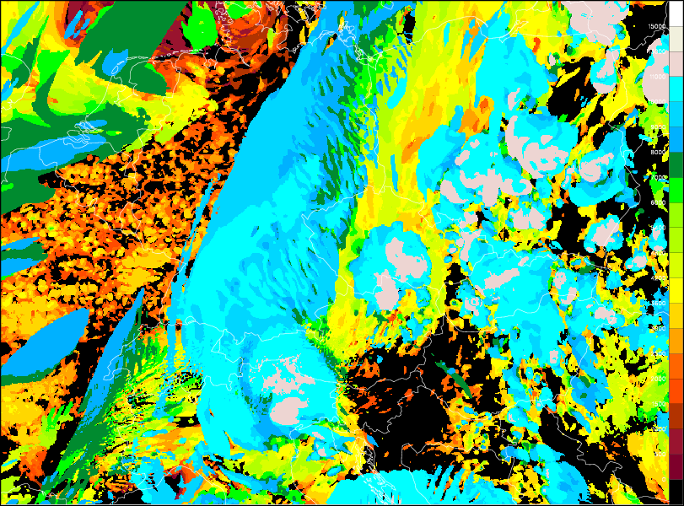
Verification of IR BT 10.8 μm (3/3)
Investigation has shown that cloud cover (of anvils) is present in the model (picture);
The cloud is thin;
The cloud ice content is small;
Not enough LW absorption

Slide 11
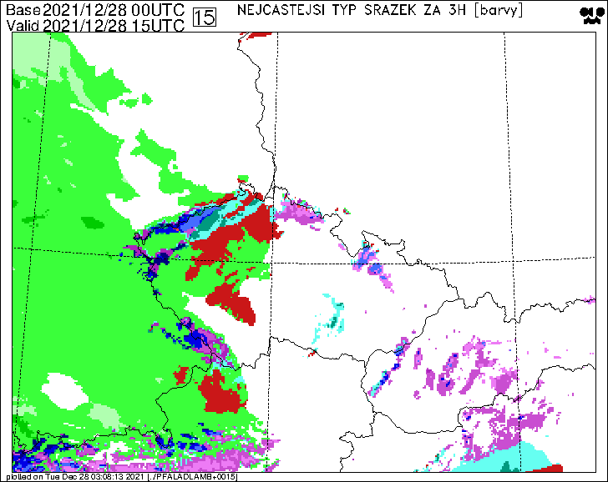
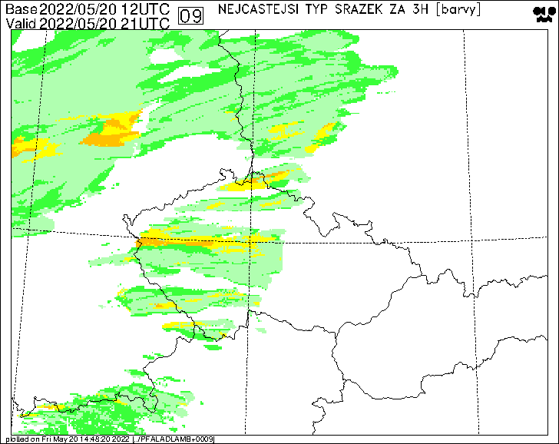
Precipitation type from Météo-France
Winter case with freezing rain (red color) and summer case with small and
bigger hail (yellow and orange color). Appreciated product.

Slide 12
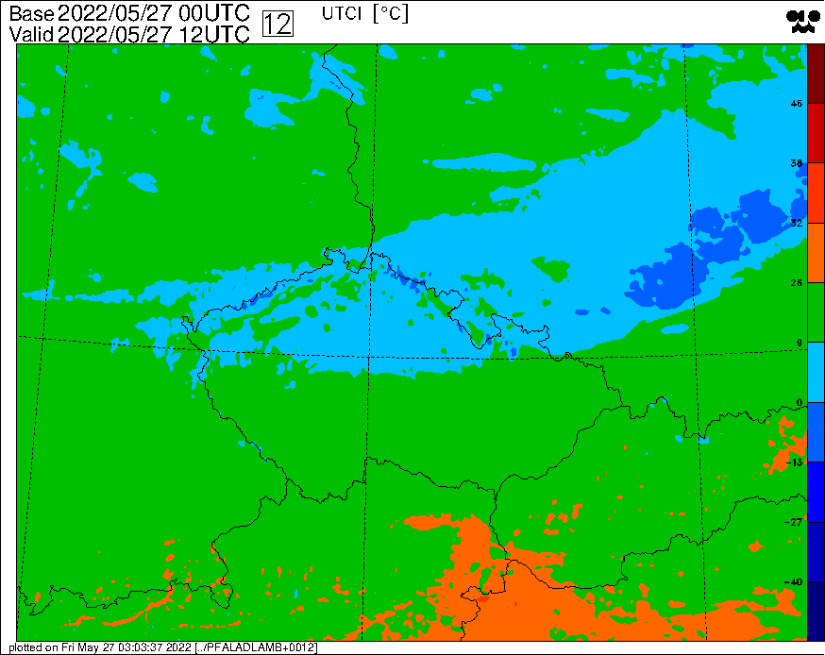
Universal Thermal Comfort Index
It is based on a “radiative balance” of human body, wind speed etc. Thus it
reacts to cloudiness as we see on the cold front case.

Slide 13
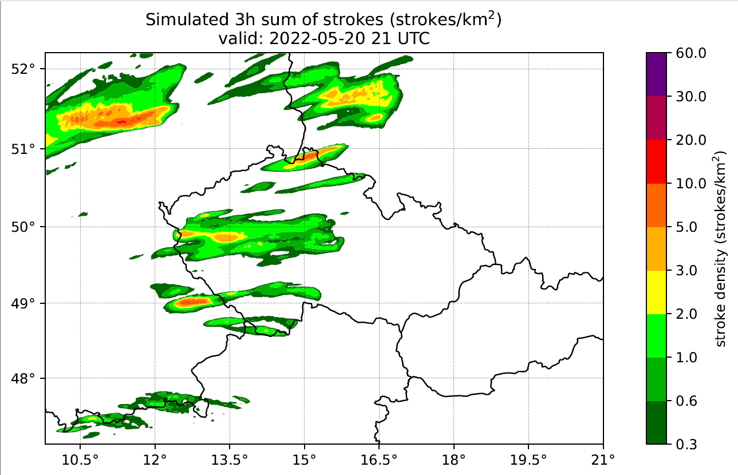
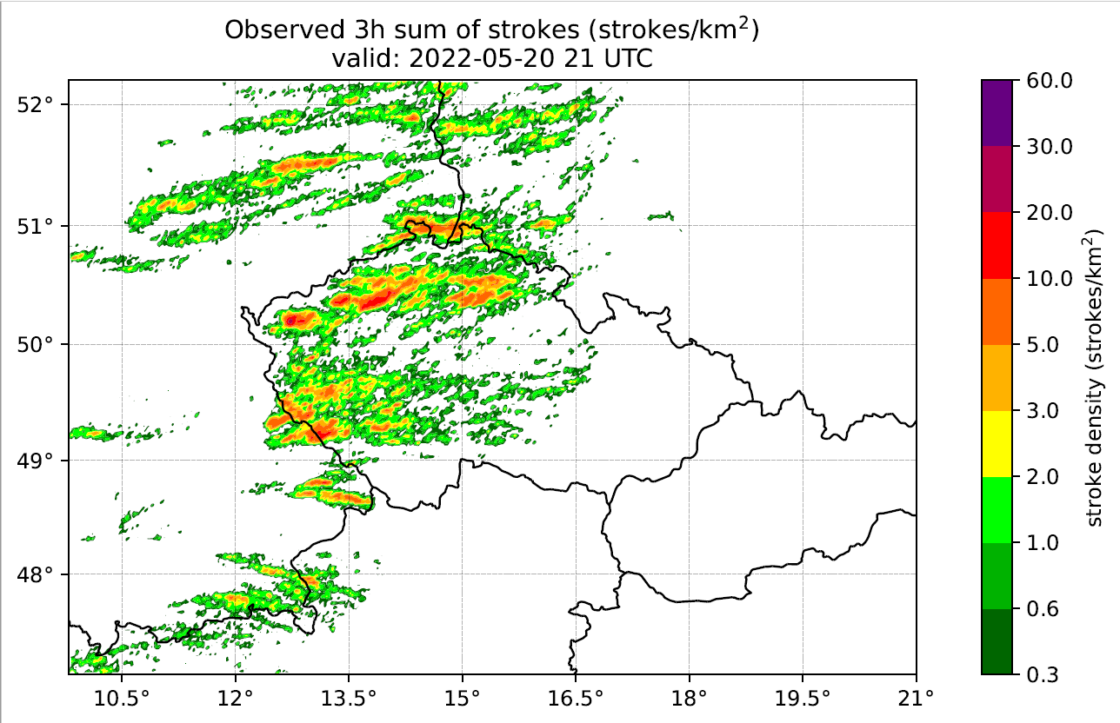
Lightning discharge density
Cold front case example: left – simulation, right – observations.
For more details see please presentation of David at the Accord WS.

Slide 14
Cold bias in T2m
In winter under stable conditions: minima are too cold, in presence of snow it is another story;
In summer in the afternoon: maxima are too cold;
Is there a common reason?
Answer:
  It is not really clear;
  one of big driving ingredient is soil moisture due to the latent heat effect – the bias can go to both directions (!);
  soil moisture depends on precipitation and surface analysis.

Slide 15
Thank you for your attention.

